Slide 1
Leave of Absence Overview
Presented by: Antonia Gonzalez
Harvard Longwood Campus Leave of Absence Specialist

Slide 2
Leaves of Absence
 | Family Medical and Leave Act (FMLA ) | Massachusetts Paid Family and Medical Leave (MA PFML) | Short-Term Disability (STD)
Who is eligible? | Employees who worked with their employer for 12 months, with at least 1,250 hours worked. | All active benefits-eligible nonunion staff - including full-time, part-time, permanent, on-call, per diem, temporary, and seasonal employees - who perform services within Massachusetts. | Admin and professional staff who work at least 17.5 hours per week and have completed their 90-day O&R period Postdoctoral fellows who work at least 17.5 hours per week Union staff
How long can I use benefits and for what? | 12 weeks for family leave and medical leave 26 weeks to care for family member in the military | 12 weeks for family leave (including bonding leave to bond with a child) 20 weeks for medical leave 26 weeks for military care leave | Up to 26 weeks (6 months)
Is the benefit paid? | No | Yes | Yes
Who is considered a covered family member? | Spouse, child, parent | Spouse, domestic partner, child, parent or parent of a spouse or domestic partner; guardian who legally acted as a parent, or grandchild, grandparent or sibling. | You cannot take STD to care for a family member.

Slide 3
Maternity and Bonding Leave for Post Docs (Birth Parents)
Weeks | STD Amount/MA PFML
Weeks 1 –8 (medical leave under STD) | 8 weeks of STD at 100%
Weeks 9 –12 (bonding leave under MA PFML) Weeks 13-20 (bonding leave under MA PFML) | First 4 weeks of bonding leave under MA PFML - pay is same as STD Program at 100%. Additional 8 weeks of bonding leave under MA PFML - pay at a flat 80% pay replacement up to a maximum of $1,250 per week.

Slide 4
Bonding Leave for Post Docs (Non-Birth Parents)
Weeks | MA PFML Amount
Week 1 | Waiting period (unpaid or PTO)
Weeks 2-5 | 4 weeks at 100%
Weeks 6-12 | Flat 80% pay replacement up to a maximum of $1,250 per week

Slide 5
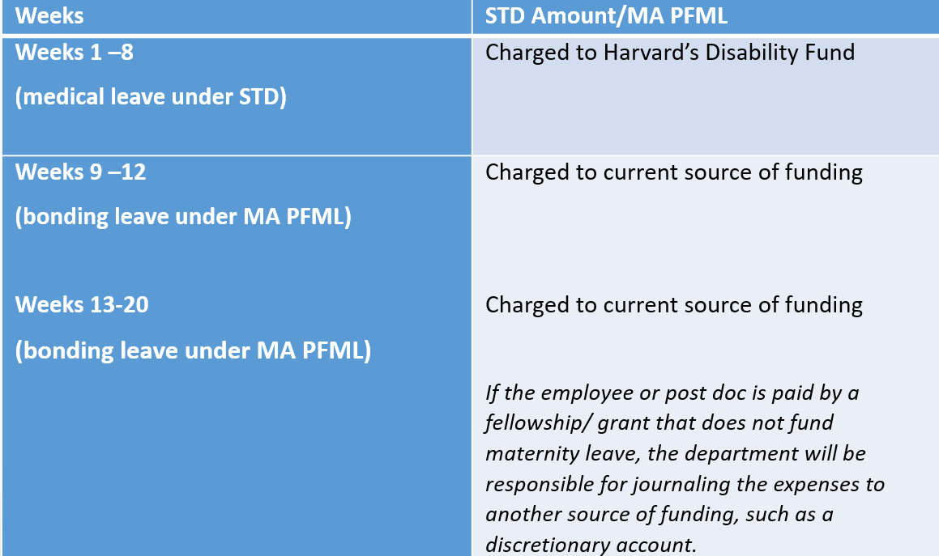
Funding for Maternity and Bonding Leave (Birth Parents)

Slide 6
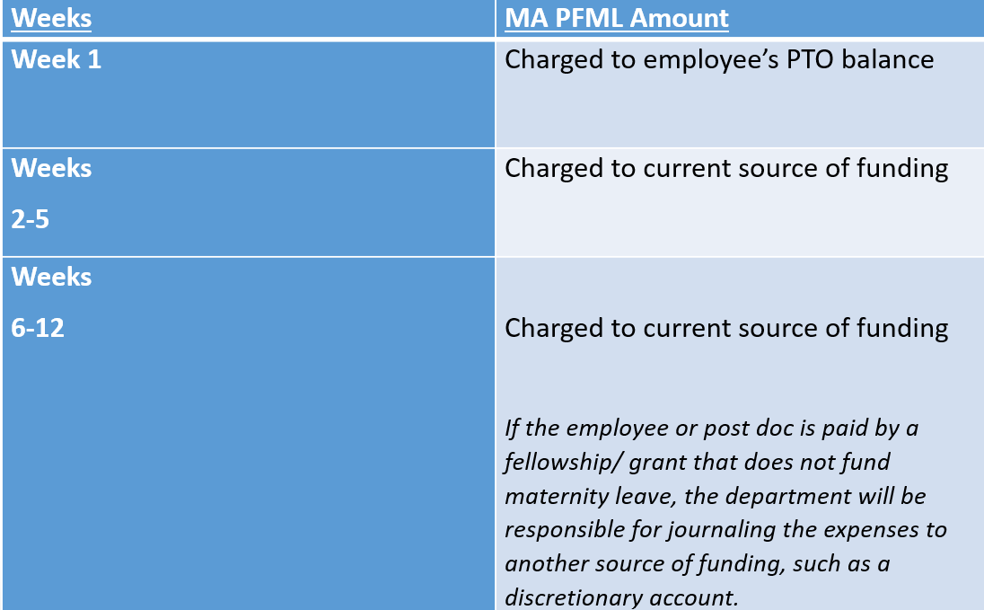
Funding for Bonding Leave (Non-birth Parents)

Slide 7
Frequently Asked Questions
How do I file a leave?
Contact Lincoln Financial Group to request a leave, by:
Calling the Harvard-dedicated number at 1-844-600-3978. Intake is available 8AM – 10 PM EST, Monday – Friday.
Going to My Lincoln Portal® (www.MyLincolnPortal.com) and click on “Register for an account” under the “Log In” button. The Employer Code is Harvard.
Am I expected to stay in contact while on leave? Am I responsible for anything else?
Timely responses to all requests for information from Lincoln Financial Group
Keeping your Leave of Absence Specialist informed of changes to your leave or return to work plans

