Slide 1
Outbreak scenario:
mink pox in Kabuka
12th Annual Workshop to Increase Diversity in Mathematical Modeling and Public Health
Tuesday, March 5, 2024
Notes:
Introduce ourselves

Slide 2
Activity
Kabuka, a quiet suburban town, has been rocked by a sudden outbreak of mink pox.
There is full blown panic in the town, everyone is freaking out, businesses are being disrupted and people are afraid to send their children to school.
You have been called in as a team of public health experts to contain the outbreak
You will discuss questions in groups and report back to the public health agency
Source: moneyweek.com
Handout with the information in this presentation: https://tinyurl.com/outbreak-scenario
Notes:
QY

Slide 3
Logistics
In your teams you will discuss 4 questions and report back to the local public health agency
You have 5 minutes to discuss each question amongst your team.
Appoint a reporter to give your feedback
Each time you report, nominate a new reporter
For each question, we will have 3 groups share.
Each group will each have 2 minutes to share
Then we will have a 5 minute whole group discussion.
Notes:
QY

Slide 4
Discussion guidelines
Listen respectfully, without interrupting.
Listen actively and with an ear to understanding others’ views. (Don’t just think about what you are going to say while someone else is talking.)
Criticize ideas, not individuals. We all can learn something from each other, even if your views don’t necessarily align.
Avoid blame, speculation, and inflammatory language.
Allow everyone the chance to speak.
Avoid assumptions about any member of the class or generalizations about social groups. Do not ask individuals to speak for their (perceived) social group.
We are accountable for our words and their impact.
Taken from: https://tll.mit.edu/teaching-resources/inclusive-classroom/discussion-guidelines/
Notes:
QY

Slide 5
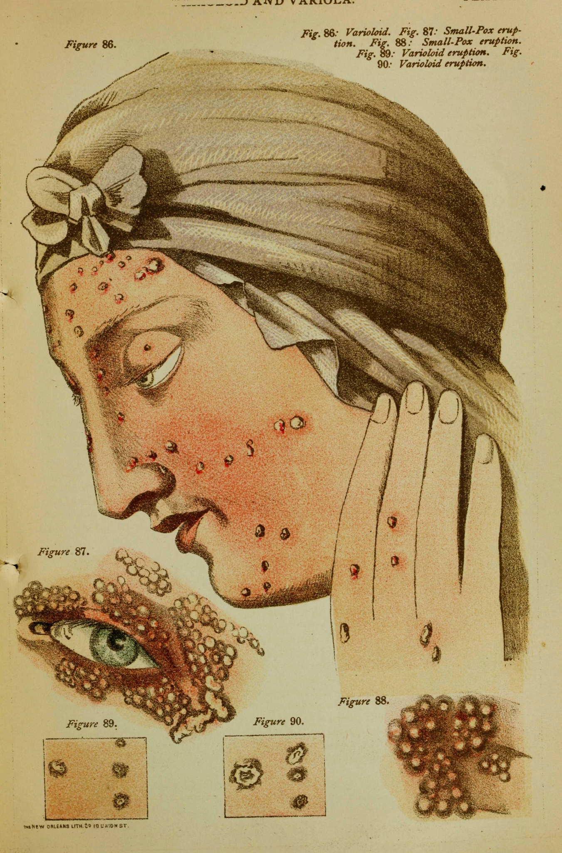
Mink pox in Kabuka
Kabuka’s population:
Primarily young and healthy
Mink pox:
Typically not lethal among younger people
Causes serious illness in older people
Causes small pimples that are filled with contagious pus that cause the disease to spread from person to person
Pimples leave a scar when dried, which locals call “spot-face”
Kabukans are extremely conscious about their image, and the thought of having scars on their faces is really scaring people.
Source: Wikimedia
Notes:
SO

Slide 6
Question 1: Surveillance
The local agency wants to set up a surveillance system to start to understand who is infecting whom and some of the factors that are placing individuals at risk of mink pox.
They come to you for advice on what data they should collect to aid their surveillance.
What additional information would you like to know to set up an outbreak surveillance system?
Notes:
SO

Slide 7
Question 1 responses
Data to collect
Number of cases over time, by demographic group
Close contacts of cases
Serology to determine immunity in the population
Pathogen genomic sequencing data
Wastewater data of the concentration of the pathogen genetic material over time
Additional information that we would like to know
What kind of pathogen is it (viral/bacterial/fungal/parasite)?
Do we have a diagnostic test?
Have there been similar outbreaks in the past?
What resources for infection control / lab capacity do they have?
Is there an animal reservoir?
For more information, see: https://archive.cdc.gov/#/details?archive_url=https://archive.cdc.gov/www_cdc_gov/csels/dsepd/ss1978/lesson6/section2.html
Notes:
SO

Slide 8
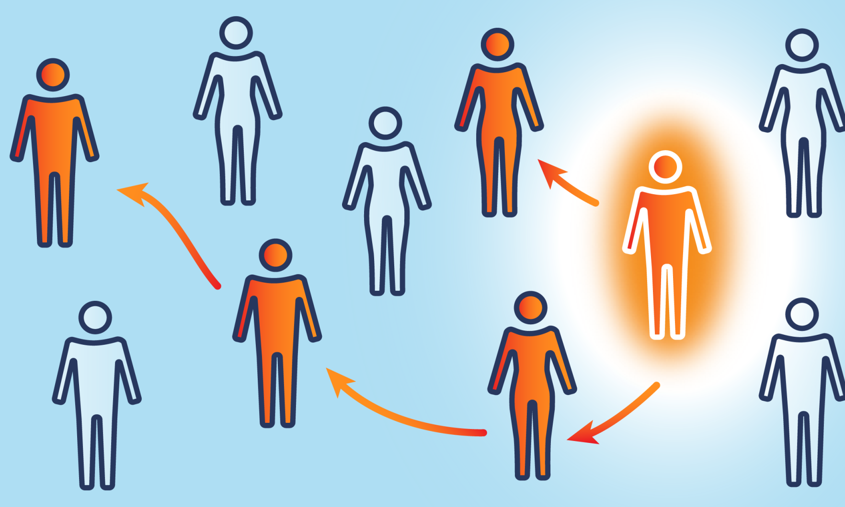
Briefing by local public health officials
Outbreak started ~4 weeks ago
The number of new causes is increasing every week
On average, patients carry the infectious pimples for approximately 10 days
On average, every infected individual is transmitting to two new individuals (R₀ = 2)
Once individuals recover from mink pox, they cannot be reinfected
Source: publichealth.jhu.edu
Notes:
QY

Slide 9
Question 2: Mathematical modeling
The local officials would like to know what to expect if this outbreak continues without any intervention. You and your colleagues decide to employ a standard SIR model to demonstrate this. However, you need to define two important parameters beta (β) and gamma (Ɣ). Remember: R₀= β/Ɣ.
Justify to your colleagues why an SIR model is appropriate in this context!
Calculate the values for beta and gamma, based on the summary provided by the local public health officials
Bonus question: How would you incorporate differences between young and old people into the SIR model? Try to draw a diagram of a compartmental model.
N
Notes:
β is the average number of contacts per person per time, multiplied by the probability of disease transmission in a contact between a susceptible and an infectious subject
QY

Slide 10
Question 2 responses
An SIR model is appropriate because individuals cannot be reinfected, there is no known pre-infectious period (no known exposed group)
Ɣ = recovery rate = 1/(10 days) = 0.1/day β = (average number of contacts/person/time)*(probability of disease transmission in a contact between a susceptible and an infectious subject) = R₀*Ɣ = 2*0.1 = 0.2/person/day
C.
β_{yy}I_{y}S_{y}/N_{y}
Ɣ_{y}I_{y}
Susceptible, young
Infectious, young
Recovered, young
β_{yo}I_{o}S_{y}/N_{y}
β_{oy}I_{y}S_{o}/N_{o}
Ɣ_{o}I_{o}
Susceptible, old
Infectious, old
Recovered, old
β_{oo}I_{o}S_{o}/N_{o}
Notes:
QY

Slide 11
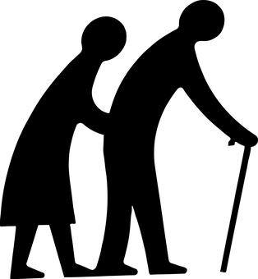
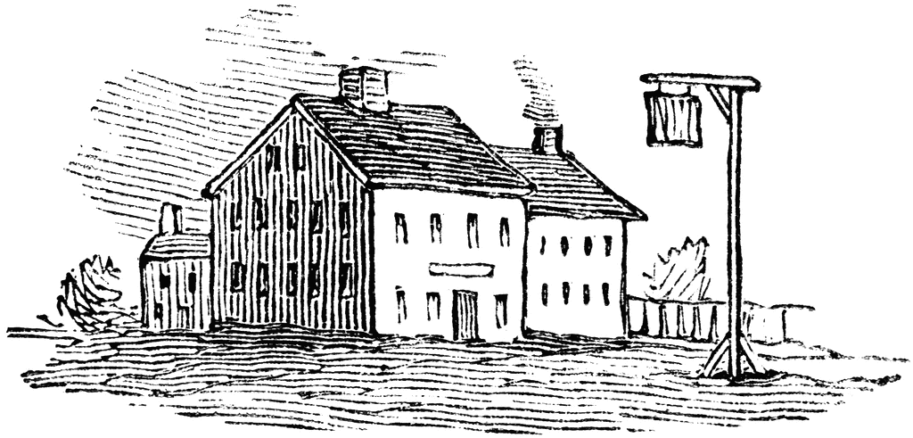
Neighboring town of Nirvana
Population is older
Nirvana is well known for its peanut butter beer, which Kabukans love. Every weekend, sores of Kabukans flock to the Tavern Pub in Nirvana to enjoy peanut butter beer and have a good time.
Nirvana locals have heard rumblings about “spot-face” and the once peaceful town has been gripped by fear.
Source: pixabay.com
Source: hopculture.com
Source: etc.usf.edu
Notes:
SO

Slide 12
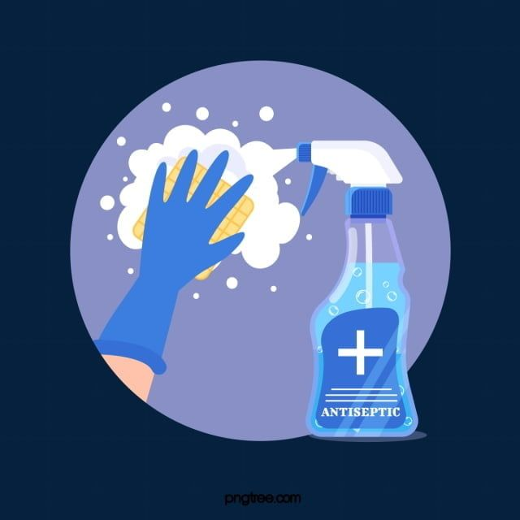
Question 3: Non-pharmaceutical interventions
There is growing anxiety that the outbreak will spread to Nirvana and cause an even bigger public health emergency among the older population.
Your colleagues seek your advice on non-pharmaceutical interventions that can be implemented to prevent the spread of the of the disease to Nirvana and beyond.
What intervention(s) do you propose?
What are the advantages and disadvantages of your chosen strategy?
Notes:
SO

Slide 13
Question 3 responses
Personal - handwashing, self-isolation, social distancing
Advantage: easy to implement
Disadvantage: relies on individuals remembering/deciding to do interventions
Community - lockdowns / closures (of bars or schools), intervention at place in the bars like temperature checks, check for lesions etc.
Advantage: easier to enforce
Disadvantage: need buy-in from the bars/schools
Environmental - disinfection of all surfaces
Advantage: Can be implemented without individual effort
Disadvantage: may not be as effective on its own (i.e. if there is transmission upon contact with an infected individual)
For more information, see: https://www.cdc.gov/nonpharmaceutical-interventions/index.html
Notes:
SO

Slide 14
Question 4: Social media
Quietly, local experts are worried that young people in a neighboring community are infected but not reporting. One of the local folks has a clever idea, instead of creating panic by screening people in neighboring towns, why don’t we track recent activity on social media to see if there are searches related to mink pox? Again, they turn to you for advice.
Do you think that this approach is a good idea? Why or why not?
What websites should they consider in their search and why?
What are the ethical considerations of using this approach?
Bonus: aside from social media, what are other ways to get information about how people are moving between the two communities?
Source: istock.com
Notes:
QY

Slide 15
Question 4 responses
Yes could be a good idea to leverage different data sources
Can give an idea of interest and level of panic in the community
Can give an idea of where the outbreak is more severe and where to target resources
Could help with contact tracing and estimating disease trends
Note that there could be biases, issues with misinformation, who has access to the websites
Google search data, google mobility reports, Facebook and Twitter/X, TikTok, other search engines (Amazon)
Privacy concerns
Survey data (self-reported)
https://cos.northeastern.edu/people/mauricio-santillana/
https://cos.northeastern.edu/news/can-digital-traces-from-internet-searches-and-social-media-predict-outbreaks-of-covid-19/
https://www-science-org.ezp-prod1.hul.harvard.edu/doi/10.1126/sciadv.abd6989
Notes:
QY

Slide 16
Acknowledgements
Madikay Senghore
Sylvia Ofori
Madeline Kline
QinQin Yu

