Slide 1
Back-of-the-envelope calculations
Christopher Boyer, Emmanuelle Dankwa, Katherine Jia
March 5, 2024

Slide 2
Learning objectives
Define what a back-of-the-envelope calculation is
Consider when and why these calculations are appropriate
Apply this understanding to a case study – backcalculating SARS-CoV-2 infections from reported deaths

Slide 3
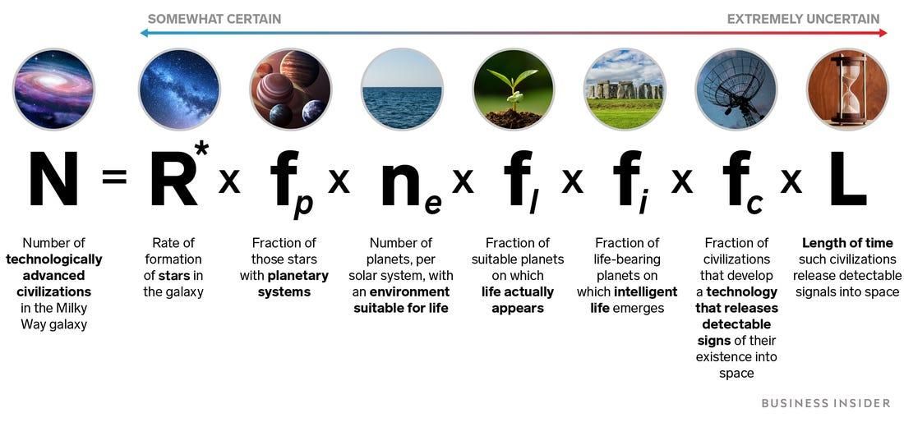
What are they?
Idea is to get an order of magnitude or reasonable estimate without the need for a formal analysis – “Fermi problems”
Drake equation: how many intelligent extraterrestrial civilizations are there in the galaxy?
Notes:
“Fermi problems”—physicist Enrico Fermi known for good approximate calculations without data
Range of estimates in the order of 100-billion fold difference, but still useful to formalize thinking

Slide 4
Why and where are they useful?
Quick answer – decision makers often favor speed over precision
Early on we know very little, but still must act
Based on domain expertise or preliminary data
Notes:
<< Ask for suggestions >>

Slide 5
Why and where are they useful?
Quick answer – decision makers often favor speed over precision
Early on we know very little, but still must act
Based on domain expertise or preliminary data
Consider COVID-19 - what questions might have needed fast answers for hospitals or governments?
Notes:
Philosophical – when does it become a full model?
All models are wrong anyway…

Slide 6
Why and where are they useful?
Quick answer – decision makers often favor speed over precision
Early on we know very little, but still must act
Based on domain expertise or preliminary data
Consider COVID-19 - what questions might have needed fast answers for hospitals or governments?
“How many test kits should we order?”
“How many hospital beds do we need?”
“How long until our ICU is overwhelmed?”
Notes:
Philosophical – when does it become a full model?
All models are wrong anyway…

Slide 7
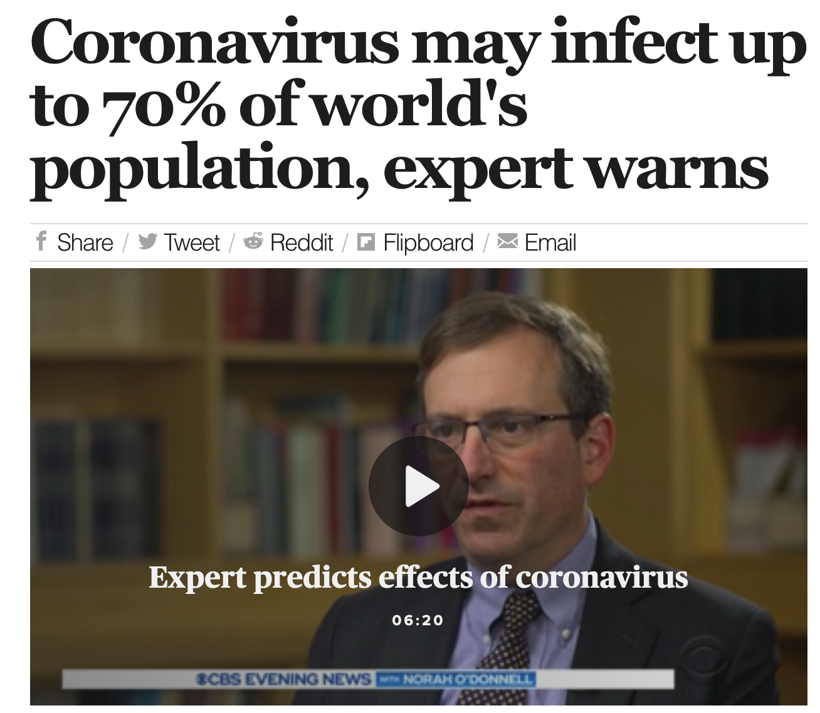
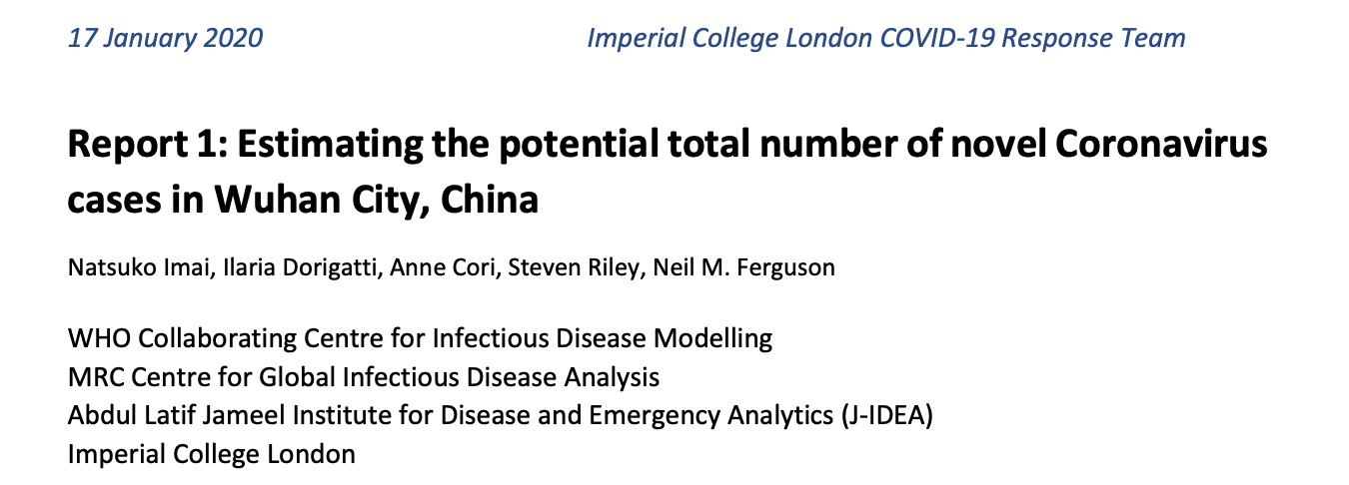
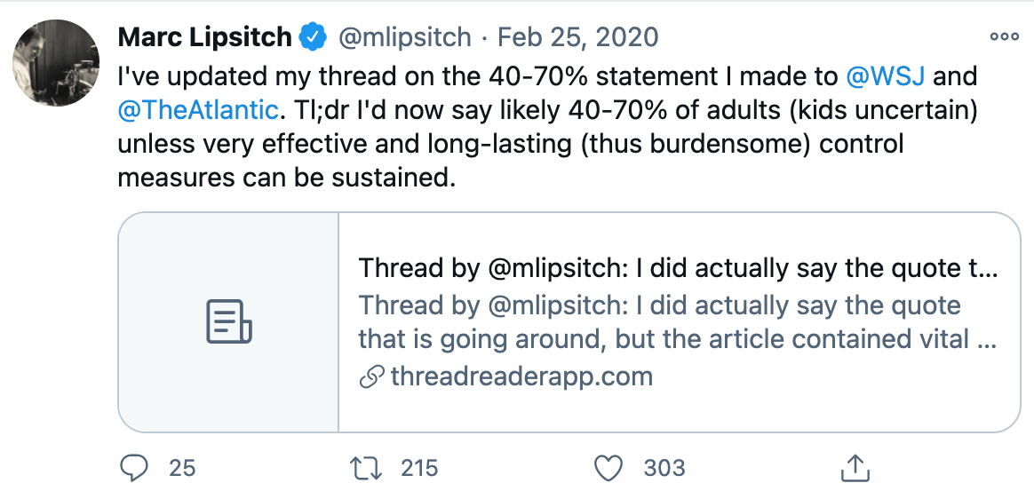
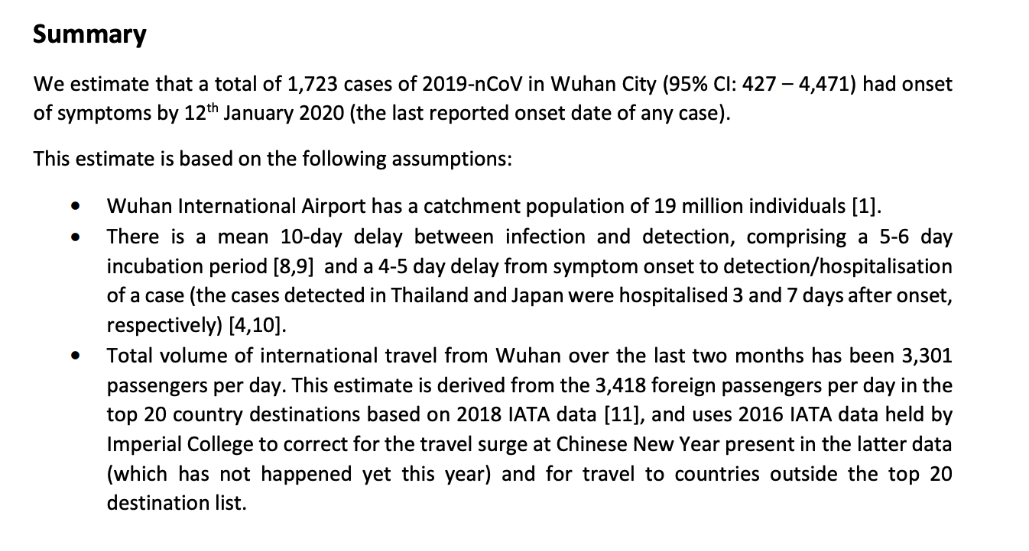
COVID-19 examples

Slide 8
Approach
Question: what are you trying to answer?
Reason: why do we want to know it?
Data: what do we know that we can use?
Precision: how precise to be useful?
Assumptions: why might our existing data be flawed?

Slide 9
R Exercise – SARS-CoV-2 infections in Brazil
Question: what is the true incidence of infection in Brazil?
Reason:
Data:
Precision:
Assumptions:

Slide 10
R Exercise – SARS-CoV-2 infections in Brazil
Question: what is the true incidence of infection in Brazil?
Reason: testing capacity/criteria has changed over time, so case counts are not reliable on their own
Data:
Precision:
Assumptions:

Slide 11
R Exercise – SARS-CoV-2 infections in Brazil
Question: what is the true incidence of infection in Brazil?
Reason: testing capacity/criteria has changed over time, so case counts are not reliable on their own
Data: we have number of deaths, which are more reliable because the infection-fatality ratio (IFR) should not change (much).
Precision:
Assumptions:

Slide 12
R Exercise – SARS-CoV-2 infections in Brazil
Question: what is the true incidence of infection in Brazil?
Reason: testing capacity/criteria has changed over time, so case counts are not reliable on their own
Data: we have number of deaths, which are more reliable because the IFR should not change (much).
Precision: aim for +/- 10%
Assumptions:

Slide 13
R Exercise – SARS-CoV-2 infections in Brazil
Question: what is the true incidence of infection in Brazil?
Reason: testing capacity/criteria has changed over time, so case counts are not reliable on their own
Data: we have number of deaths, which are more reliable because the IFR should not change (much).
Precision: aim for +/- 10%
Assumptions: the IFR from other studies, info about reporting deaths

Slide 14
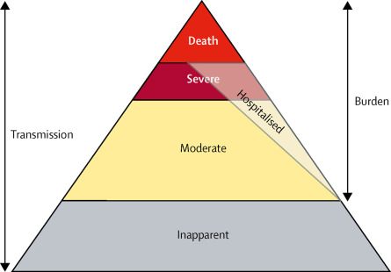
R Exercise – SARS-CoV-2 infections in Brazil
CBD 2017 Influenza Collaborators, Lancet Respiratory Medicine, 2018 (7);1:69-89

Slide 15
R Exercise – SARS-CoV-2 infections in Brazil
20 minutes group discussion

Slide 16
Summary
Approximate answers – be ready to discard!
Think about the objective – is the approach suitable?
Question assumptions – how could this be wrong?
Do not be scared of uncertainty
Notes:
Imperial example is an estimate. Vaccine rollout time is a forecast. Oxford model shows scenarios.

Slide 17
Credit
Slides and originally developed by James A Hay and Alice Arcury-Quandt

Slide 18
Unused

Slide 19
Exercise debrief
What answer do we get?
Other interesting observations?
Can we verify?
Where might we be wrong?
Death reporting may also change
IFR may change based on shifting care quality/hospital capacity
Useful references: https://tinyurl.com/4df9eeb8; https://tinyurl.com/yr8949dv; https://tinyurl.com/3exwpv9s

Slide 20
Dangers of back-of-the-envelope
Why do we need to be careful?
Scenarios: under these assumptions, what happens/happened?
Forecasts: what do we think will happen?
Estimates: what do we think this parameter/statistic is?
Notes:
https://twitter.com/AdamJKucharski/status/1242569554171179008
https://twitter.com/jameshay218/status/1242935875719303169
Say we don’t know what an estimate/parameter for certain – how can we explore eventualities depending on different assumptions?
An assumption for one setting might not hold for another

Slide 21
COVID-19 examples
Forecast
Scenario
Estimate

Slide 22
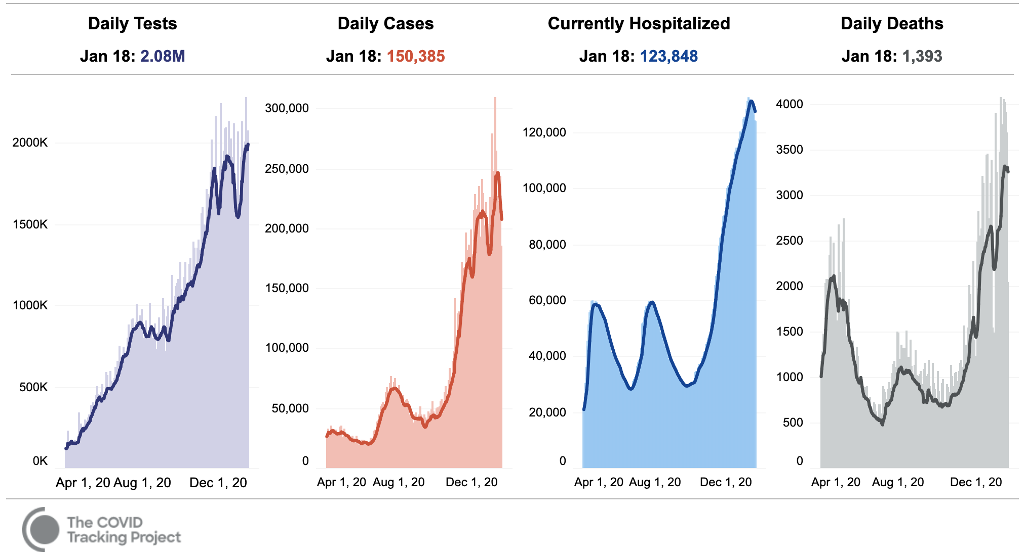
Summary on COVID-19 testing
Case study on the limits of data
Only as many cases as we test
Sensitivity (how many of the real infections do we detect)
Specificity (how many detected infections aren’t real)
Changes over time and by location
“Test positivity”

Slide 23
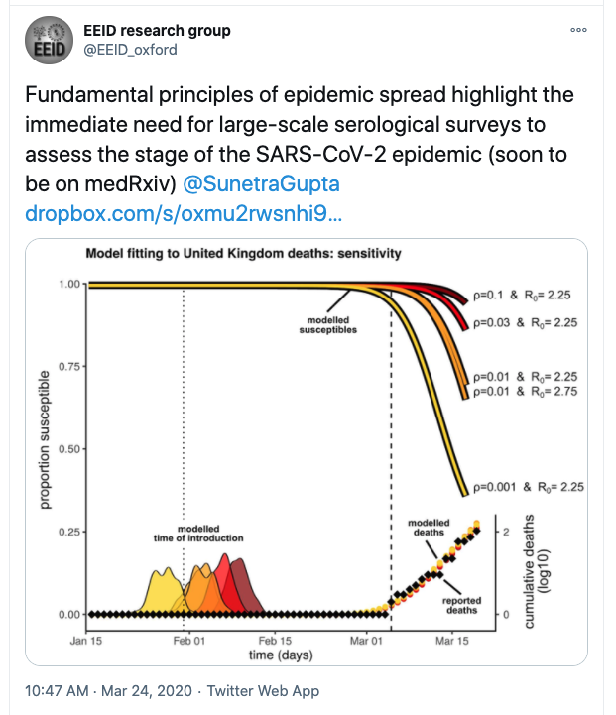
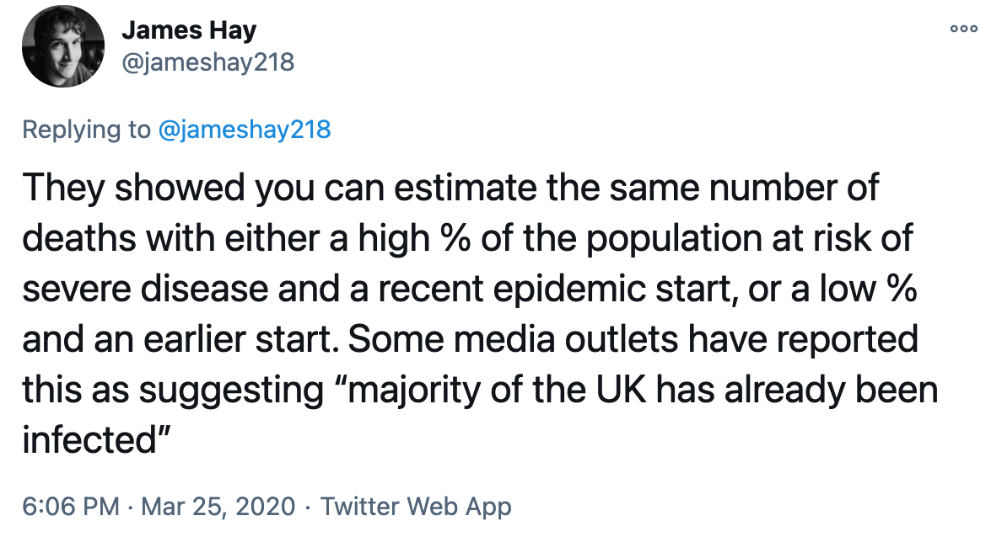
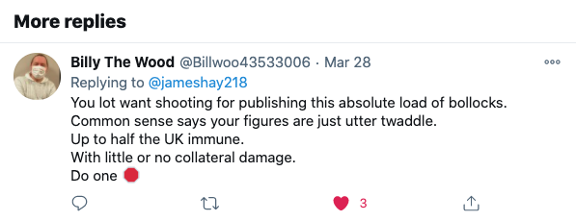
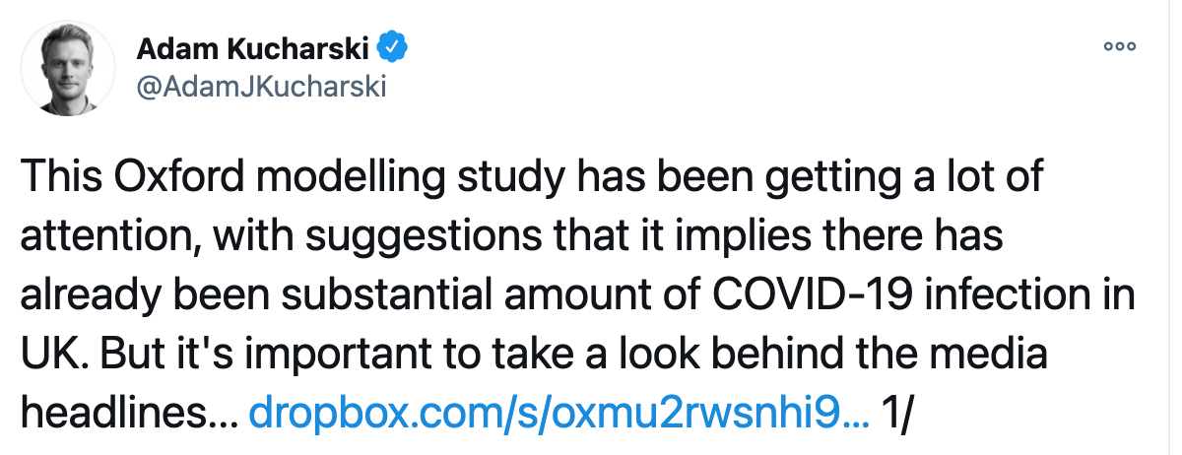
Dangers of back-of-the-envelope
How far should we take them?
Notes:
https://twitter.com/AdamJKucharski/status/1242569554171179008
https://twitter.com/jameshay218/status/1242935875719303169

Slide 25
Approach
Question:
Reason:
Data:
Precision:
Assumptions:

Slide 26
Approach
Question: what was the true prevalence in Wuhan?
Reason:
Data:
Precision:
Assumptions:

Slide 27
Approach
Question: what was the true prevalence in Wuhan?
Reason: this will tell us things like death rate and likely spread
Data:
Precision:
Assumptions:

Slide 28
Approach
Question: what was the true prevalence in Wuhan?
Reason: this will tell us things like death rate and likely spread
Data: confirmed cases on flights, flight data
Precision:
Assumptions:

Slide 29
Approach
Question: what was the true prevalence in Wuhan?
Reason: this will tell us things like death rate and likely spread
Data: confirmed cases on flights, flight data
Precision: one order of magnitude (how many zeros)
Assumptions:

Slide 30
Approach
Question: what was the true prevalence in Wuhan?
Reason: this will tell us things like death rate and likely spread
Data: confirmed cases on flights, flight data
Precision: one order of magnitude (how many zeros)
Assumptions: many regarding timings and population numbers

Slide 31
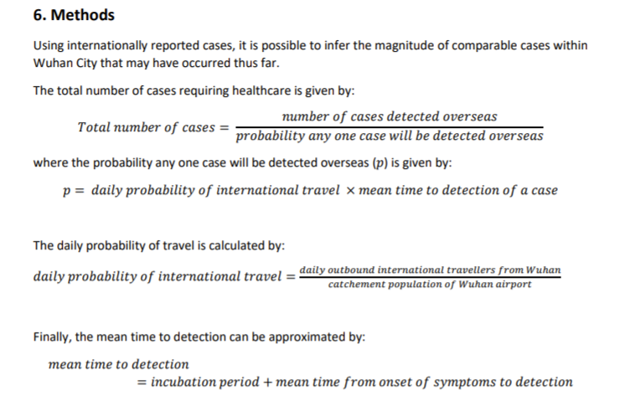
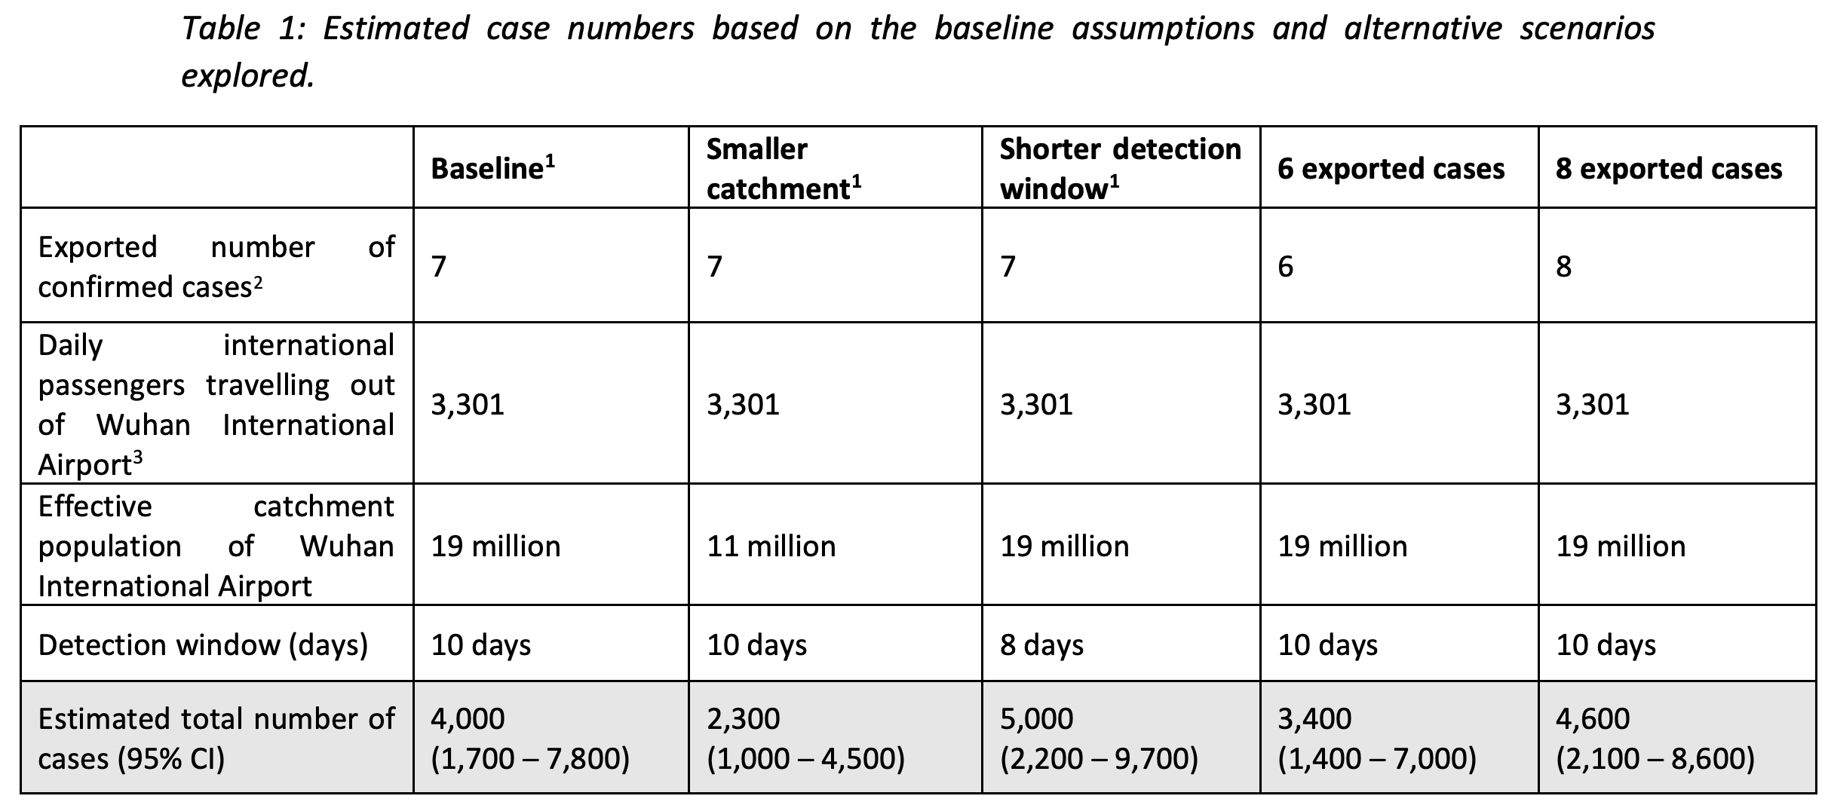

Slide 32
