Slide 1
Forecasting Using Digital Epidemiology
Nicole Kogan
12th Annual Workshop to Increase Diversity in Mathematical Modeling and Public Health
03.05.24

Slide 2
My Background
Professional
Personal

Slide 3
Motivation: Social Media
4 petabytes (4,000 photos per day for life) of data generated daily
500 M tweets daily
8.5 billion searches daily

Slide 4
Other “Alternative” Data Sources
News
Smartphones
Weather
Sensors
Poop
Shopping

Slide 5
Digital Epidemiology
The idea in digital epidemiology is to take our “cloud” of analytic information and translate it into something potentially epidemiologically useful for public health decision makers
There are 2 ways we can do this:
(1) Take the digital data we observe and translate it into something akin to an epidemic curve (can digital disease detection pick up signals of outbreaks earlier than traditional disease detection and can these signals be used for forecasting?)
(2) Identify spatially where the digital data originated to better localize where outbreaks may be occurring (can disease incidence be mapped earlier?)

Slide 6
Bottlenecks in Information Flow: Traditional Disease Reporting
Public
HCW
Labs
Health depts.
World bodies (WHO)

Slide 7
Bottlenecks in Information Flow: Parallelizing Things
Digital Disease Detection
Public
Labs
World bodies (WHO)
HCW
Health depts.

Slide 8
Practical Example: Google Flu Trends
Launched by Google in 2008, shuttered by Google in 2015
Supposed to provide information on how many people are likely to be experiencing flu-like symptoms in the US over time
Based on observations of seasonal Google Search activity (e.g., “what temperature is a fever?”)
When lots of people are concurrently searching for things – aka at an “ensemble” level – this can help establish a relationship between human behavior and flu incidence, from which a time series can be created

Slide 9
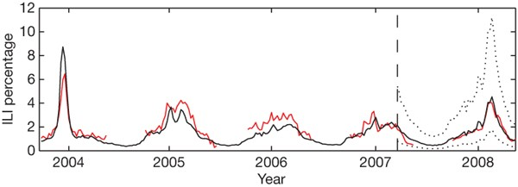
Google Flu Trends: Background
A comparison of model estimates for the mid-Atlantic region of New York, New Jersey, and Pennsylvania (black) against CDC-reported ILI percentages (red), including points over which the model was fit and validated. A correlation of 0.85 was obtained over 128 points from this region to which the model was fit. Dotted lines indicate 95% prediction intervals.
Notes:
ILI: influenza-like illness

Slide 10
Next flu season: 2009

Slide 11
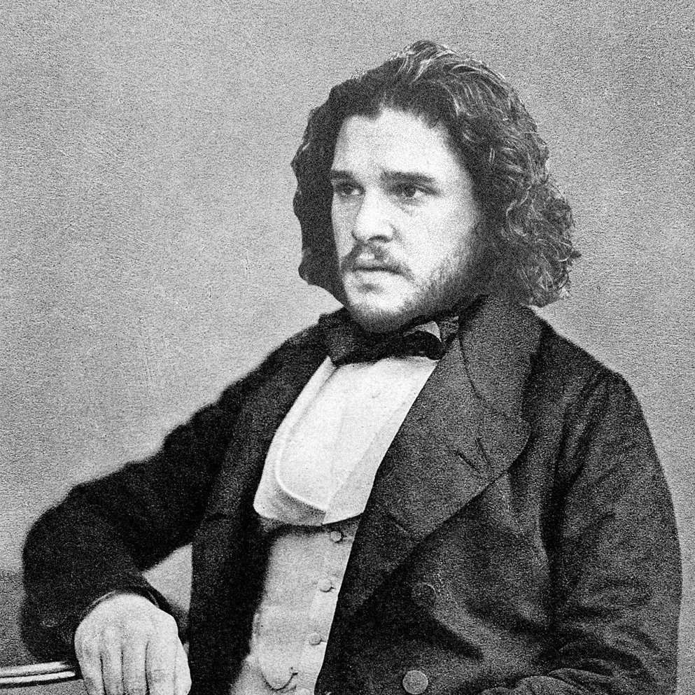
Next flu season: 2009
Off-season swine flu (H1N1) pandemic, which Google didn’t pick up :/
But Google did pick up something else: turns out the first iteration of GFT was accidentally a method to predict the start of winter!
Back to the drawing board…
Winter is coming…

Slide 12
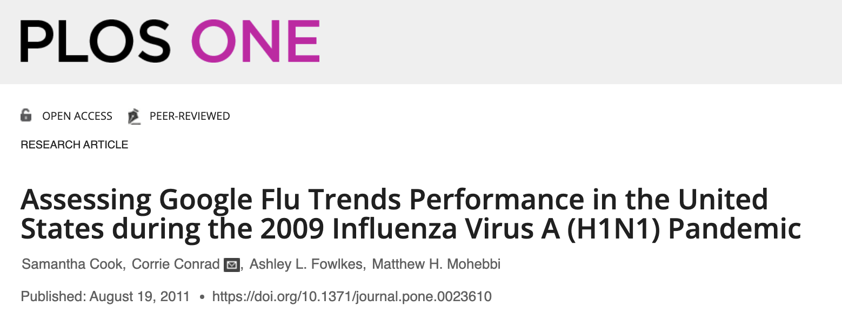
Google Flu Trends: Redesign
H1N1

Slide 13
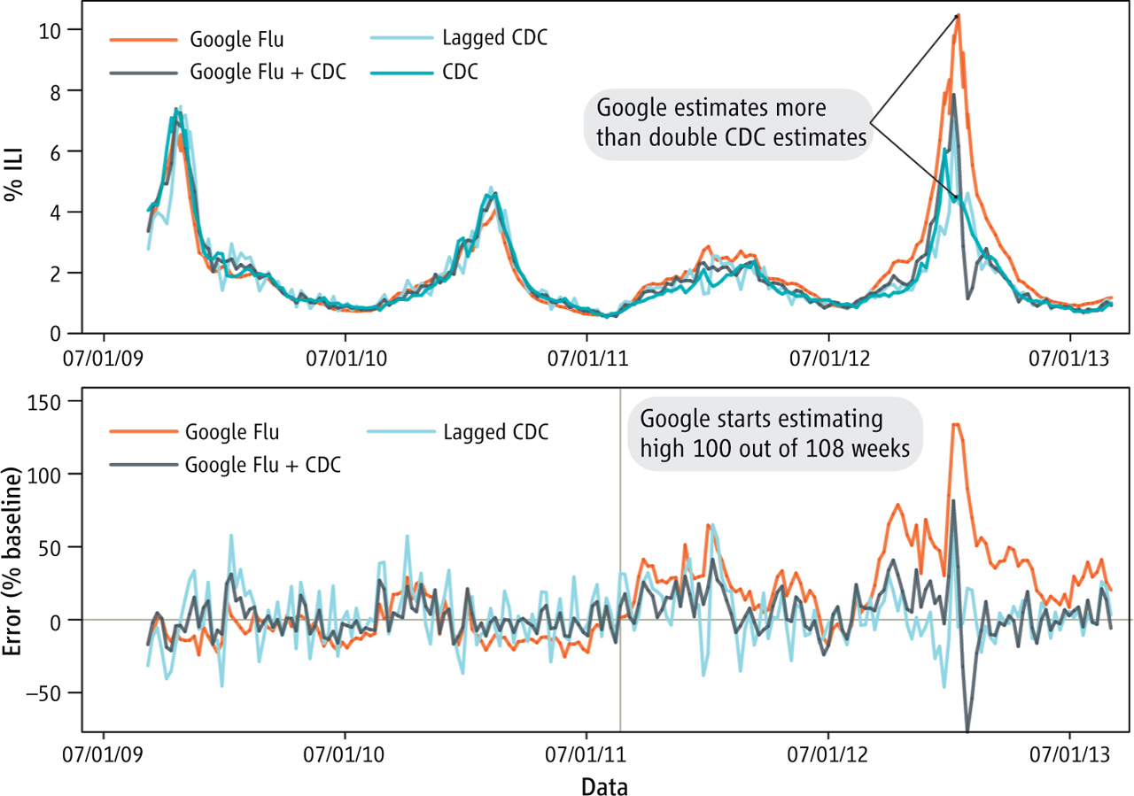
Lazer et al. (Science, 2014)

Slide 14
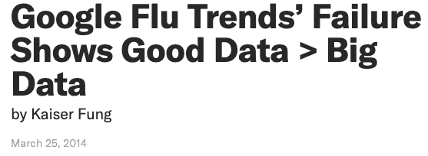

Slide 15
Shortcomings of Google Flu Trends
Assumption that the # of influenza-like ill people is proportional to the # of total searches of influenza-like illness-related terms (e.g., “fever”, “chicken soup”, “cold”)
Single-variable approach, where Q is a composite of 45 undisclosed queries that yielded the best correlation with CDC data
Crappy data transparency: Google never actually published what search terms they used and did not make their methodology public because they claimed that if they did, people could “hack” the system and inject noise into predictions
Assumption that the relationship between search volume and proportion of people with ILI is static in a given year, so the model required constant supervising and updating by human experts
$$logit\left(P\right)=β_{0}+β_{1}logit\left(Q\right)+ϵ$$
% ILI physician visits
ILI-related query fraction

Slide 16
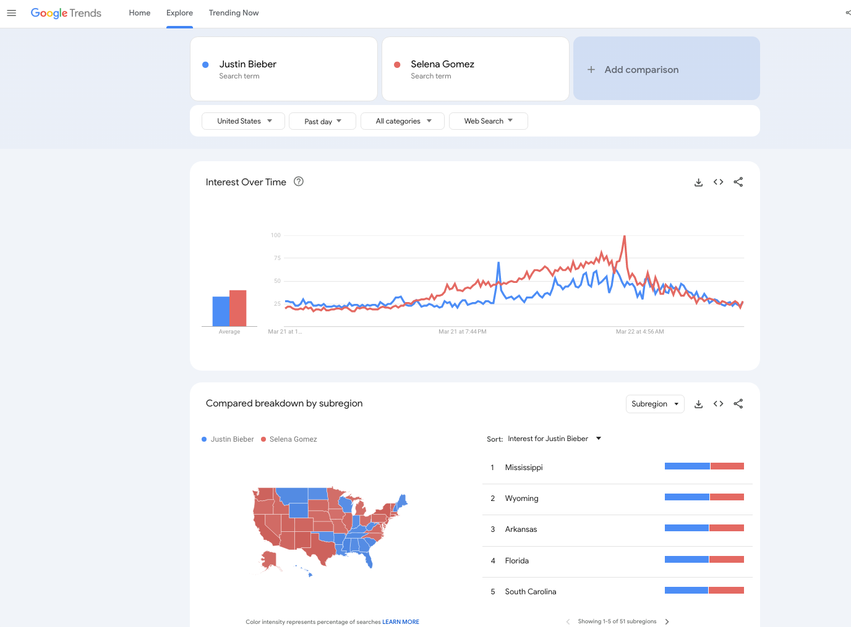
Silver lining: Google Trends

Slide 17
Thought Exercise
Now you are a digital epidemiologist… Pick a disease and an “alternative” data source, and describe how you might use the latter for disease surveillance. Try to think outside the box! For example, think about data on the number of people tuning in to video game streams during covid – if more people are tuning in, does this mean that lockdown is working?

Slide 18
Proposed GFT improvements
Multivariate approach, where each search term may contribute to prediction of ILI rate separately
Make the relationship between term-specific search volume and proportion of ill people dynamic
Publish which Google search terms contribute most to weekly predictions

Slide 19
Google “Dengue” Trends

Slide 20
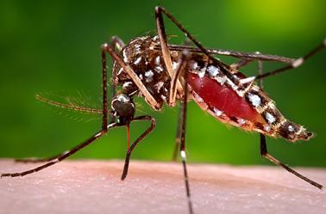
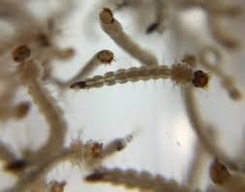
Background: Dengue and Google Trends Modeling Exercise

Slide 21
Background: Dengue and Google Trends Modeling Exercise
Dengue fever is an infectious disease caused by a virus that is spread by mosquitoes. It affects millions of people in tropical environments around the world.
In this exercise, you’ll be asked to construct a simple Excel version of the digital disease detection tool “Google Dengue Trends” – a Dengue analog to Google Flu Trends – for Mexico. You’ll need to download the spreadsheet Dengue_trends_AM_111.xlsx. The first column represents the date (in months, from 2004 – 2011), the second column represents the number of cases of Dengue in Mexico (as reported by the Mexican Ministry of Health), and the third column represents a rescaled number of Google searches for the term “dengue” in Mexico each month.
In the 4th and 5th columns, you’ll notice that we have gone ahead and standardized the data in columns two and three, respectively. When we develop models for machine learning, we often want to make sure that the components – or features – of our models are on the same scale so that they can be compared directly (i.e., in our case, we can see that column two contains raw values while column three contains scaled values). One way to do this is through standardization, which takes input data and scales it so that it has a mean of 0 and a standard deviation of 1; the formula we use is as follows: $Z=\frac{x−μ}{σ}$, where $x$ is each original data point, $μ$ is the mean of the given data, $σ$ is the standard deviation of the given data, and $Z$ – also known as a standard score – is our rescaled data point that represents the number of standard deviations above or below the mean that a specific data point falls. A negative Z score means that the value of our original data point is less than the average value of the dataset.

Slide 22
Question 1
Plot the standardized number of Dengue cases as a function of time. What trends do you notice in the curve?

Slide 23
Question 2
In machine learning, we often talk about dividing our data into a training set and a testing set. When we want to “teach” a machine learning model how to do a task – in this case, ultimately forecasting Dengue cases – we need to give it examples of what we want it to learn. By showing the model lots of examples, it can learn to recognize patterns and to make predictions on new data that it hasn’t seen before. The training set is this collection of examples, more specifically a collection of input-output pairs, and is a subset of the entire dataset. Typically 60-80% training, 10-20% testing.
Let your training period span the period 2004 – 2006, inclusive (36 months). Fit a linear regression model – “y = mx + b” – that explains the standardized number of cases of Dengue as a function of Google searches for the term “dengue” (HINT: you can use Excel’s “add trendline” option). What is the equation of the best-fit line? Do Google searches for the term “dengue” appear positively or negatively correlated with the number of cases of Dengue?

Slide 24
Question 3
Use the equation of the line you obtained in 2) to plot the standardized number of Dengue cases as a function of standardized Google searches, predicted by your method during the training period. You may want to create another column in the spreadsheet that reflects these predicted values. Additionally, compare your results to the plot in 1) restricted to the same time period.

Slide 25
Question 4
Now, for the prediction period spanning 2007 – 2011, inclusive, use the equation of the line you obtained in 2) to predict the number of Dengue cases as a function of Google searches for “dengue.” Plot this prediction and compare it to the actual number of cases for the same time period.

Slide 26
Question 5
Discuss the results you obtained in 1) – 4). How would you suggest improving this modeling approach? What other data sources would you propose using to increase confidence in the approach? Take into specific consideration the geography in question.

Slide 27
Digital epidemiology isn’t just about using Google Search data!

Slide 28
Some Applications of “Alternative” Data
Twitter: tweet-derived sentiment about vaccines as a proxy for vaccine uptake
Facebook: mobility data as a proxy for non-pharmaceutical intervention success or contact rate between susceptible and infectious individuals
Yelp and Tripadvisor: restaurant reviews containing terms like “diarrhea” and “vomit” as a proxy for foodborne illness hotspots
CVS and Walgreen’s: inventory of tissues, cough drops, etc. as a proxy for flu season start
Convenience stores: cigarette inventory as a proxy for local lung cancer incidence
Smart thermometers: internet-connected thermometers that aggregate fever data in the US, which can be used as a proxy of flu-like illness

Slide 29
Food for Thought
We must be extra mindful of false signals in publicly available data (e.g., from media hype), which necessitates two things: (1) improved signal processing techniques, and (2) gold standards that can ground findings in observations from traditional epidemiological data sources
There’s an element of human behavior: analogy in financial markets is that if you disclose a forecast that a specific stock price will go up, it’s likely that more people will buy the stock in response
Ethical considerations around mining and scraping data, even if publicly available
Data representativity – who has access to internet? Is digital epidemiology really democratizing infectious disease surveillance?

Slide 30
Thank you!

