Slide 1
Horizons for Homeless Children
September 6, 2022

Slide 2
Organization Overview
The mission of Horizons for Homeless Children is to improve the lives of young homeless children in Massachusetts and help their families succeed by providing high-quality early education, opportunities for play, and comprehensive family support services.
Every homeless child will have the opportunity to learn, play, and thrive.

Slide 3
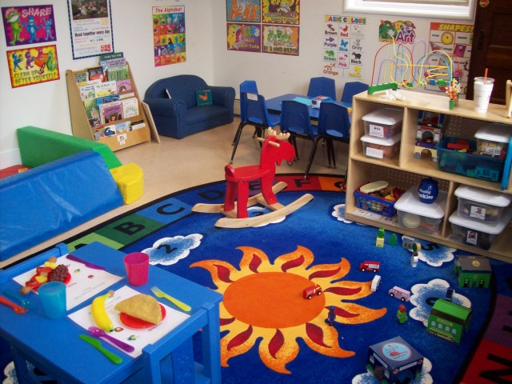
Organization Overview
Early Education Center: We operate one of the state’s top-ranked early education programs, which starts children along the path toward success at school.
Family Partnerships Program: We give their parents a much-needed respite from the difficulties of homelessness, a shoulder to lean on, and practical guidance toward getting their lives back on track.
Playspace Program: We give children in shelters play experiences that let them be kids for a few hours each week.
Policy & Advocacy: We highlight the unique needs of homeless children and families to ensure they are consistent priorities among policymakers on local, state, and federal levels.

Slide 4
Project Overview
Harvard is closely working with Horizons to assist in data collection and analyses of the teaching algorithm TS Gold.
Additionally, there will be outcome assessments of all children in Horizons’ behavioral and emotional metrics, including anxiety, aggression, and withdrawal.
Work will/can be partly on-site at Horizons in Roxbury, MA.

Slide 5
Description of student role
The student will assist with data collection, cleaning, and implementing the Child Behavior Checklist (CBCL).
Student will analyze data already collected in collaboration with Harvard team
Skills: Basic epidemiological skills, organization, and communication skills.
The ideal student is sensitive to the needs and difficulties of the population.

Slide 6
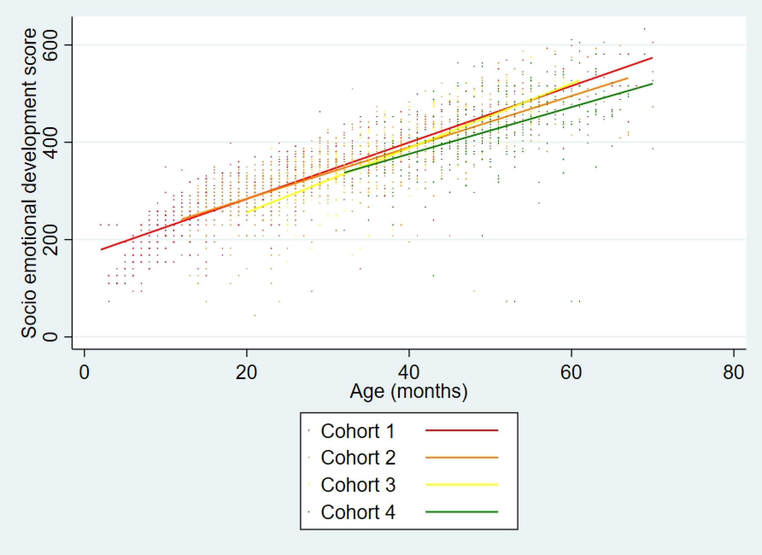
Data from current child assessments with TS Gold: student project
TS GOLD ASSESSMENTS:
From Fall 2011 until now
Around 500 children
Over 2,000 observations per domain
Six domains:
Socio-emotional
Physical
Literacy
Language
Cognitive
Mathematics

Slide 7
Questions?
Notes:
There are 242 “rows” of data for English-speaking respondents.
Every time a parent fills out a survey, it counts as another row (regardless of whether or not the parent completes the survey).

