Slide 2
Protecting your family involves more than keeping them safe from accident or attack.

Slide 3
U.S. Suicide & Homicide Rates
Suicide
Homicide
Rates are the number of deaths for every 100,000 people in the U.S. The graph includes suicides and homicides by all methods. In 2015, 50% of suicides and 73% of homicides in the U.S. were by firearms.
Notes:
3
You can customize this graph to your particular state by going to the CDC WONDER website http://wonder.cdc.gov/ and choosing the “Compressed Mortality” data and selecting your state. Follow these steps:
At “1. Organize table layout” select Group Results by “Injury Intent” and, in the next box, “Year”
At “2. Select location” highlight your state.
At “3. Select years and demographics” select 2000-the most recent available.
At “4. Select cause of death” press the radio button that switches the display options to “Injury Intent and Mechanism.” (see details on previous slide) At Injury Intent select “Homicide” and hold down the Control key and select “Suicide” so that both are highlighted.
Under Injury Mechanism, select “All.”
Now hit send.
You should have the number of homicides and suicides for your state. Once you have the numbers, right click on the graph above and select “Edit data” and replace the US numbers with your state’s numbers. The graph should update automatically. Don’t forget to change the heading from “U.S.” to your state and make the relevant change to the note at the bottom. Contact Cathy Barber if you need help: 617-432-1143.

Slide 4
U.S. Firearm Deaths, 2011 – 2015
62% of firearm deaths in the U.S. are suicides.
Source: CDC WONDER website (official mortality data)
Notes:
You can customize this graph and the next one to your particular state’s data by going to the CDC WONDER website http://wonder.cdc.gov/ and choosing the “Compressed Mortality” data and selecting your state. Follow these steps:
At “1. Organize table layout” select Group Results by “Injury Intent”
At “2. Select location” highlight your state.
At “3. Select years and demographics” select the five most recent years.
At “4. Select cause of death” press the radio button that switches the display options to “Injury Intent and Mechanism.” You don’t want it to be in the mode that requires you to select ICD-10 codes. Make sure you hit the radio button and not the blue words (they only connect to a definition).
Once you do that, the options will switch to Injury Intent on the left of the screen and Injury Mechanism on the right. Leave Injury Intent at “All.”
Under Injury Mechanism, select “Firearm.”
Now hit send.
You should have the number of suicides, homicides, legal interventions, unintentional deaths, and undetermined deaths by firearms for your state. CDC WONDER won’t show results if there are fewer than 5 for a given category. That could be the case for undetermined or unintentional, as there are so few of these. If that happens, one option is to combine those two categories. Go back to “1. Organize table layout” and choose “State” for Group output results by. Then under 4. Select Cause of Death, hit “unintentional” and while holding down the Control key also hit “undetermined” and hit “Send.” If that still results in fewer than 5 cases, you can simply indicate “fewer than 5” on the slide. If there are too few legal intervention firearm deaths to show, you can do the same procedure to combine homicide and legal interventions by selecting those two intent types at the same time and hitting “send.”
Once you have the numbers, right click on the graph above and select “Edit data” and replace the US numbers with your state’s numbers. The graph should update automatically. Don’t forget to change the heading from “U.S.” to your state. Contact Cathy Barber if you need help: 617-432-1143.

Slide 5
What does Louisiana look like?

Slide 6
VA, 2021
Notes:
Please feel free to edit this slide as updated data and information becomes available. You can visit Veteran Suicide Data and Reporting - Mental Health at: (https://www.mentalhealth.va.gov/suicide_prevention/data.asp) to find the updated state-level veteran suicide statistics. Scroll down to the tab that states, “View Individual State Data Sheets,” select the state desired and a new browser will open with the desired up to date information.
To edit this information in the chart, use the cursor and click on a singular bar on the graph and it should highlight the entire chart area. Then, right click the selected bar and select, “Edit Data in Excel.” This should open Microsoft Excel in a new window. In Excel, you can now enter the state’s name, and the specific numbers associated with you the state. Entering the data will automatically update the information in the power point slide.

Slide 7
Method of Suicide
VA, 2021
Notes:
Please feel free to edit this slide as updated data and information becomes available. You can visit Veteran Suicide Data and Reporting - Mental Health at: (https://www.mentalhealth.va.gov/suicide_prevention/data.asp) to find the updated state-level veteran suicide statistics. Scroll down to the tab that states, “View Individual State Data Sheets,” select the state desired and a new browser will open with the desired up to date information.
To edit this information in the chart, use the cursor and click on the specific circle graph and it should highlight the chart area. Then, right click the selected bar and select, “Edit Data in Excel.” This should open Microsoft Excel in a new window. In Excel, you can now enter the state’s name, and the specific numbers associated with you the state. Entering the data will automatically update the information in the power point slide.

Slide 8
Putting time & distance between a suicidal person and a gun may save a life.
Time & Distance
But won’t they just substitute another method?
Some may, but nearly anything else is less likely to kill.
Others may delay their attempt.
Either way, the odds of survival go up, for three reasons…

Slide 9
Why Means Matter
Suicidal crises are often brief.
The deadliness of an attempt depends in part on the method used.
90% of those who attempt suicide and survive don’t go on to kill themselves — even those making very serious attempts.

Slide 10
People admitted to a hospital after an attempt were asked how long they had been thinking about suicide before the attempt.
Suicidal Crises
48% said ten minutes or less.
Most people who become suicidal have struggled with ongoing, underlying problems. But the movement from suicidal idea to action is sometimes rapid.
Notes:
The 48% finding was reported in this study: Deisenhammer et al. “The duration of the suicidal process.” Journal of Clinical Psychiatry. 2009;70(1):19-24. It was based on interviewing 82 people who had been admitted to a hospital for a suicide attempt. It doesn’t mean that the person had never thought of suicide before in their life.
While some suicides are deliberative and involve careful planning, many involve little or no deliberation and occur during a short-term crisis. Chronic, underlying risk factors such as substance abuse and depression are also often present, but the acute period of heightened risk for suicidal behavior is often only minutes, hours, or days long.

Slide 11
Why Means Matter
Suicidal crises are often brief.
The deadliness of an attempt depends in part on the method used.
90% of those who attempt suicide and survive don’t go on to kill themselves — even those making very serious attempts.
Notes:
Firearms and jumps from a very great height are the deadliest methods of suicide. Many methods have low lethality. Firearms and jumps from a very great height have something else in common: once you start the attempt, you can’t stop it. Nearly every other method allows a window of opportunity to change your mind mid-attempt or to be rescued. (Lots of people who attempt suicide change their minds mid-attempt.)
The 90% figure comes from Owens, Horrocks and House’s 2002 meta-analysis of over 90 studies of repetition of self-harm. These studies followed people over time who had harmed themselves to see what proportion attempted another time and what proportion actually killed themselves. The proportion who eventually killed themselves ranged from 5-11% in the studies that followed people multiple years. One study looked only at people who had thrown themselves in front of a train, and even in that study 90% did not go on to later kill themselves.

Slide 12
Protecting One Another
Having access to a firearm during a suicidal crisis increases the odds that an attempter will die.
We can protect one another. Be alert to signs of suicide in friends and family.
If someone is at risk, help keep guns from them until they recover.
It’s like holding a friend’s car keys when they’re drunk.

Slide 13
Who’s at Risk of Suicide?
People who struggle with depression, substance abuse, or other mental health problems, especially if they’re also facing a painful crisis like a relationship break-up, arrest, trouble at work, or financial crisis—problems that make you feel hopeless and trapped.
Teens at home? Teens who die by suicide may show few or no warning signs. A wise precaution: store all guns locked if you have children at home — especially teenagers – and make sure they don’t know where the keys or combination are.

Slide 14
Storage Options
If a household member is at risk of suicide, you could store guns away from home until they’ve recovered (e.g., with a relative you trust, at a storage unit)
Or change the locks and make sure they can’t find the keys/combination.
Another option: don’t keep ammunition at home until they’ve recovered.
Hiding guns isn’t recommended. Family members tend to know one another’s hiding places.
If it’s a friend at risk, offer to hold onto their guns.*
*Unless this is not legal under your state laws.

Slide 15
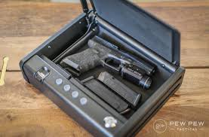
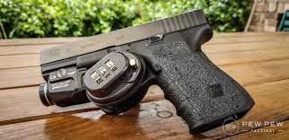
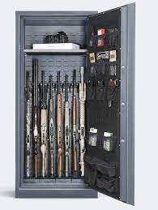
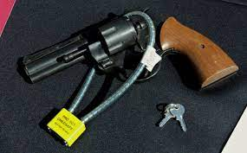
Gun safes and locks come in all different sizes and types with specifications to meet virtually anyone’s preference, or budget. Cable locks are free at most local Police or Sherriff offices! Veterans can request free cable locks at their VA!

Slide 16
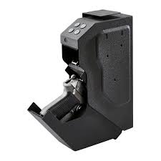
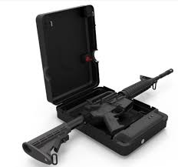
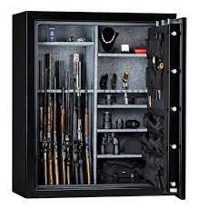
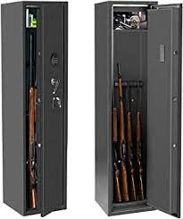
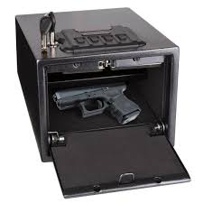
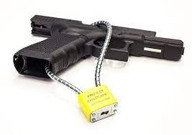
Storage Options and Prices
Small safes for pistols ($30 – up)
Even one’s that mount inside your car
Medium or large safes for a long rifle, or any number of firearms ($150 – up)

Slide 17
What if it’s You at Risk?
If you feel yourself spiraling down, take precautions before things get to a crisis point.
Any strategy that builds some time between you and a gun in a suicidal crisis will keep you safer.
Store your guns off-site temporarily, or ask someone you trust to hold onto the keys, or store the keys somewhere they’re not available in a crisis like a bank safe deposit box, or disassemble the guns.
These are temporary measures until you’ve recovered.

Slide 18
*Let’s look at a real example of a different kind of protection
Shane grew up on a small farm along a river in rural Louisiana.
Just like his father, and grandfather before that, he raised his hand to serve his country in the Army.
Shane was deployed to Iraq with a medical unit during the surge in 2009 and worked in the Emergency Room at a major hospital.
Notes:
*This is a real story, as such the names have been changed to protect the privacy of the individuals involved. Please feel free to update with your own personal story, if desired.

Slide 19
When Shane initially got home from Iraq, he and his wife had troubles re-adjusting to life back together in Louisiana and one afternoon he was confronted with a crisis in his marriage.
Shane went out to the farm where he had grown up and walked out into the woods as he had hundreds of times before.
Shane sat under a large maple tree with a pistol in his lap and thought about killing himself, but he called his old battle buddy Randall instead.

Slide 20
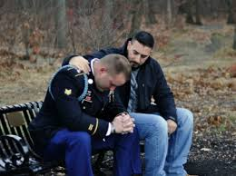
Randall talked to Shane until he was able to get to the woods…
They sat together and continued to talk about the storm swirling around Shane, and how Randall wanted to hold onto Shane’s firearms until the storm had passed.
Shane trusted Randall to hold onto his firearms. This gave him time to think, seek help, and work through the crisis in his marriage…
without access to lethal means.
Randall was happy when he gave Shane his firearms back. They agreed to be there for each other in this way, if it was ever needed again.

Slide 21
Protecting our Freedom
Families that own firearms can bring down the number of firearm suicides.
We can do it without government mandates.
Together, we can protect our family, our friends, and our freedom.
Notes:
Photo courtesy of Lukas Budimaier, Unsplash
Thanks to instructor Tom Brown for the wording of the third bullet on this slide.

Slide 22
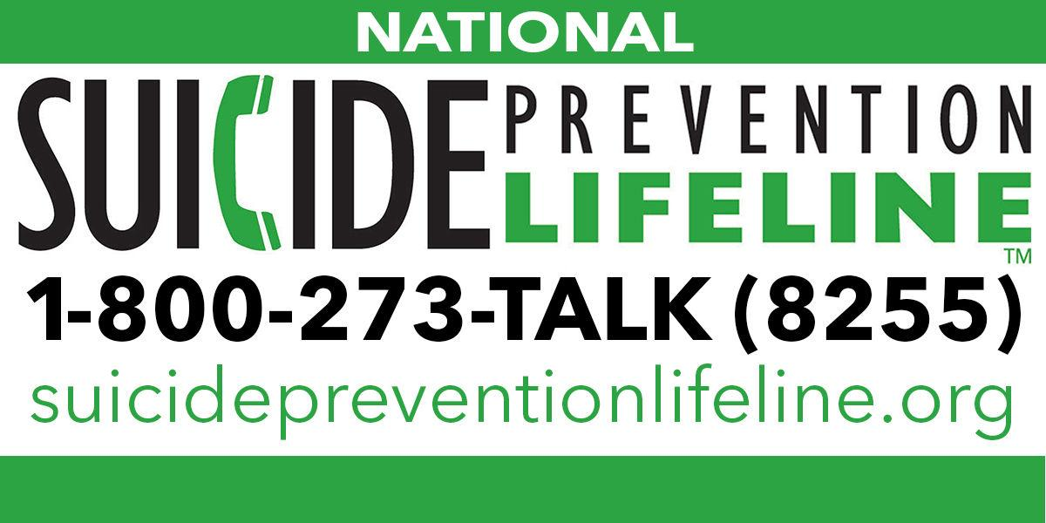
RESOURCES:
Veteran Informed Safety Intervention and Outreach Network (VISION)
Louisiana-based efforts to prevent Veteran firearm suicide, including resources for temporary firearm storage: https://www.visioncoalition.net/
Local Mental Health Services
Veterans
New Orleans VA: (800) 935-8387
Vets for Warriors: (855) 838-8255
Vet Center: (877) 927-8387
Veterans Crisis Line: (800) 273-8255, press 1 for Veterans
Community members:
Ochsner (numerous locations)
LSU Health Sciences (numerous locations)
NAMI Louisiana: (225) 291-6262
Jefferson Parish Human Services Authority: (504) 838-5215
Metropolitan Human Services District: (504) 568-3130
Suicide Prevention Lifeline: (800) 273-8255

Slide 23
Acknowledgements
These slides were adapted with permission from the New Hampshire Firearm Safety Coalition
This material is based upon work supported by the Department of Veterans Affairs, Health Services Research & Development Service (Award # INV 19-294) to Gala True and Joseph Constans. The views expressed in this video are those of the authors and do not necessarily reflect the position or policy of the Department of Veterans Affairs or the United States Government

