Slide 1


Practicum Overview​
THE MPH Practicum
MPH-45

Slide 2


Today’s Topics
The MPH PRACTICUM
Overview of the MPH practicum
Timeline
Resources for finding a practicum
And… Questions for you?

Slide 3

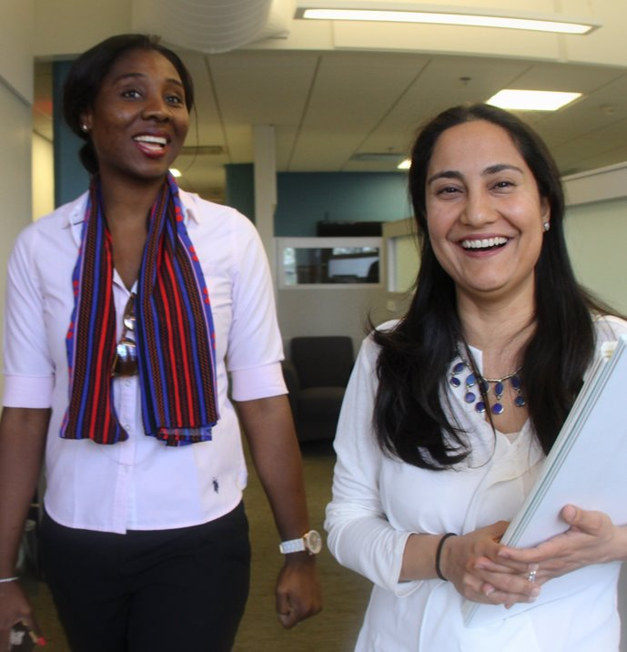

Goal
To integrate competencies and apply knowledge gained in the classroom to a real world public health problem
The MPH Practicum​
What are my personal and professional goals while I am here?​
How can I best use field practice to reach my goals?

Slide 4

Applied Practice Experience (APE) Nuts & Bolts
Apply classroom skill and build competencies in real world setting.
Project is specific and well-defined, has a realistic scope, and is of significance to the host organization. Schedule is mutually agreed upon between preceptor and student.
Component | Details
Course | Your field of study determines your “Practice Class”
Time | Minimum 120 hours, between December and March.
Who’s involved | Host organization, Preceptor, practice course faculty, MPH practice team. Possibly other students if a team.
School deliverables | Learning Agreement 2 APE products that demonstrate 5 competencies Poster or Presentation
Host organization deliverables | Determined by you and your preceptor

Slide 5
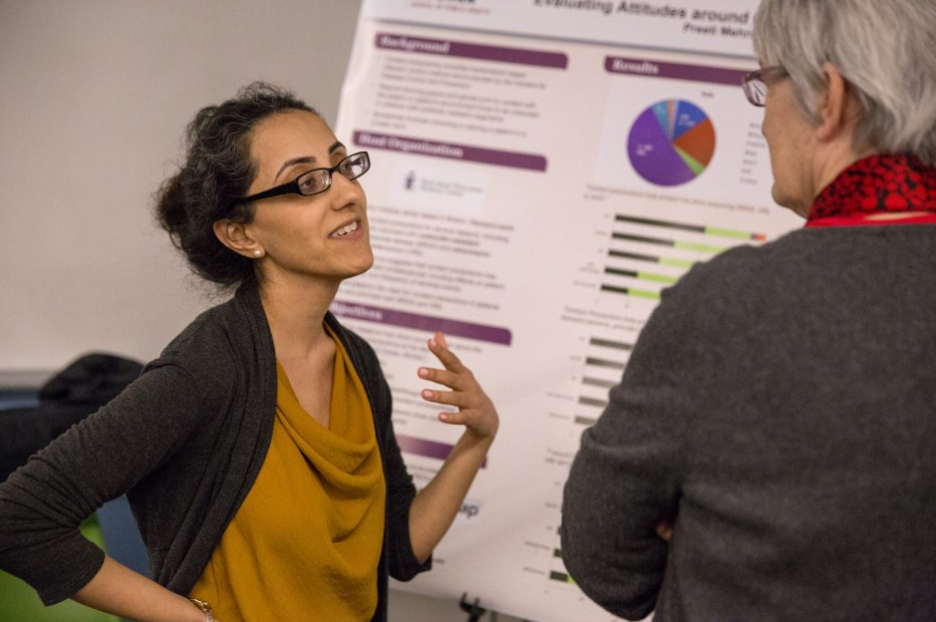
What Students Do for Their Practicum
⁵

Slide 6
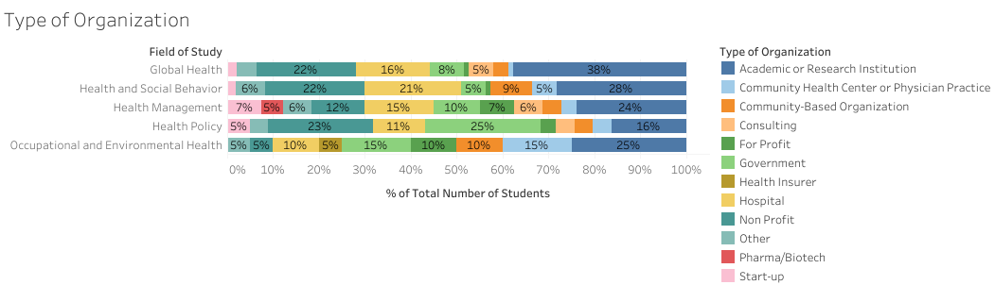


Where do students do their Practicum?
n = 1610 students

Slide 7


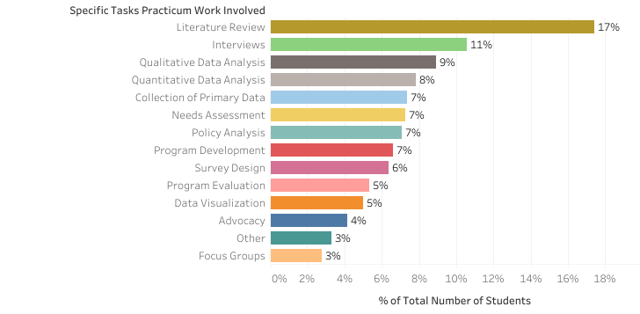
Examples of Practicum Work
n = 1610 students

Slide 8


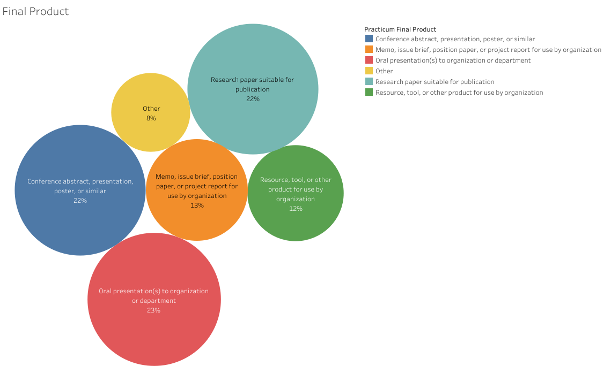
Final Practicum Products
n = 1610 students

Slide 9

How Students Search for their Practicum
⁹

Slide 10


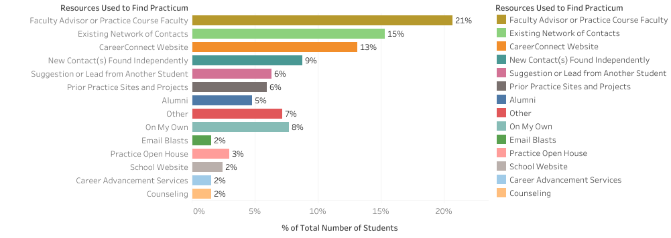
Resources Used to Find Practicum
n = 1610 students

Slide 11
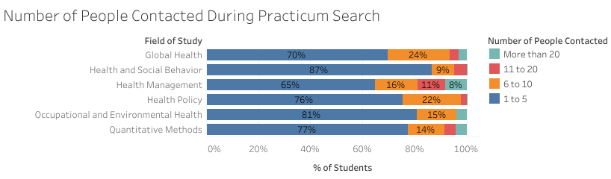

Number of People Contacted During Practicum Search
n = 1610 students

Slide 12


Timeline for MPH-45
Component | Details
Seek practicum placement & finalize scope | September – October
Draft and submit Learning Agreement | November
Conduct Practicum | December – March
Wrap up Practicum and host organization final deliverables | March
Complete practice course requirements (paper, poster, etc.) | April - May

Slide 13

Resources for Practice
Online
Practice webpages for Students - Prior host sites
Practice webpages for host organizations
CareerConnect
Advising
Applied Practice Experience requirements
Field Practice data
People
Department Faculty and Staff
Field Education and Practice Team - Stacey King, Andrew Bell, Jocelyn Chu
Current Students
Alumni Follow Harvard T.H. Chan School of Public Health on LinkedIn to see and search Alumni: https://www.linkedin.com/school/harvardpublichealth/people/
Preceptors and Practitioners

Slide 14

THANK YOU
MPH-Practice@hsph.Harvard.edu

