Slide 1
Digital Accessibility
Essentials
Digital Accessibility Services (DAS)
Harvard University Information Technology (HUIT)
Notes:
A11y more important than ever as we all move online
Best practices to help not just for websites but in all your digital communications
Goal to make it not overwhelming or technical, but give you actionable practical steps to take right away to start making the content you create accessible to all of your users

Slide 2
After today’s session, you’ll be prepared to
Describe what digital accessibility is
Recall key components of Harvard’s accessibility policy and standards
Recognize how barriers affect people with disabilities
Apply essential skills for web, docs, and communications
Integrate accessibility into your planning processes

Slide 3
Accessibility Overview

Slide 4
What is digital accessibility?
Making electronic content available to and usable by everyone - at the same time, with the same ease of use - including and especially people with disabilities.
A11y = Accessibility

Slide 5
Harvard’s Standards: WCAG
Web Content Accessibility Guidelines (WCAG) 2.1
Acronym often said like “Wuh-Cag”
Internationally recognized
4 principles: Perceivable, Operable, Understandable, Robust (POUR)
3 cumulative levels of compliance, A → AA → AAA
Notes:
Levels aren’t equal to good, better, best, but refer to the:
number of people who would be impacted by the change and the
perceived cost or difficulty of implementation
Level A
high impact on a broad array of users,
Easiest to implement, low impact on the business side of things
Level AA
High impact, but sometimes only specific user populations.
Adherence would require more changes to the business side of things
Level AAA
More difficult or expensive to adhere to.
Success criteria focused on improvements for specific user populations.
For Harvard’s policy, content must satisfy all A and AA criteria

Slide 6
Digital Accessibility Policy Highlights
Harvard University Digital Accessibility Policy: effective June 1, 2023
The Policy applies to new
digital content created or substantially revised
technology purchased or developed
The Policy covers
public-facing content and technologies (websites, social channels)
password-protected content and technologies (LMS, apps, etc.)
Should aim to meet WCAG 2.1 AA standards

Slide 7
Digital Accessibility Policy Procedures
Policy Procedures
Information and guidance on implementing Harvard's Digital Accessibility Policy, with supporting examples and definitions.
Introduction
Policy Requirements
Websites
Purchasing & Procurement
Multimedia Accessibility
Documents & Internal Communication Tools
Social Media
Temporary Exceptions
Available Assistance
Policy and Procedures Terms and Phrases

Slide 8
How are people affected?
Disabilities can alter how we interact with technology
Each has specific causes and symptoms
Vary greatly across different conditions
Visual
blindness, color blindness, low vision
Auditory
difficulty hearing, deafness
Motor
paralysis, tremors, carpal tunnel syndrome
Cognitive
memory or attention issues, difficulty interpreting information
Notes:
Some types of conditions to consider when preparing web content.
Even those without diagnosed disabilities are likely affected. The goal is to be inclusive. And to be most inclusive, we have to consider who is excluded.
“Barriers” - the disability isn’t the barrier, the design or functionality is the barrier
But there’s hope! Smart people have developed many tools to help people overcome technological barriers. Example: Screen reader, captions, keyboard
So our job is to make sure the content we create can be easily accessed by these technologies.

Slide 9
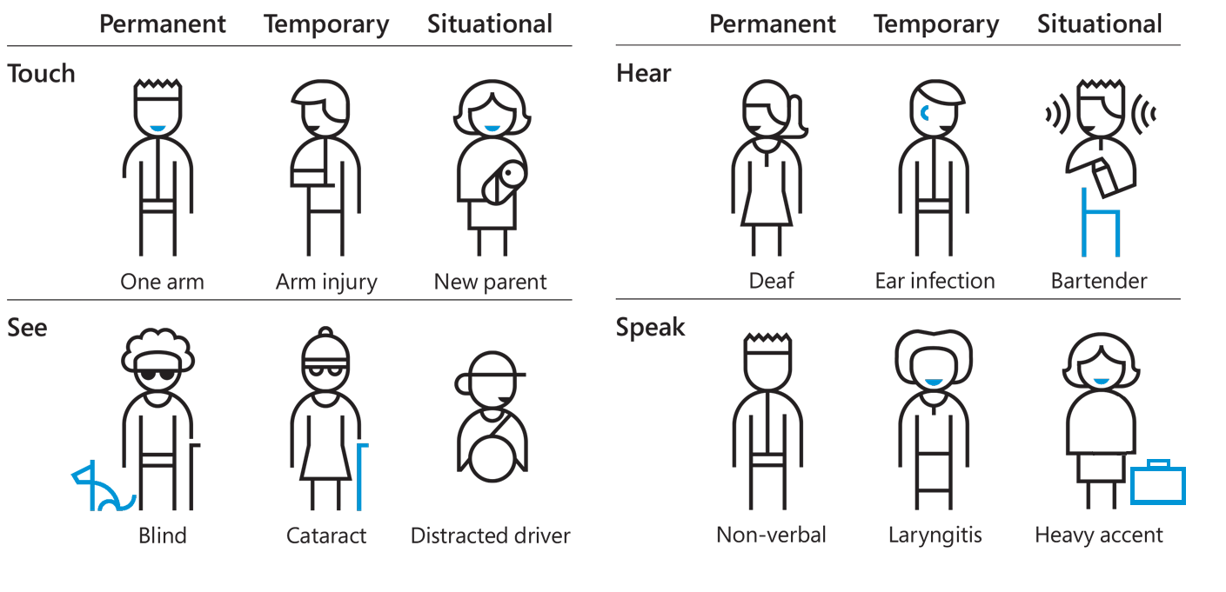
Types of exclusions
Image from https://www.microsoft.com/design/
Notes:
All of us can be affected, all of us can be excluded at any point in time.
We usually think of permanent when we think of disability
We all are impaired at some point/situation
Make the connection between how this promotes universal design, since everyone is affected by impairments at some point, even if it’s temporary, or due to the situation.
Examples:
Getting older,
Getting an injury
Forgetting our glasses
Point is we’re not designing for a small subset of people

Slide 10
7 Accessibility Essentials
Best practices for people who create and publish content
Notes:
Small actions that can have big impact.

Slide 11
7 Accessibility Essentials
Headings: Descriptive headings for content section
Tables: Purpose and labels
Color: Color contrast and conveying meaning
Plain Language: Easy and quick comprehension
Links: Easy to find and descriptive
Image Alternatives: Meaningful and descriptive
Media Alternatives: Captions and description
Notes:
Use this as a high level checklist for when you are creating new web content and/or when you’re going thru an already existing website

Slide 12
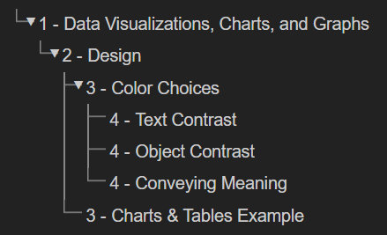
1. Headings Are Descriptive
Use one H1 per page
H2 for all major sections
H3 for all subsections, etc
Avoid skipping heading levels
Writing Headings
Heading Structure
Write Useful Headings
Notes:
Similar best practices to page titles
Mention that “Main Heading” is technically the “Page Title” when describing the image
Keywords:
both for searchability & clarity
SEO is different now - don’t cram keywords into fields - incorporate them naturally within the content

Slide 13
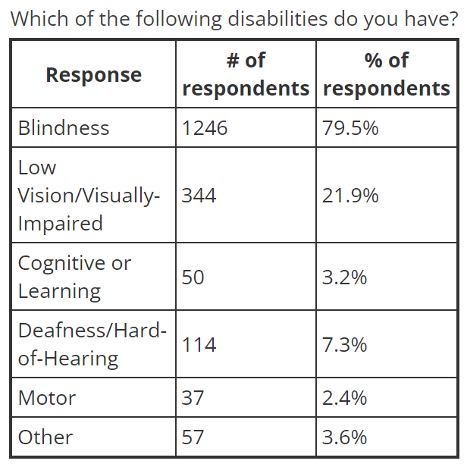
2. Use Tables for Data, Not Layouts
Data arranged by columns/rows
Include descriptive headers
Include caption text
Avoid merged/split cells
Avoid tables for design layouts
Source: WebAIM Screen Reader User Survey #9
Identifying Headings, Lists, and Tables
Notes:
Without row headings, screen readers might jumble the order of content.
We saw in the video earlier how row headings may be used to navigate a table

Slide 14
3. Intentional Use of Color
Text has strong color contrast
Dark on light or Light on Dark
4.5:1 minimum contrast ratio
Combine other formatting/design features.
ALLCAPS or Bold
Distinct shapes/patterns
Avoid Reliance on Color
Checking Color Contrast
Using Color to Convey Information / Use Sufficient Color Contrast
Notes:
Be mindful of using Harvard crimson with black and gray

Slide 15
4. Plain language and clear structure
Use plain language
“prior to” → “before”
“sufficient” → “enough”
Define acronyms on first use
Avoid jargon and figures of speech
Use bulleted lists, when possible
Keep sentences short
Break page up into paragraphs
Readability Analyzer
Notes:
Organize and group content thematically on the page, Write clear headings and subheadings
No one has ever complained that something was too easy to read!
Try to reduce your user’s cognitive load by organizing content into related buckets or sections. Avoid users having to parse a long list of links or blocks of text.
Examples of figures of speech: low-hanging fruit, batting a thousand, preaching to the choir, etc - can create barriers to your users understanding what you’re trying to convey

Slide 16
5. Descriptive link text
Describe where links go
Understand link out of context
Avoid generic phrases like:
Click here
Read more
Three Examples
WORST:
Check color contrast here: https://webaim.org/resources/contrastchecker/
STILL NOT GREAT:
Go here to check color contrast.
BETTER:
Check color contrast with the WebAIM Contrast Checker.
Writing Helpful Link Text
Notes:
Continue Reading links changed to: Browse the Faculty Directory, and Discover research and clinical opportunities

Slide 17
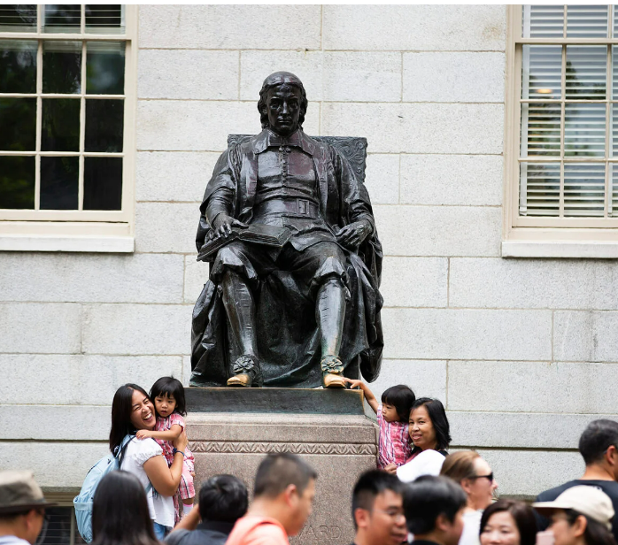
6. Alternative Text
Read by screen reader software
Describes image and provides context
Displayed if image fails to load
Indexed by search engines
Many users turn off images in emails
Tourists pose for pictures while touching the foot of the John Harvard Statue.
Writing Good Alt Text to Describe Images
Notes:
Alt text isn’t just for the vision impaired. If you’re on a bad connection, or you’re on your phone and you go through a tunnel, images won’t want to load. You’ll want to know what the image is, and whether it’s significant.

Slide 18
Alt text do’s and don’ts
Do...
Keep it simple, helpful & descriptive
Mention if it’s a logo, illustration, painting etc.
Alt=“” when decorative
End with a period.
Don’t...
Overthink it
Use “image of” or “link to”
Duplicate text on the page
Notes:
Ending alt text w/ a period: This will make screen readers pause a bit after the last word in the alt-text, which creates a more pleasant reading experience for the user.
Name of photographer: can include in captions
Keywords: creates confusion and doesn’t help SEO
Leave blank: adds cognitive load if image is decorative

Slide 19
Activity
Writing alt text for images

Slide 20
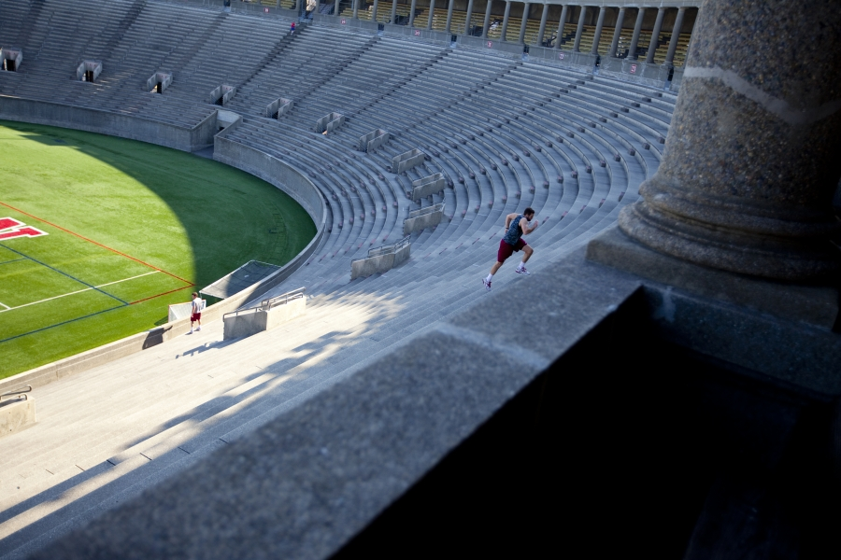
What should the alt text be?
Notes:
Ask the participants first what they think the alt text might be for this image. How would you describe this image to someone who can’t see?
Then show the version with context and without

Slide 21
Alt text changes with context
No context: A mostly empty stadium.
Recent turnout for track tryouts: Harvard Stadium with two lone runners bounding up the steps.
Renovation projects: Harvard Stadium with cracked concrete pillars.
Notes:
No context: describes what’s happening in the image. Okay but not ideal
w/ context: message they’re conveying

Slide 22
7. Three forms of media alternatives
Captions
Synchronized text of the audio material provided on screen with the video
Transcripts
Non-synchronized text of the audio material provided adjacent to the video or audio file
Audio Description
A separate spoken audio track of what is visually happening in a video

Slide 23
Accessible Documents
Notes:
Bonus essential
Documents are often posted on websites, and must follow accessibility best practices with those documents as well.
Not part of the list of essentials, but very important nonetheless.

Slide 24
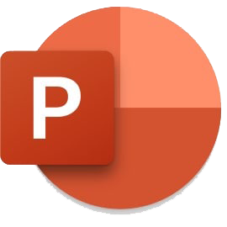
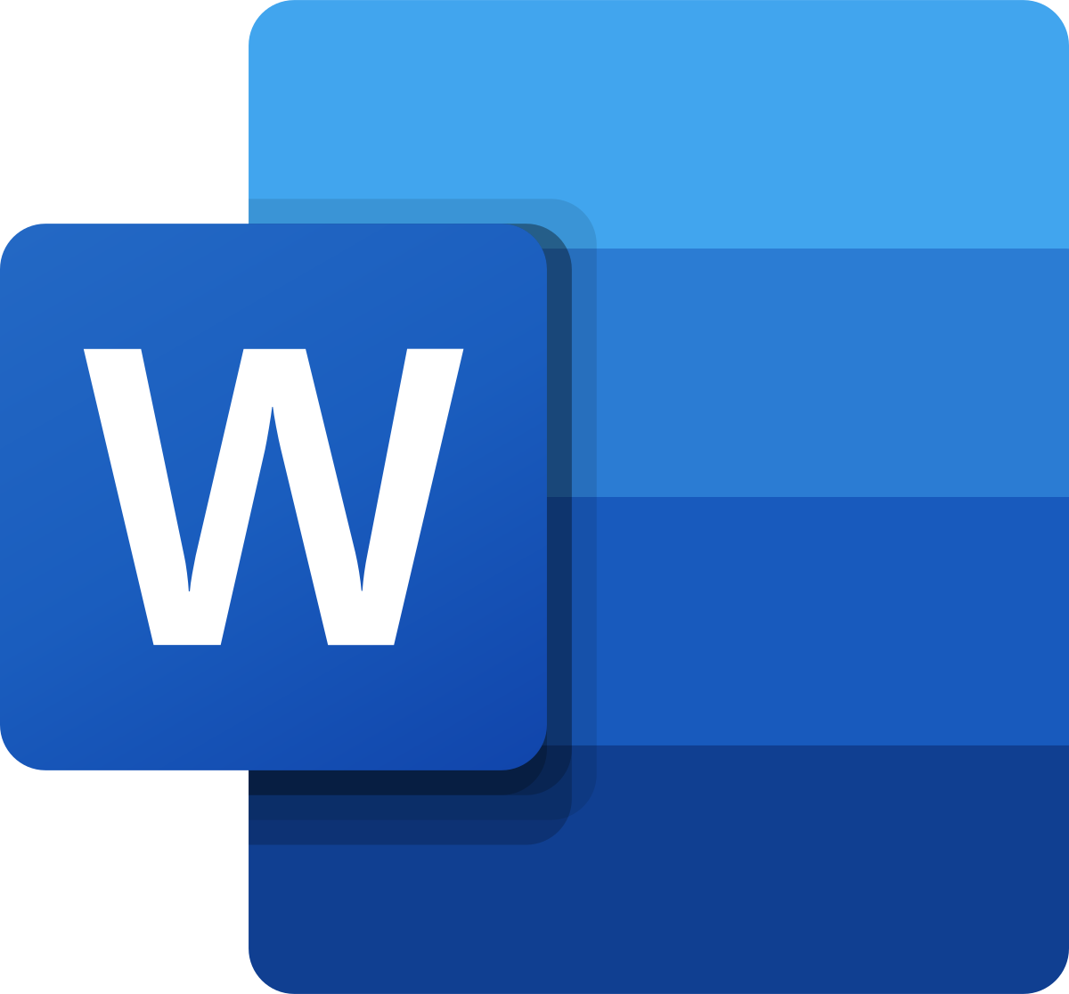
Accessible Documents
DAP includes documents posted on websites.
Apply 7 essentials when creating or cleaning up source docs
Use document accessibility checkers
Microsoft Office
Google Docs (Grackle)
Adobe Acrobat (PDF)
Notes:
Similar “essentials” apply to creating pdfs
Use heading levels
Add alt text images
Use the Check Accessibility tool if available in the original program to catch basic errors (Review → Check Accessibility)
Available in Word, Outlook, PowerPoint, and Excel
Many users not aware of this automatic tool
It will find accessibility errors in real time and offer help.

Slide 25
Accessible PDFs
Convert accessible source files (Word, InDesign)
Avoid export options for print (print to PDF)
Use Acrobat Accessibility Full Check
Verify and fix remaining issues
Check tags and reading order
Publish and share your PDF
Notes:
Check to see if you can highlight the text
Already pdf - something to check for if multi-column layout

Slide 26
Getting Started
Notes:
This can seem overwhelming, but don’t panic! It’s a lot, but we’re here to help.

Slide 27
How do I get started?
Integrate a11y essentials into your process
Assess your site’s a11y
Prioritize what to fix
Take small steps now
Notes:
Shift left; the new digital accessibility policy is forward looking. E.g., from now on, enter thoughtful alt text for every image, markup headings, etc
Assess your site; 2 common ways to get started
Automated testing
Manual testing: Navigate your site with the keyboard, Navigate your site with a screen reader
Prioritizing: When you get results of automated/manual testing, you can decide where to focus your attention

Slide 28
Integrate A11y into your process
Starting with a11y is easier and less expensive than remediation.
Add alt text to your images
Consider how you are using color in your content
Utilize DAS site’s Get Started Guide
Notes:
Incorporating early: As an example, consider a building that is architecturally planned for accessibility from the beginning and has a wheelchair-accessible entrance that fits with the building design aesthetically and practically. Compare that to a building with a ramp added on after the building was already designed and the ramp looks awkward and is less useful to all. Incorporating accessibility from the beginning of a design project is significantly easier, more effective, and less expensive than waiting until later in the project.

Slide 29
2. Assess your Site
Start with Automated Tools:
WAVE browser extension
HeadingsMap extension
Sign up for Siteimprove
Download the Chrome Extension
Follow up with Manual Testing:
Identify common user tasks
Test those tasks using:
Only the keyboard
Screen readers like NVDA and VoiceOver
Notes:
Wave browser extension goes page by page, also works behind login
Siteimprove: This is a good tool to start with. Siteimprove scans your website for broken links, misspelled words, accessibility issues, etc.
It will also assess SEO and analytics.
Fix what you can fix; don’t obsess about the score.
Sends report every few days so it can remind you to be consistent
Automated tools only test for 25-29% of WCAG criteria (www.karlgroves.com)
Therefore, you’ll need to do some manual testing to supplement automated testing.
AMP: More complex tool, which can be used behind login. Request access as needed.

Slide 30
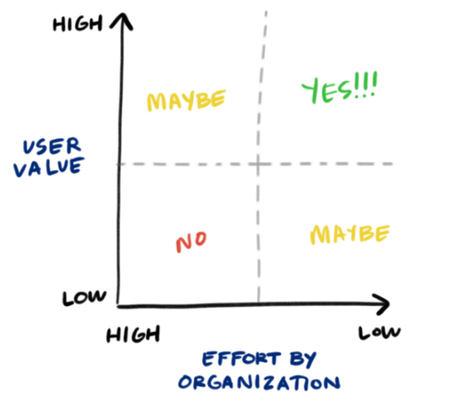
3. Prioritize what to fix
Review findings from testing
Use prioritization matrix
Fix high impact + low effort issues
Low-hanging fruit…
Image credit: NN Group
Notes:
Figuring out what to fix can be informed by the outcomes of your automated and manual testing, as well as how much value provided and the effort required.

Slide 31
4. Start small, start now
Check a11y the next time you create a web page or doc
Caption your videos
Attend DAS Office Hours
Sign up for DAS trainings
Contact DAS anytime: digitalaccessibility@harvard.edu

Slide 32
Appendix - Getting started
Assess your site
Request a Siteimprove or AMP Account
accessibility.huit.harvard.edu/tools
WAVE Browser Extension (Chrome & Firefox)
wave.webaim.org/extension/
Easy Checks - A First Review of Web Accessibility
w3.org/WAI/test-evaluate/preliminary/
PC Users: Using NVDA screen reader
webaim.org/articles/nvda/
MAC Users: Using Voiceover screen reader
webaim.org/articles/voiceover/
Prioritize what to fix
Using Prioritization Matrices to Inform UX Decisions
nngroup.com/articles/prioritization-matrices/
Integrate accessibility into your process
Incorporating accessibility early and throughout
uiaccess.com/accessucd/early.html
Planning for accessibility from the start
accessibility.umn.edu/tutorials/planning-accessibility-start

Slide 33
Resources
Notes:
This can seem overwhelming, but don’t panic! It’s a lot, but we’re here to help.

Slide 34
Trainings by Digital Accessibility Services (DAS)
Content
Digital Accessibility for Content Creators (instructor-led or on-demand)
Digital Accessibility in Canvas
Creating Accessible Docs or Slides or PDFs
Multimedia Accessibility (On-demand course)
IT Academy: Digital Accessibility Foundations
Testing and Technical Knowledge
Testing for Digital Accessibility
Measuring Accessibility with Siteimprove
Web Accessibility in HTML and CSS
Procurement and Policy
Accessible Technology Procurement
Intro to Digital Accessibility and Harvard Policy
Notes:
Next office hours - Friday, June 24: https://accessibility.huit.harvard.edu/das-office-hours
New Accessibility Testing page: https://accessibility.huit.harvard.edu/testing
accessibility.huit.harvard.edu/training

Slide 35
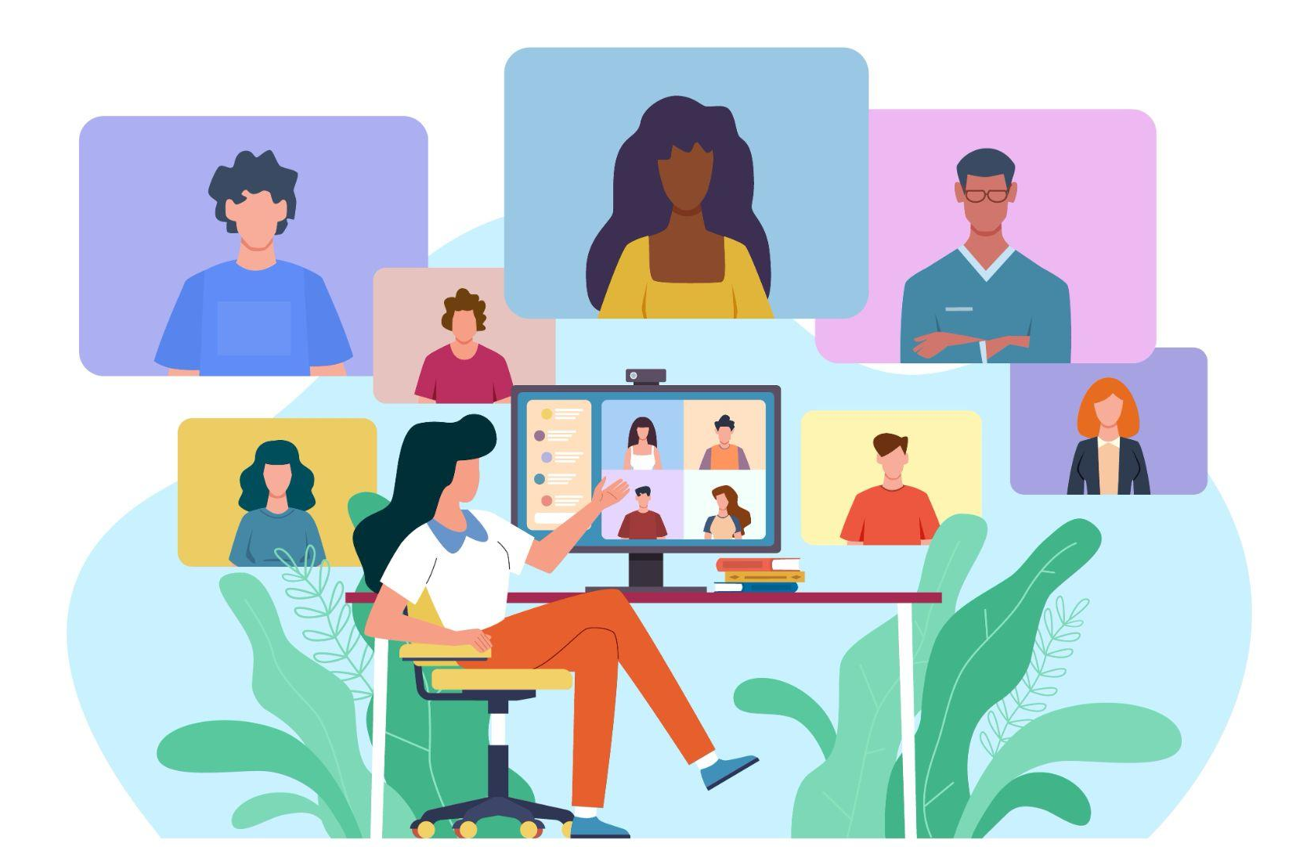
Stop by our virtual Office Hours!
Offered on the 2nd and 4th Fridays of each month from 10am-12pm.
Bring your accessibility questions, or just stop by to say hello! 👋
accessibility.huit.harvard.edu/das-office-hours

Slide 36
Need an accessible doc fast?
Submit to Harvard's preferred remediation vendor, AbleDocs!
Quotes are provided before remediation work begins
For any cost questions, contact DAS to explore other remediation options
Vendor will add accessible tags to the PDF
Vendor will not fix color contrast or color alone for meaning issues.
Submit to AbleDocs
Simple documents
starts at $5/page
$25 minimum charge
Complex documents
$12/page
Fillable/OCR documents
$55/page
Notes:
AbleDocs: https://harvard.abledocs.com/

Slide 37
Useful Accessibility Resources
Digital Accessibility Services
Training Offerings
Guidance on Creating Accessible Google Docs
Attend an Upcoming Office Hours
PDF
Adobe Acrobat Accessibility
InDesign Accessibility
PDF Accessibility (video) from 508.gov
Adobe Overview of Accessible PDFs
PDF Reading Order
How to Tag Footnotes and Endnotes.
Microsoft Word Programs
Using the Accessibility Checker
Make Accessible Word Documents (Microsoft)
Accessible Word templates (Microsoft)
Google Programs
Make your doc or slides more accessible
Create Accessible Docs using Grackle
How to Open Grackle
Try Grackle in a Walkthrough Document
Grackle Video Library

Slide 38
Final Questions?

