Slide 1
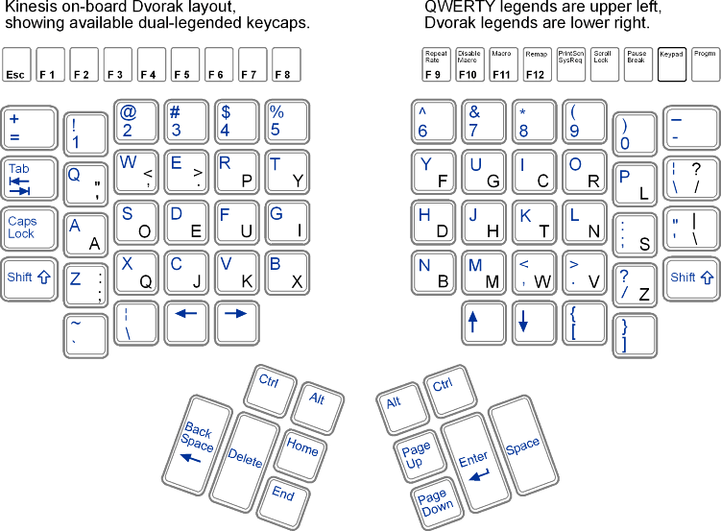
Y P
Swap
Dvorak
D, C, R
D C
R
Enter
Delete
I U
Page up
Delete
Swap
these 2
down
Home End
Cap Lock
Shift
Ctrl Ctrl
Alt Alt
“Smartly modified Dvorak in Kinesis”

