Slide 1
Winter term course on Chile
Diana Bowser and Thomas Bossert
Information Session
September 14, 2022

Slide 2
Health System, Primary Care for Covid-19, Protests, and Constitutional Reform
Chile has been an innovator in reforms of its health system and is now facing renewed need for reforms in the face of protests and Covid-19
Chile adopted positive policies in response to Covid-19, including the most effective vaccination campaign in the Americas.
Chile shocked the world with the unexpected “social explosion” in October 2019 which was followed by many social protest movements across the Americas. This led to a process for a new Constitution.

Slide 3
After two years of on-line courses, we are returning to in-person field visit course
Similar to the courses for previous years. This course will be limited to 15 students and will be assisted with a subsidy for flights and per diem and logistics for housing will be arranged by the Santiago office of Harvard’s David Rockefeller Center for Latin American Studies.
Up to 15 Chilean residents in Family Medicine from the Catholic University’s medical school will participate in all activities and collaborate with Harvard students on independent work of the last week.

Slide 4
Course topics
Health system innovations—targeted sessions on Innovative financing and payment
Primary Care and Family Medicine
Covid-19
Public Private Partnerships
Urban and rural services
Political context of health system including protests, legislative initiatives and constitutional reform

Slide 5
Innovations in Health System Policies
Chile has important innovations to study:
Health systems and health reform including innovations in payment systems similar to our DRG
Family medicine, public private partnerships; hospital and primary care services in both public and private sectors,
Public and Private Health Insurance and Universal Coverage
Universal Coverage with explicit benefits packages (AUGE or GES—Aceso Universal con Garantias Explicitas)
Politics of changing policies including a visit to the Congress in Valparaiso and meeting with the Health Commission members.
Notes:
Waiting lines, quality of care, drgs, payment;

Slide 6
Innovations in Implementing Policies
Public Private Partnerships (ANCORA clinics – now a Harvard Business School case)
How municipal governments manage the decentralized primary care systems in urban and rural settings.
Challenges around implementing DRGs
The challenges of implementing a “family medicine” approach in primary care clinics
The challenges of both public and private hospitals in Santiago
The challenges in rural health care in municipalities near Santiago if possible.

Slide 7
Protests

Slide 8
The Pandemic: Chile had one of the highest vaccination rates in the world

Slide 9
Interviews and Field Visits
We will have interviews with key officials:
The current Minister and other officials of Ministry of Health
Clinics and hospitals
Physicians and other clinicians
Health Economists
Academic and researchers from university programs
Field Visits to:
Congress in Valparaiso
Municipal governments
Public and private clinics and hospitals in urban and rural areas.

Slide 10
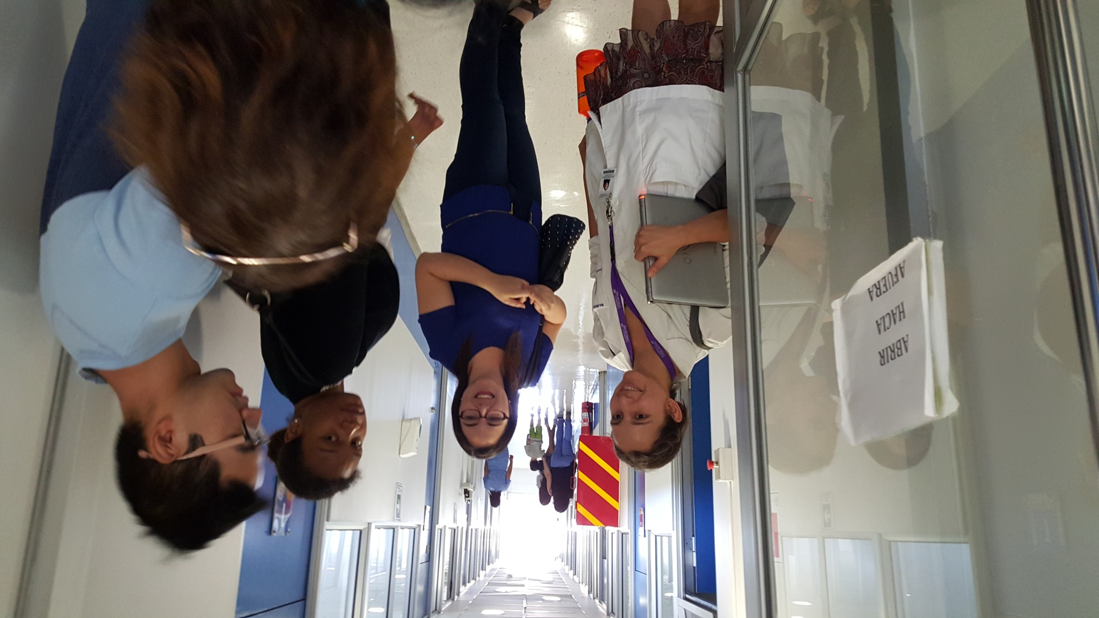

Slide 11
Recorded Panel Webinars
We will have access to several panel webinars with experts on Chile that the David Rockefeller Center for Latin American Studies in Santiago and the Petrie-Flom Center in Cambridge have organized on:
The political situation of protests and the Constitutional reform
The response to Covid-19 in Chile and other Latin American countries

Slide 12
Independent Projects or Practicums
One week of independent work individually or in groups (option of collaborating with Chilean Residents in Family Medicine)
Can be used for the practicum requirement for MPH or independent study
Many topics are available:
Social Determinants of Covid infection rates in Santiago
Impacts of COVID-19 pandemic on the cardiovascular mortality in Chile
Family medicine programs
Tobacco legislation
Recent legislation on abortion
Obesity problems and policies
Evaluation of public private partnerships
Politics of health policies
Decentralization and municipal services
Your special interest applied to Chilean reality

Slide 13
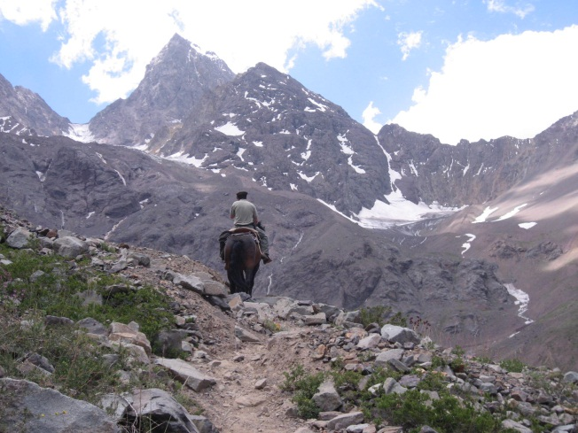
Summer in Winter Term
January in Chile is like July in US
Hiking in the Andes

Slide 14
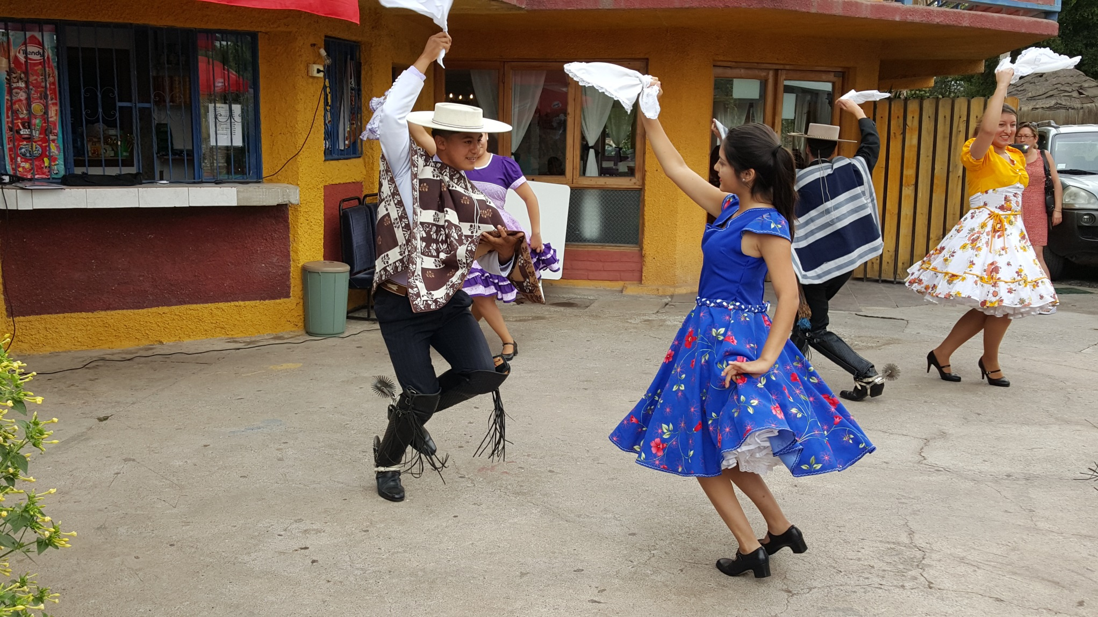

Slide 15
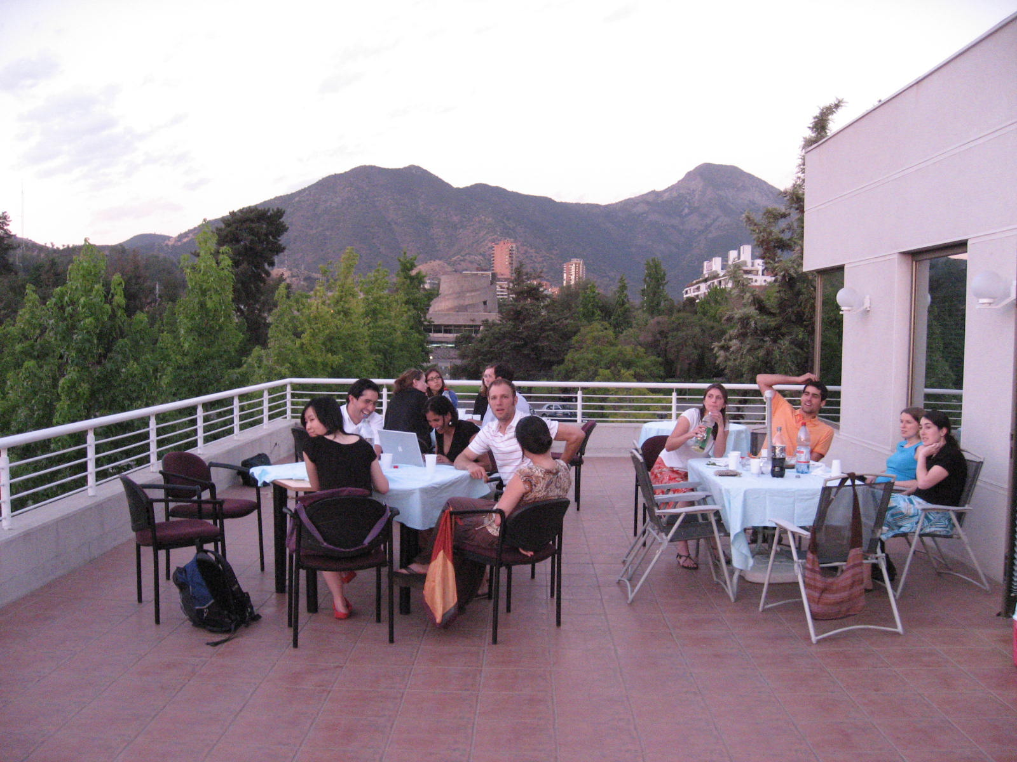

Slide 16
Spanish? Costs?
Spanish?
Not a requirement!
Many sessions are in English
Will try to have at least half the class with good Spanish to help in translation and will do sequential translations if needed.
Costs?
Flight – $1000 – 1300 (subsidized at about $200)
Hotel – @ $25-35/ night (2 sharing rooms) (subsidized at $100 per week)
Food – comparable to Boston
$300 deposit used for buses for long trips, one weekly dinner together, and gifts to people who help us a lot
Dates: January 2-18, 2023

