Slide 1
BONDED LABOR – _{A FORM OF MODERN SLAVERY}
By Krishna Aarti Reddy
Notes:
The most common form of slavery which is never heard.

Slide 2
OVERVIEW
INTRODUCTION
What is bonded labour?
Definitions and explanations by the Supreme Court
STATE OF WORKERS
Current Situation
Child labor
Modus operandi
SAFEGUARDS AVAILABLE TO THEM
Constitution
National bodies
International
REASONS FOR THEIR CURRENT SITUATION
POSSIBLE REMEDIES

Slide 3
INTRODUCTION
In consideration of an advance or economic benefit obtained by him or his lineal ascendants or descendants
In pursuance of any customary or social obligation,
In pursuance of an obligation devolving on him by succession
By reason of his birth in any particular caste or community, he forfeits his rights and freedoms
The Bonded Labour System (Abolition) Act, 1976 defines bonded labour system under section 2(g) of the act as the system of forced, or partly forced labour under which a debtor enters is meant to, and covers all of the many permutations of the bonded labor system in modern India.
Bonded labour is characterized by a relationship between employer and employee or accurately Master and Servant, through a loan. This system is deeply rooted in India’s diverse culture—a culture that is a product of class relations, a colonial history, and persistent poverty [National Commission for Human Rights Report, 2011 Keynote address]
Also known as debt bondage, bonded labor is a specific form of forced labour in which compulsion into servitude is derived from debt.

Slide 4
Beggar is an ancient caste-based obligation, a “form of forced labour under which a person is
compelled to work without receiving any remuneration”
(People’s Union for Democratic Rights v. Union of India [Asiad Workers’ Case], AIR 1982 S.C. 1473
“Other similar forms of forced labour” was interpreted expansively by the Supreme Court in 1982, when it ruled in the seminal Asiad Workers’ Case that both unpaid and paid labour were prohibited by Article 23, so long as the element of force or compulsion was present in the worker’s ongoing services to the employer.
Overt physical compulsion and compulsion under threat of legal sanction (as for example in the case of an allegedly unpaid debt
More subtle forms of compulsion, including “compulsion arising from hunger and poverty, want and destitution”
The Supreme Court provided a helpful rule for determining exactly what situations constitute forced labor.
“Where a person provides labour or service to another for remuneration which is less than minimum wage, the labour or service provided by him clearly falls within the scope and ambit of the word `forced labour’”
[People’s Union for Democratic Rights v. Union of India, (1982) 3 SCC 235 . All labor rewarded with less than the minimum wage, then, constitutes forced labor and violates the Constitution of India.
Notes:
150 rupees in Bihar to 361 rupees in Delhi

Slide 5
STATE OF THESE WORKERS
.
Bonded laborers are forced to work to repay debts their employer says they owe, they are forced to work exclusively for the employer and are coerced into staying and working.
Bonded labour in the farming sector is mostly due to caste- based prejudices practiced against the Dalit communities and due to the lack proper implementation of the land reform policy.
Proper implementation of Land reforms in few places like Kerala has resulted in the virtual elimination of bonded labour. Alas, this success is down ridden by the failure to implement these reforms especially in states of Gujarat, Uttar Pradesh, Bihar, Tamil Nadu and Karnataka where the feudal form of land ownership is still practiced.

Slide 6
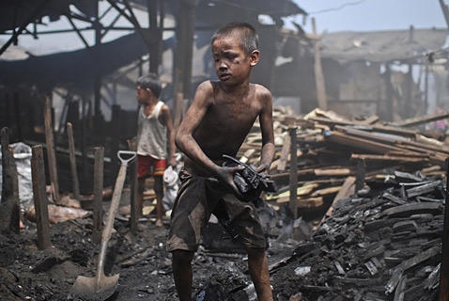
CHILD LABOUR
A large number of children employed as bonded laborers by the non-farming sectors like
-- small-scale textile,
-- Firecracker
--leather goods manufacturing
--brick kilns
--granite extraction units
Most are from the families who are subjected to distress migration from the rural villages.
In the cities, children from these families are employed as bonded laborers in restaurants and eateries or end up being employed as bonded beggars or fall prey to sex trade
Owing to lack of livelihood options, large number of rural population are forced to work for landlords and eventually end up in perpetual debt traps resulting in entire families and villages ending up as bonded to the landlord for generations.²
The absence of public health facilities and education opportunities force the rural population to search for employment opportunities and these people more often than not end up working either as bonded laborers or eventually migrate to urban areas seeking odd jobs. Their livelihoods further propel them into poverty and keep public health facilities and education opportunities out of their reach. This cycle continues.
Bonded labour is most prevalent in rural areas.
Characterized by a creditor-debtor relationship that a laborer often passes on to his family members, bonded labor is typically of an indefinite duration – stretching across generations of families and involves illegal contractual stipulations.
Bonded labor contracts in India are not only economic, as they are reinforced by custom or coercion in many sectors.
Child Labor
Source : Human Rights Watch Asia (1996), The Small Hands of Slavery: Bonded
Child Labor in India, Human Rights Watch.
Notes:
\

Slide 7
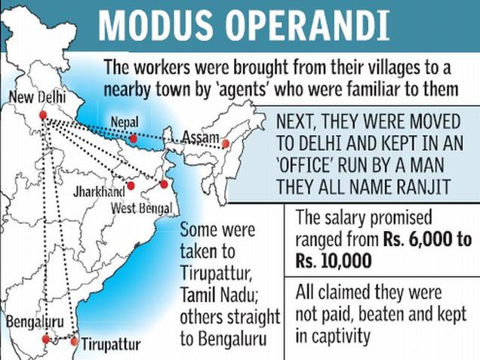
HOW IT WORKS – THE DEBT CYCLE
The 2015 raid on an agarbatti factory on the outskirts of Bengaluru in the Agarbatti Factory at Kaggalipura, in which 107 laborers were rescued, pointed to a deeper, more organized and structured trafficking network that runs much deeper than what this specific case reveals.
There are numerous ways by which people become bonded labor –
Inherit from ancestors – custom and tradition
Borrow for special needs in exchange for employment.
Source : The Hindu BENGALURU, June 2, 2015 Updated: June 2, 2015 10:06 IST

Slide 8
SAFEGUARDS AVAILABLE
the right of free movement,
the right to eat, sleep and work when one pleases,
the right to be free from inhuman and degrading treatment,
the right to integrity and dignity of the person,
Article 21 of the Constitution of India guarantees the right to life and liberty. The Indian Supreme Court has interpreted the right of liberty to include : the practice of bonded labor violates all of these constitutionally-mandated rights.
Article 23 of the constitution prohibits the practice of debt bondage and other forms of slavery both modern and ancient
Article 24 prohibits the employment of children in factories, mines, and other hazardous occupations. Together, Articles 23 and 24 are placed under the heading “Right against Exploitation,” one of India’s constitutionally-proclaimed fundamental rights.
Article 39 requires the state to “direct its policy toward securing” the rights of children vis-à-vis their health and their opportunity to develop themselves.

Slide 9
Bonded Labour System (Abolition) Act, 1976 purports to abolish all debt agreements and obligations arising out of India’s longstanding bonded labor system.
Child Labour (Prohibition and Regulation) Act, 1986 regulates the hours and conditions of work for child laborers, while prohibiting the employment of children in twenty-five hazardous industries. Loophole
Factories Act, 1948 strictly forbids the employment of children less than fourteen years old in factories.
Contract Labour (Regulation and Abolition) Act, 1970 regulates the use of contract labor and provides for its abolition in certain industries, at the discretion of the appropriate government (state or central).
Minimum Wages Act, 1948 sets the minimum wage for certain enumerated occupations and requires that overtime be paid to all workers who work beyond a “normal working day.”
Bonded Labour System (Abolition) Act, 1976
It frees all bonded laborers, cancels any outstanding debts against them,
Prohibits the creation of new bondage agreements
It also criminalizes all post-act attempts to compel a person to engage in bonded labor, with maximum penalties of three years in prison and a 2,000 rupee fine
Orders the economic rehabilitation of freed bonded laborers by the state.

Slide 10
Convention on the Suppression of Slave Trade and Slavery, 1926 requires signatories to “prevent and suppress the slave trade” and “to bring about, progressively and as soon as possible, the complete abolition of slavery in all its forms.” It also obligates parties to “take all necessary measures to prevent compulsory or forced labor from developing into conditions analogous to slavery”.
Supplementary Convention on the Abolition of Slavery, the Slave Trade, and Institutions and Practices Similar to Slavery entered into force, April 30, 1957 – debt bondage and child servitude.
Forced Labour Convention, 1930
The International Labour Organization (ILO) Forced Labour Convention requires signatories to “suppress the use of forced or compulsory labour in all its forms in the shortest period possible” In 1957, the ILO explicitly incorporated debt bondage and serfdom within its definition of forced and also passed the Abolition of Forced Labour Convention.
International Covenant on Civil and Political Rights (ICCPR), 1966
Article 8 of the ICCPR prohibits slavery and the slave trade in all their forms, servitude, and forced or compulsory labor. Article 24 entitles all children to “the right to such measures of protection as are required by his status as a minor, on the part of his family, society and the State”
International Covenant on Economic, Social and Cultural Rights (ICESCR), 1966
Article 7 of the ICESCR provides that States Parties shall “recognize the right of everyone to the enjoyment of just and favorable conditions of work.” Article 10 requires Parties to protect “children and young persons… from economic and social exploitation”
Notes:
\

Slide 11
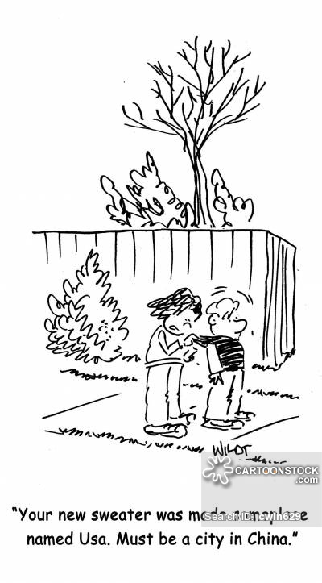
REASONS
ILLITERCY
LACK OF KNOWLEDGE OF EXISTING SAFEGUARDS
OPPORTUNITY COSTS
CUSTOM – BEEN HANDED DOWN SINCE GENERATIONS
PREVENTED FROM DOING SO
LACK OF ADMINISTRATIVE EFFICIENCY
LOOPHOLES IN PROVISIONS
According to Shantanu Dutta, director of national advocacy, International Justice Mission, the metamorphosis from a vestige of the traditional feudal agrarian system into a source for cheap labour in the age where profit maximization is the driving force has meant that bonded labour can be found in virtually every sector that has a large unorganized component: construction, gems and jewelry, mining and quarrying, carpet weaving, rice mills and sericulture, among others.

Slide 12
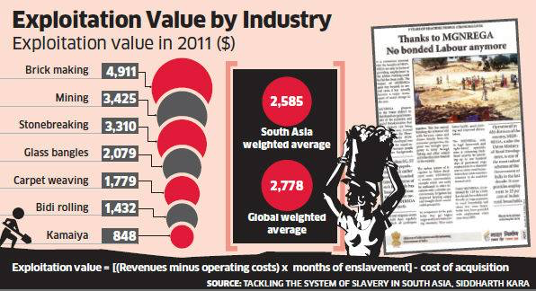
NEED OF THE HOUR
Surveys by civil society organizations and researchers show that even 37 years after Parliament passed the Bonded Labour System (Abolition) Act, 1976 - defining this practice, making it a criminal offence and freeing all bonded labours from their obligations - bonded labour exists in India. And the difference between government and non-government statistics goes back nearly as much.
Eradication of bonded laborers is not a one time event.
The financial assistance from the Government along with additional support mechanism to aid the released and asset less laborer.
STRICT IMPLEMENTATION OF LAWS AND POLICIES IN INDIA
Collaborating centrally Sponsored Scheme for rehabilitation of bonded laborers with other ongoing poverty alleviation schemes such as Swarna Jyanti Gram Swaraj Rozgar Yojana (SJGSRY), Special Component Plan for Scheduled Castes, Tribal Sub Plans, etc. [National Commission for Human rights Keynote address 2011]

Slide 13
Preventive efforts must recognize the social dimensions of bondage, and thereby address it through public sensitization and rights awareness, adult literacy, organizing workers, income generation and vocational skills development.
The strategies to eliminate bonded labour need to go beyond the surface and need to delve deep into the roots of this phenomena which dates back to beyond the colonial rule. There is a need for an integrated and long term strategy.
Collective Action and realization by the society.
NOT THIS !

Slide 14
Thank You

Slide 15
REFERENCES
Documents referred to :
National Commission for Human Rights Report, 2011 Keynote address
Human Rights Watch Asia (1996), The Small Hands of Slavery: Bonded Child Labor in India
Constitution of India
Acts and International Bodies :
The Bonded Labour System (Abolition) Act, 1976
Child Labour (Prohibition and Regulation) Act, 1986
Factories Act, 1948
Contract Labour (Regulation and Abolition) Act, 1970
Minimum Wages Act, 1948
Convention on the Suppression of Slave Trade and Slavery, 1926
International Covenant on Civil and Political Rights (ICCPR), 1966
International Covenant on Economic, Social and Cultural Rights (ICESCR), 1966

