Slide 1
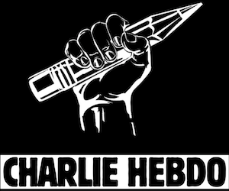
Freedom of Speech and Expression: A CHARLIE HEBDO Case Study
“A good cartoon is a punch in the face”
By Akshay Sharan
Notes:
START WITH FACT THAT WORST YEAR for European Union for TERRORISM (official)

Slide 2
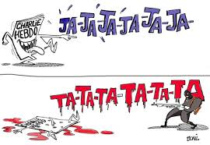
Overview
Definition of Freedom of Speech
Discussion of the Charlie Hebdo incident
Unprovoked Violence vs. Incitement of Violence
Freedom of Expression vs. Protection of religious sentiments

Slide 3
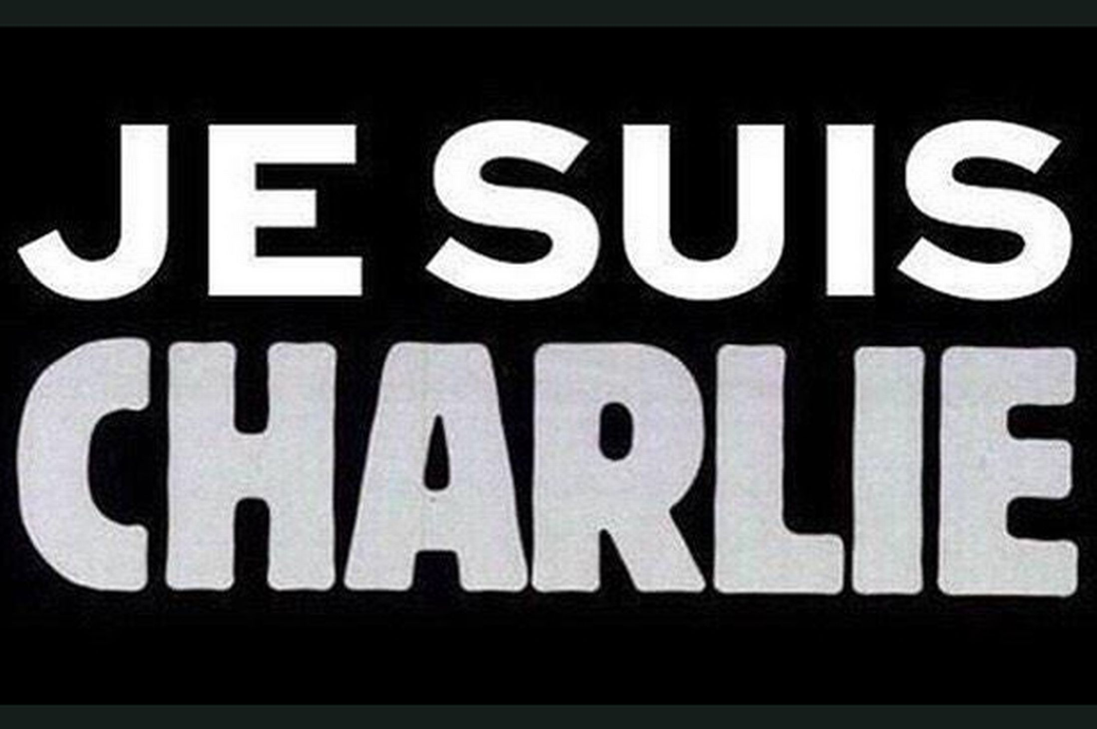
Freedom of Speech
As per Article 11 of the Declaration of Human and Civic Rights of 1789, which were based on the French Revolution, defines freedom of speech as;
The free communication of ideas and of opinions is one of the most precious rights of man. Any citizen may therefore speak, write and publish freely, except what is tantamount to the abuse of this liberty in the cases determined by Law.
Notes:
I will later expand on this definition in order to explain my views on the same

Slide 4
Charlie Hebdo
What? An organization which creates cartoons based on anything and everything around the world
Why? Because life is too short to take everything seriously!
Where? It is a French based weekly magazine which often came out with controversial cartoons mocking religious sentiments such as their series on the Prophet Muhammad
How? Using their right to freedom of expression, Charlie used cartoons by world famous cartoonists in their weekly magazine. They addressed issues currently plaguing the world as well as what they considered to be irrelevant.

Slide 5
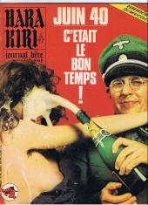
History
Charlie Hebdo had been an integral part of the French culture
The Idea of Charlie Hebdo had come up in 1960 (originally called Hara-Kiri Mensuel) but it got its name in 1970.
Founders of Charlie Hebdo included Charb, Wolinski, Reis, Cavana and more

Slide 6
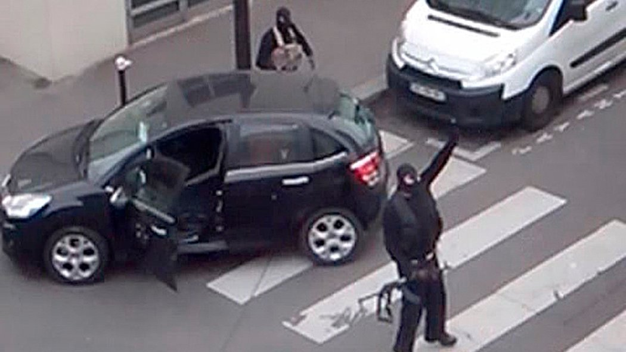
7th January 2015
Kouachi brothers (2) entered the office of Charlie Hebdo, called out the names of 5 artists; Charb, Wolinski, Tignous, Cabu and Honore and killed them
Further, 7 others were also killed in the attacks which was motivated by the idea to avenge the Prophet Muhammad
Notes:
Condemned by world leaders from USA, Italy, India, Germany, Russia and many more----Je suis Charlie emerged in support
Further, the attacks were condemned at a UN conference as well. (WORLDWIDE CONDEMNATION)
Almost like a retaliatory punch in the face by ISIS. The whole idea of a caliphate means that the caliph is a direct descendant of the Prophet. Thus, it was a direct attack in a way and thus they retaliated.

Slide 7
Unprovoked attack?
Many supporters of Charlie believe that they were only exercising their right to freedom of speech/expression
Thus, the attack is an attempt to instill fear in the minds of artists
Also, extremism/terrorism can never be justified
Despite repeated warnings of death threats to artists specifically Charb, the magazine continued to publish their offensive cartoons
Notes:
Right to speech but only if it doesn’t hurt others either mentally or physically
True, terrorism can never be justified but it cannot be stopped with a stubborn mindset. However, extremism is encouraged through cartoons as portrayed by Charlie Hebdo. Even non-extremists start hating such cultures and in turn becoming individuals with extremist mindsets

Slide 8
OR Incitement of Violence?
Despite criticisms from across the world the magazine continued to release controversial and offensive cartoons
Complete disrespect and no value for religion
No one is against cartoons based on humans but attacking someone a full religion worships is offensive
Attacks were expected. Charlie thus created a threat to national security

Slide 9
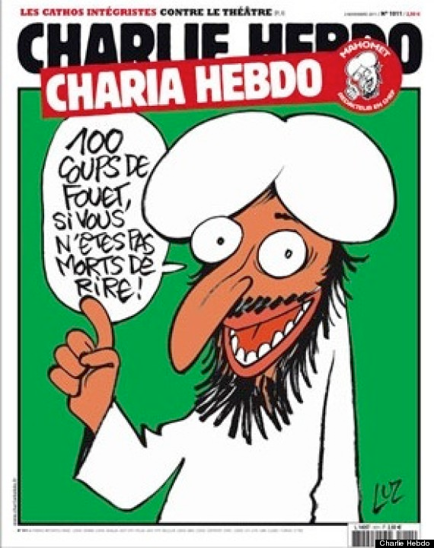
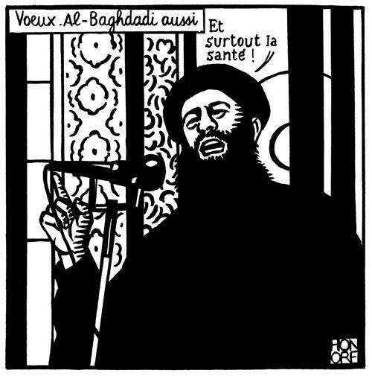
Notes:
100 lashes if you do not die laughing-CHARIA HEBDO
Best wishes and good health-Baghdadi

Slide 10
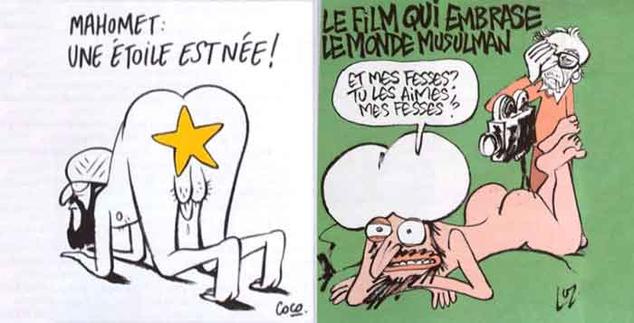
Notes:
“A star is born”
“The Film that will set the Muslim world on fire”-My ass? And you love it? My ass?

Slide 11
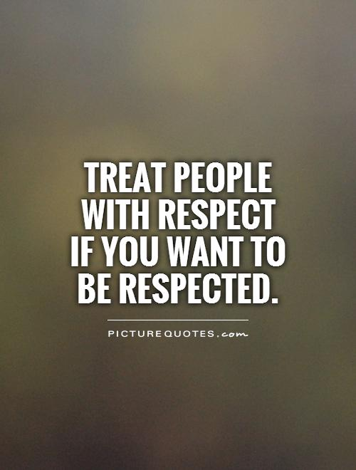
Freedom of Expression vs. Protection of Religious Sentiments
Freedom of Expression must have restrictions
Religious Sentiments must be respected. Mockery of Islam is considered to be blasphemous
This freedom was abused and turned to incitement
Notes:
Freedom should exist only till others are not hurt either mentally or physically
----The limit to law is the rights of others as well as national security (not kept in mind because after attacks also refused to stop what they do). Created public nuisance as well as disruption of public order (Hurst Hannum’s Lecture)
2. Respected in the sense may be comic but should not hurt anothers value system---Imagine a young kid seeing the cartoons of who he worships (mental effects)
Considered as blasphemy by Islam (Sharia law)
Lack of understanding or empathy---underestimating the effects on mental health

Slide 12
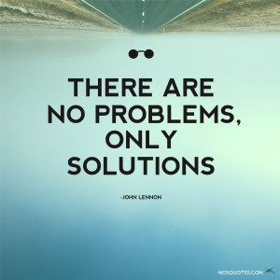
Questions which arise
Should Charlie Hebdo be held accountable for the attacks?
Should they pay for damages?
Were the attacks on Charlie Hebdo justified?
What is the ultimate solution to prevent the recurrence of such an incident?

Slide 13
Bibliography
http://www.un.org/en/ga/search/view_doc.asp?symbol=A/C.6/69/SR.28
http://www.un.org/apps/news/story.asp?NewsID=24725
http://www.ohchr.org/EN/Issues/Terrorism/Pages/SRTerrorismIndex.aspx
https://law.fiu.edu/charlie-hebdo-freedom-of-expression/
http://www.ohchr.org/EN/NewsEvents/Pages/DisplayNews.aspx?NewsID=15467
http://www.cnn.com/2015/01/07/world/france-magazine-attack-victims/
http://www.bbc.com/news/world-europe-30708237
https://charliehebdo.fr/en/history/
http://gawker.com/what-is-charlie-hebdo-and-why-a-mostly-complete-histo-1677959168
http://www.conseil-constitutionnel.fr/conseil-constitutionnel/root/bank_mm/anglais/cst2.pdf

Slide 14
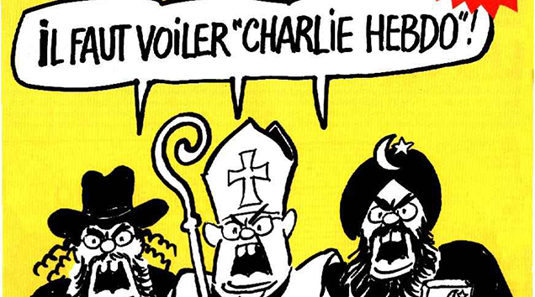
“Je suis Charlie mais Je ne suis pas Charlie”
Notes:
Veil Charlie Hebdo

