Slide 1
SUMMER SCHOOL ON HUMAN RIGHTS AND DEVELOPMENT
TUESDAY JULY 20th , 2016

Slide 2
Impact of Plastic Packaging on Right to Health in India
ASHIMA SINGH
JINDAL SCHOOL OF GOVERNMENT AND PUBLIC POLICY

Slide 3
OVERVIEW
Introduction
Health hazards
How to dispose plastic in a safe way?
Essential choices we need to make in life
Summary

Slide 4
INTRODUCTION
Plastic has made an easy access into our daily lifestyle.
Humans are suffering from cancer, birth defects, impaired immunity, etc. due to food being consumed in plastic containers.
If we wish to save ourselves from the potential health hazard in future then we need to dispose of plastic in a safe way.

Slide 6
HEALTH HAZARDS
Due to plastic’s carcinogenic properties, it is a great threat to human health.
It is advised not to give children plastic toys because they can suffer from birth defects.
Plastic has caused a lot of threat to human health due to its chemical composition.

Slide 7
The food wrapped in plastic is more likely to cause cancer than any other material.
Research has proved that plastic has injurious nature towards human health in direct or indirect ways.

Slide 8
How to dispose plastic ?
To counter plastic menace the scientists can try to develop certain types of bacteria which can degrade plastic into bio - friendly compound.

Slide 9
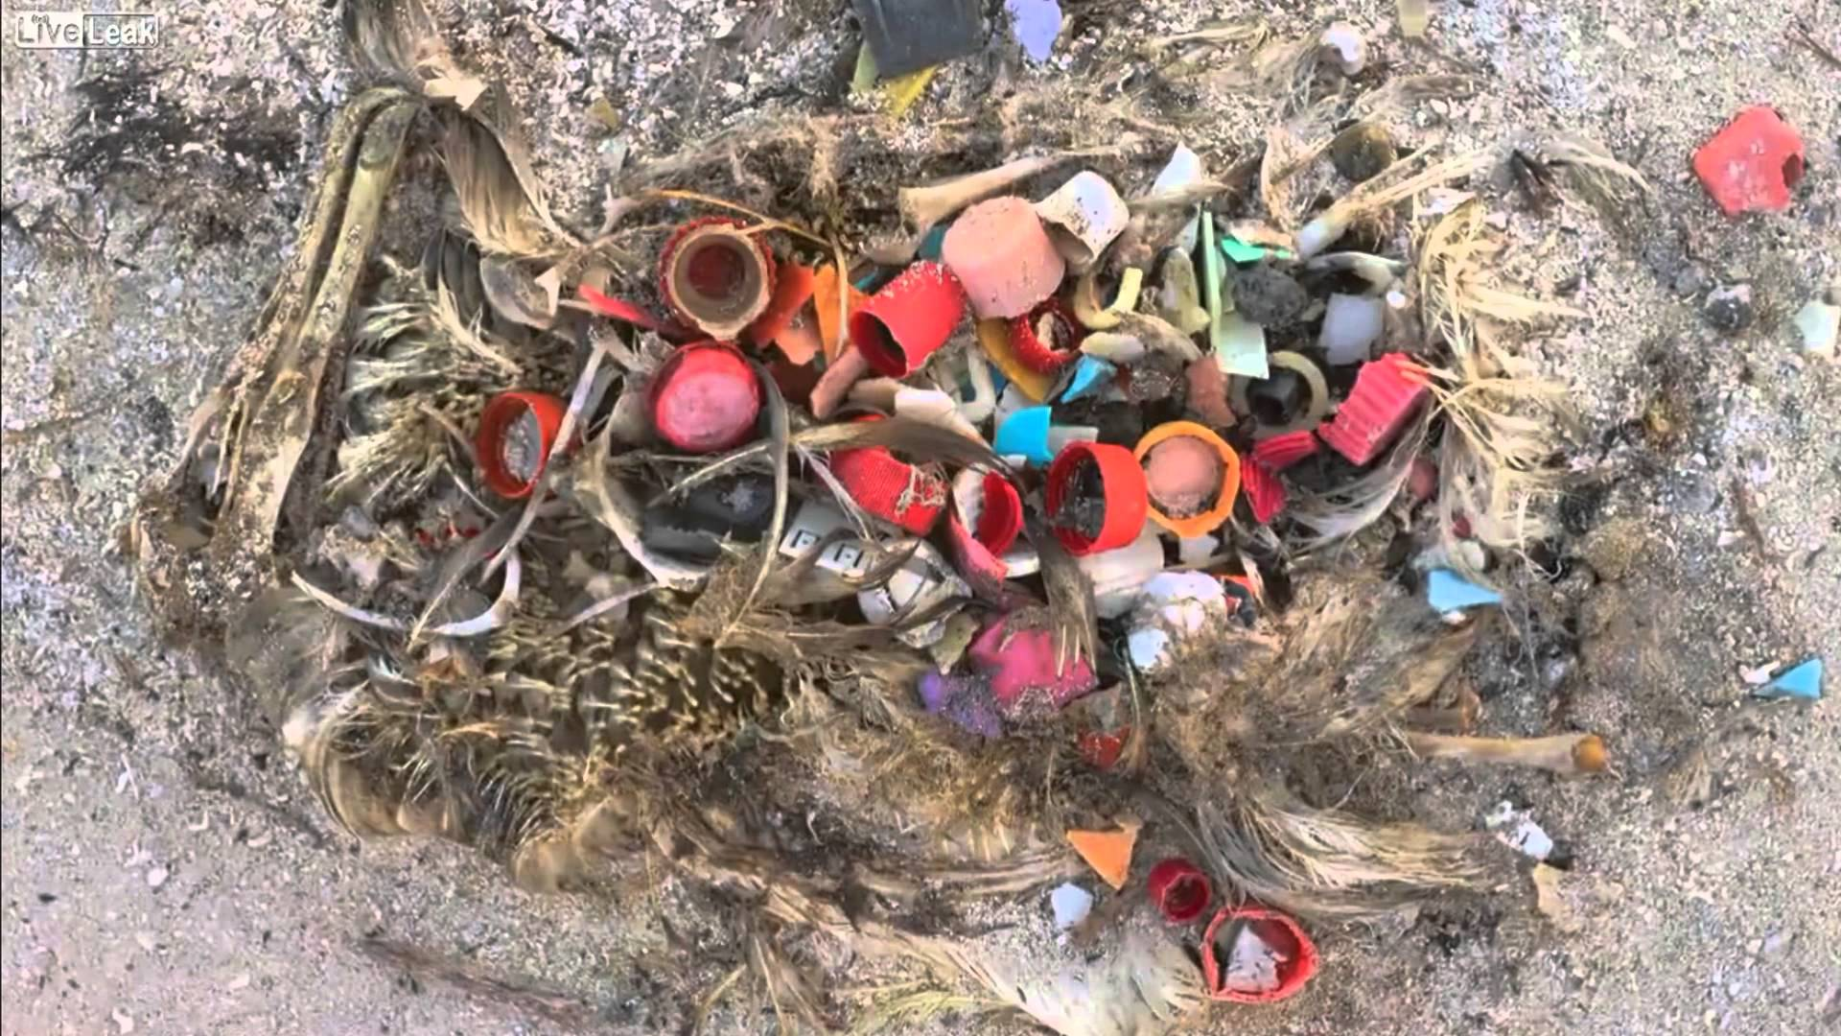
A PREVIEW OF MIDWAY
https://www.youtube.com/watch?v=PLkTTJW4xZs

Slide 10
ESSENTIAL CHOICES WE NEED TO MAKE IN LIFE
To restrain and rethink our choices.
It is imperative to change our lifestyle.
The lifestyle has been affecting us and the environment due to excessive use of plastic.
Plastic always had a negative consequence on human health and the environment.
The right choice we can make is to avoid and reduce plastic consumption.

Slide 11
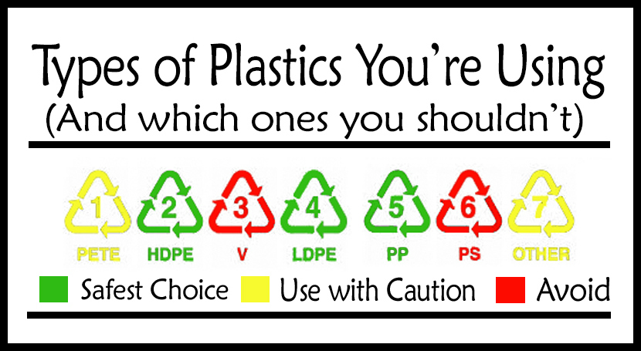

Slide 13
If we really want to improve the health conditions in India and around the world.
The 5 R’s of sustainable living need to be applied
Reuse
Refuse
Recycle
Reduce
Rebuy
The most essential ones are now added in the list which are restrain and rethink your choices, else it will be too late.

Slide 14
REFERENCES
Ecology Center, ‘Adverse Health Effects of Plastics’ http://ecologycenter.org/factsheets/adverse-health-effects-of-plastics/
Accessed date: 20th July 2016

Slide 15
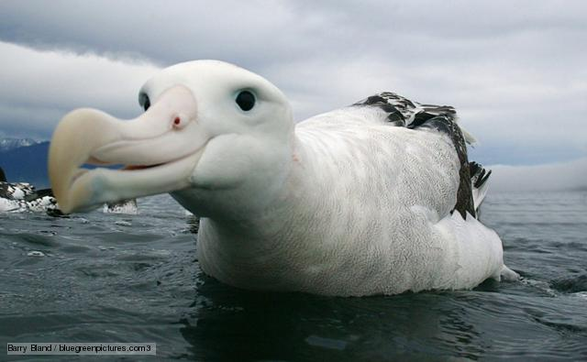
THANK YOU

