Slide 1
What is the best model for achieving human rights in a developing state?
ECONOMIC DEVELOPMENT vs SOCIAL DEVELOPMENT

Slide 2
What is Development?
Human development refers to the biological and psychological development of the human being throughout the lifespan. It consists of the development from infancy, childhood, and adolescence to adulthood.
Then what does State Development mean?

Slide 3
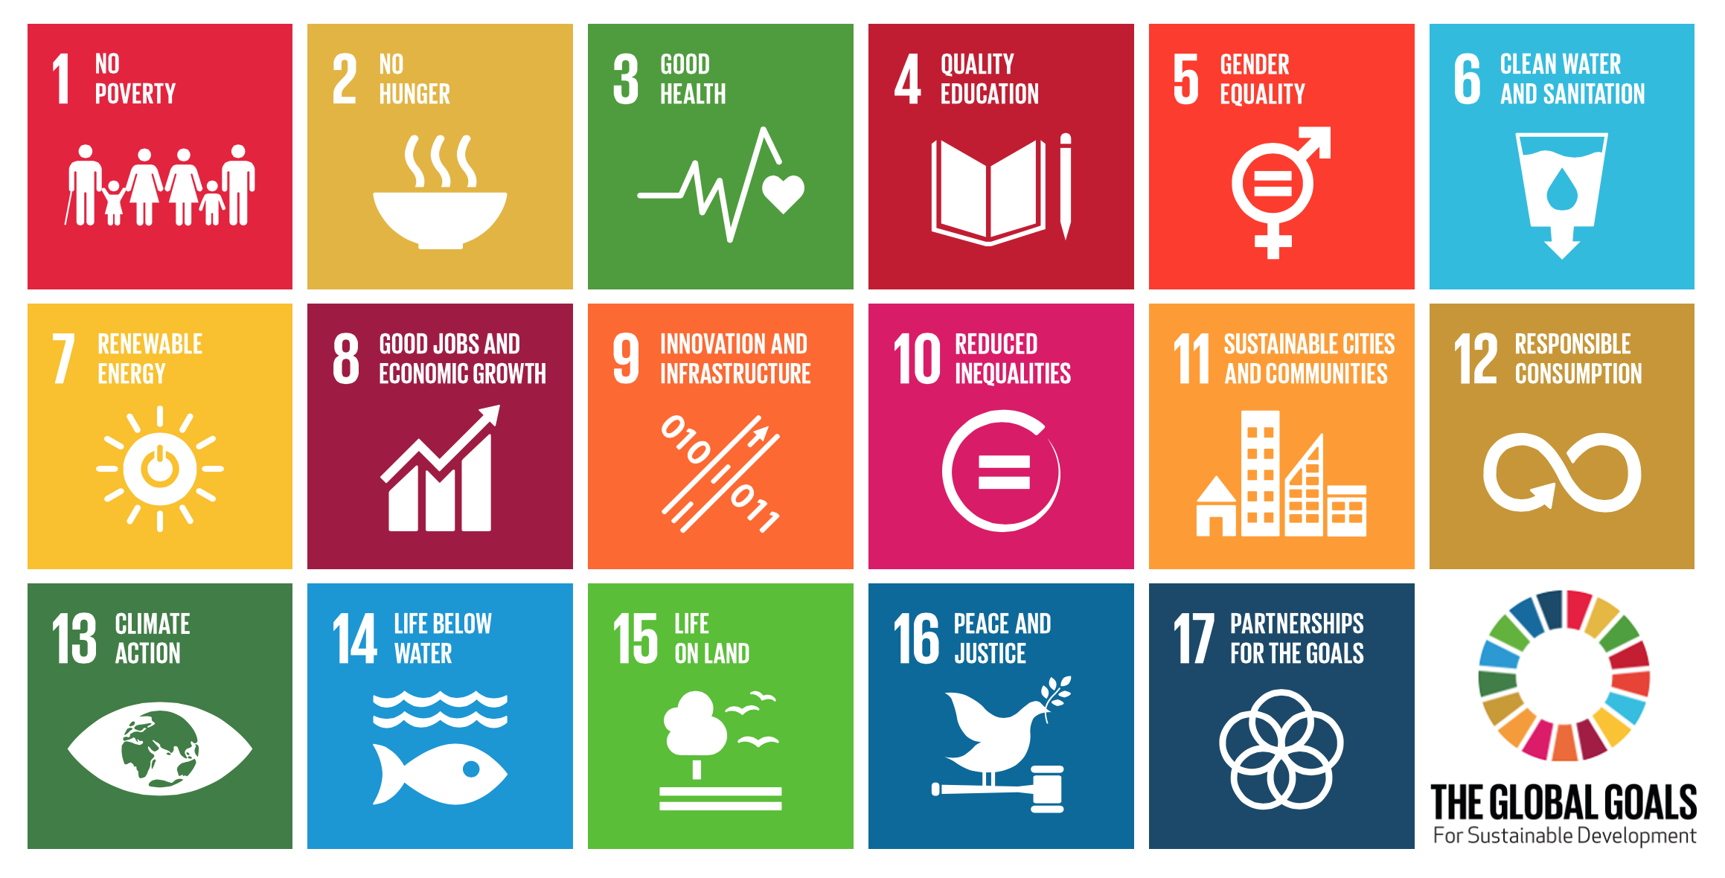
The sustainable development goals

Slide 4
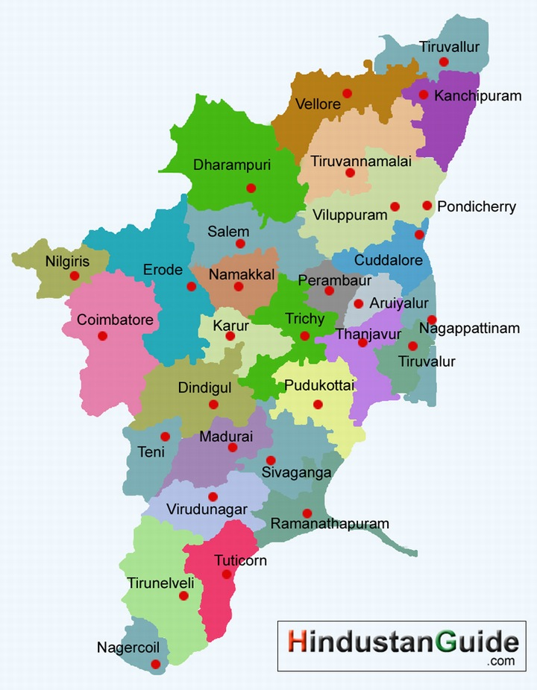
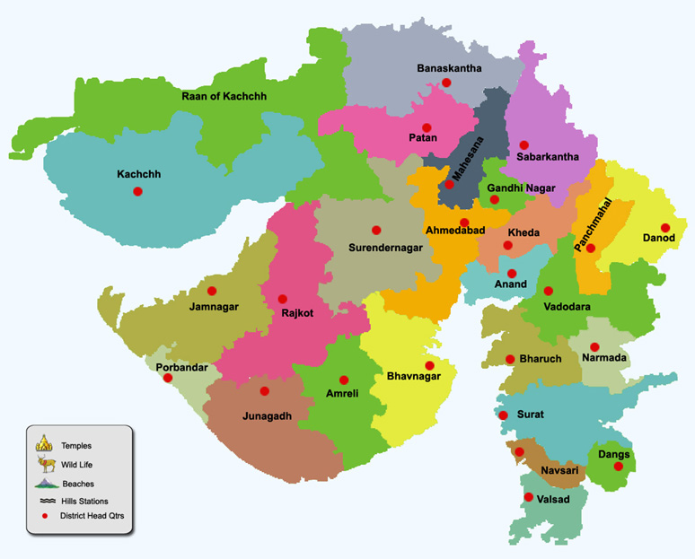
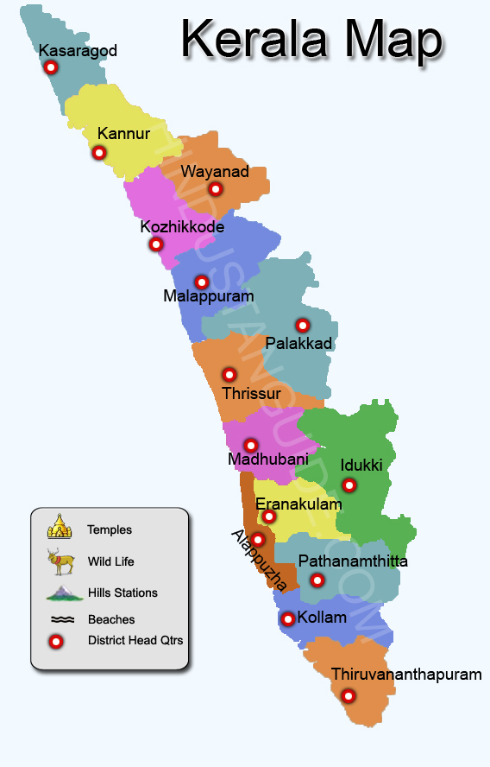
Tamil-Nadu/Gujrat/Kerala

Slide 6
Gujrat vs kerala
JAGDISH BHAGWATI
AMARTYA SEN
The policies need to focus on growth, resources can be generated which can then be invested in social sector schemes - health, education & so on. Initially growth may raise inequalities. However a sustained growth will raise enough resources for the State to redistribute and reduce the ill effects of the initial inequality
India should invest more in social infrastructure to increase productivity of its people & thus raise growth. Investing in health & education will improve human capabilities. Unhealthy & uneducated labour cannot produce memorable growth rates. Without such investments inequalities will widen & the growth process will eventually falter.

Slide 7
Tamil-nadu’s model trumps Gujrat’s and kerala’s model
Economic Development
Increase in investment in automotive Industry.
Textile Industry.
Promotion and investment in renewable energy.
Social Development
Fair distribution of wealth between the rich and poor.
Welfare schemes and programmes to increase literacy.
Increase in employment opportunities for minorities.

Slide 8
Causes of economic development
TEXTILE INDUSTRY
Largest textile hub of India.
Provides direct employment to an estimated 35 million people, and thereby contributing 4% of GDP and 35% of gross export earnings.
Contributes to 14% of the manufacturing sector in India.
TOURISM
In 2010, emerged as one of the leading tourist destinations.
Annual growth rate of industry is 16%, which was heighest amoung all the other states until 2010

Slide 9
causes of social development
KARUNANIDHI’S EXPERIMENTS WITH RESERVATIONS
Extra marks for those who didn’t have a graduate in the family (1990)
Reservation for Muslims out of the backward class reservation (2007)
Pro-Dalit stance by increasing reservation. (!971)
KAMRAJ’S MID DAY MEAL
Expanded the reach of free education across the state by providing free lunch. Indirectly resolving food scarcity issues.

Slide 10
conclusion
The Tamil-Nadu model is a successful example of appropriate economic policies that are expressively inclusive of social development. On the Economic front, the model focuses on “rate of change” rather than “level” of change. Whereas, on the social front, the model focuses of removing inequalities by providing free education and through positive discrimination.

