Slide 1
European Refugee Crisis
Gargi Katikithala

Slide 2
Who is a Refugee?
“Article 1(A)(2) of the 1951 Convention defines a refugee as an individual who is outside his or her country of nationality or habitual residence who is unable or unwilling to return due to a well-founded fear of persecution based on his or her race, religion, nationality, political opinion, or membership in a particular social group”

Slide 3
What Rights Do Refugees Have?
NON-REFOULEMENT – “Obligation of States not to refoule, or return, a refugee to “the frontiers of territories where his life or freedom would be threatened on account of his race, religion, nationality, membership of a particular social group or political opinion.”
“1951 Convention Art. 33(1). Non-refoulement is universally acknowledged as a human right. It is expressly stated in human rights treaties such as Article 3 of the Convention against Torture and Article 22(8) of the American Convention on Human Rights. ”
FREEDOM OF MOVEMENT – “ICCPR, art. 12. Article 26 of the 1951 Convention provides that States shall afford refugees the right to choose their place of residence within the territory and to move freely within the State. Meanwhile, Article 28 obliges States Parties to issue refugees travel documents permitting them to travel outside the State “unless compelling reasons of national security or public order otherwise require.”

Slide 4
RIGHT TO LIBERTY AND SECURITY OF THE PERSON – A number of judgements from the ECHR reinforce the same idea
RIGHT TO FAMILY LIFE – A.23 ICCPR – “natural and fundamental group unit of society and is entitled to protection by society and the State.”
RIGHT TO EDUCATION
ACCESS TO JUSTICE - A.16,
RIGHT TO EMPLOYMENT – A.17
RIGHT TO FAMILY LIFE – A. 23
Other privileges similarly enshrined in international and regional human rights treaties

Slide 5
IS THE 1951 REFUGEE CONVENTION COMPREHENSIVE?
“Initially, Convention was limited to protecting mainly European refugees in the aftermath of World War II, but another document, the 1967 Protocol, expanded the scope of the Convention as the problem of displacement spread around the world”

Slide 6
CAUSE FOR CRISIS
Civil war in Syria - stemming from Arab spring protests
Therefore a large scale exodus towards Europe – Motivated by the success stories

Slide 7
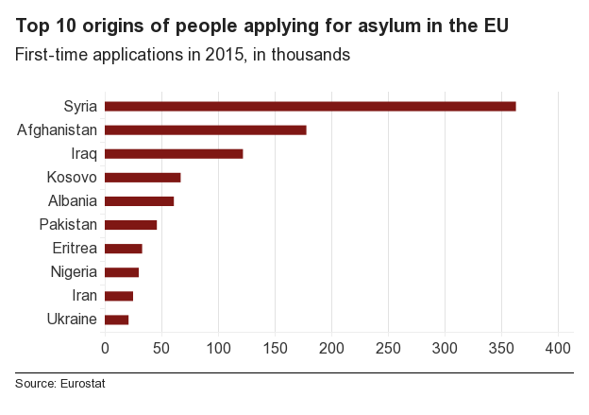

Slide 8
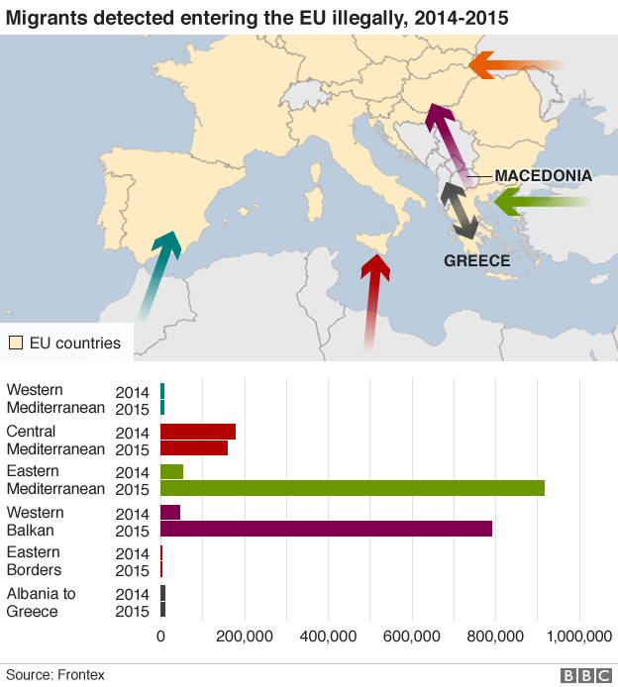

Slide 9
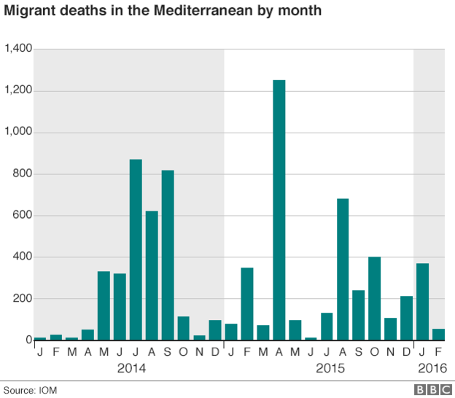

Slide 10
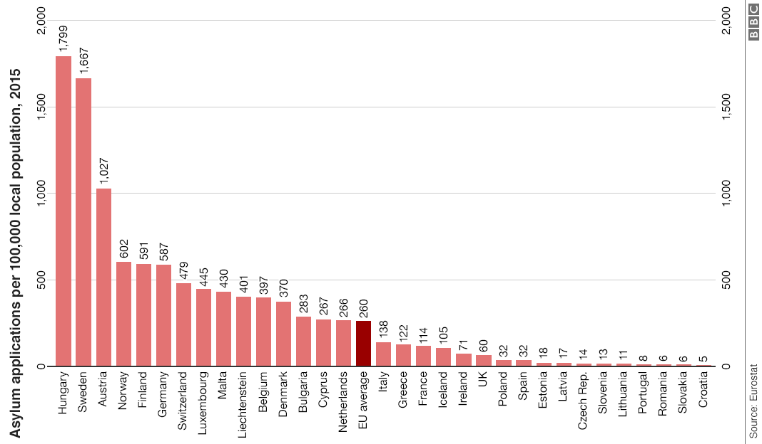

Slide 11
The Refugee Crisis in Europe is a Result of?
Unpresented Global Displacement
Overstretched Host countries
Policies which prevent safe and Legal access to the territory of the EU Member states.

Slide 12
Europe’s Response
“In 2015, EU countries offered asylum to 292,540 refugees. In the same year, more than a million migrants applied for asylum - although applying for asylum can be a lengthy procedure so many of those given refugee status may have applied in previous years.”
Hungary and Serbia on the other hand, have made a 4 meter high fence along its entire109 mile border to force migrants/refugees west into Croatia.

Slide 13
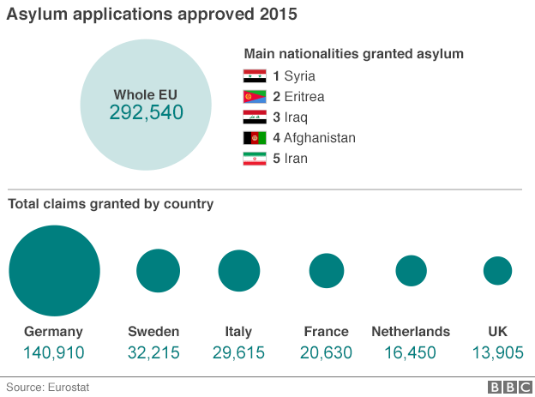
How many asylum claims are approved?

Slide 14
What is the Refugee resettlement like?
The EU has sought to develop a common immigration and asylum policy
However, national sovereignty concerns and sensitivities about minorities, integration, and identity.
Financial difficulties in some EU countries, including Italy and Greece, and the growing popularity of anti-immigrant political parties throughout Europe have also constrained the responses of some European governments to the ongoing crisis.

Slide 15
EU FAILED?
Yes, The resurgence of racism and xenophobia. (https://www.youtube.com/watch?v=RvOnXh3NN9wfrom 3:20)

Slide 16
Ok so is the ICRC Helping?
In Syria, during 2015, the ICRC and SARC provided:
food to 4.7 million people,
clean water for 16 million (almost the entire population),
health care for 32,000 displaced people,
hygiene kits (soap, blankets, towels, etc.) to 800,000 people,
learning supplies to over 19,000 children displaced by the fighting.
They also received 1,000 tracing requests from people seeking to locate their relatives.

Slide 17
Sources
http://www.ohchr.org/Documents/Publications/FactSheet20en.pdf
https://www.hrw.org/topic/refugees
http://www.ijrcenter.org/refugee-law/
http://www.unrefugees.org/what-is-a-refugee/
https://politicalviolenceataglance.org/tag/refugees/
http://www.encyclopedia.com/topic/refugee.aspx
http://www.bbc.com/news/world-europe-34131911
http://sputniknews.com/europe/20150914/1026973067/Europe-Schengen-borders-refugees.html
https://fas.org/sgp/crs/row/IF10259.pdf
http://intercrossblog.icrc.org/blog/migrant-refugee-crisis-how-the-red-cross-red-crescent-is-responding

