Slide 1
Human Rights Violations in Palestine Occupied Territory of Gaza
Lubhawna Choudhary
B.A.LL.B.
Jindal Global Law School
An analysis of the Special Rapporteur’s Reports

Slide 2
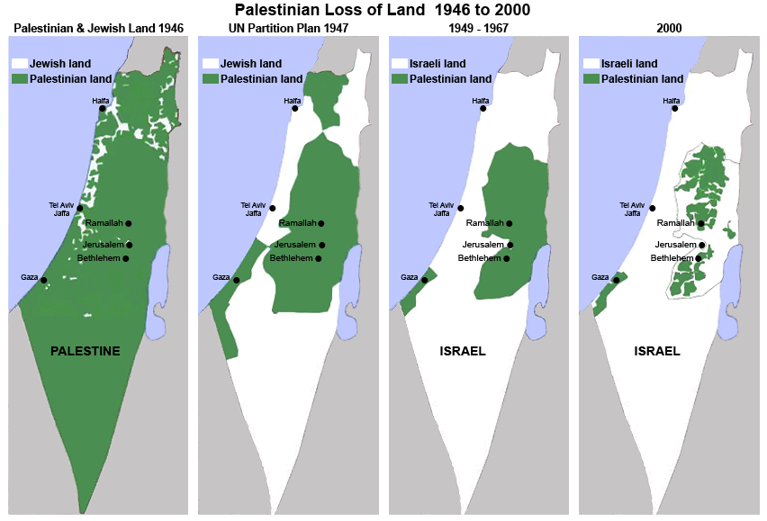
Evolution of the conflict
Source: www.vtjp.org

Slide 3
Different Approaches of Study
International Humanitarian Law
UN’s General Assembly Resolutions
General Comments
Special Procedures by the UNHRC

Slide 4
Special Procedures
Independent HR experts – Individual or Group
Undertake thematic studies and country visits
Submit reports annually to the HRC and majority of the mandates report to the General Assembly.

Slide 5
“Palestine” instead of “Occupied Palestine Territories”.
One of the recommendations made:
“The Human Rights Council appoint an expert group to propose a special protocol to the Fourth Geneva Convention with the specific purpose of proposing a legal regime for any occupation that lasts for more than five years.”

Slide 6
Special Rapportuer denied access to the Occupied Palestinian Territory – held video and telephone conferences.
Infringement of Right to life and Right to Meaningful development.

Slide 7
Further observations of the Report
Palestinian people in perpetual state of humanitarian crisis with 80% of the population dependant on aid.
Operation “Protective Edge” (7 July 2014 – 26 August 2014)
2,256 fatalities of which 1,563 were civilians including 538 children.¹
¹See Office for the Coordination of Humanitarian Assistance, Gaza Strip, Humanitarian Dashboard, November 2014.

Slide 8
Israel denied access to the Special Rapportuer.
Palestinians – “protected people” under Geneva Convention 4.
Highlights the disconnect between the rights and protections of the Palestinian people available under IHL and the ‘actual’ protection.

Slide 9
Further Observations of the Report
In October and November 2015
In Palestine : 100 dead and 11,300 injured
In Israel : 17 dead and 170 injured
72 year old woman killed on 6 November 2015.¹
Israel Official : “It’s illegal to fire on suspects who don’t pose threat”.²
Blockade in Gaza
Kept in the state of de-development.
Affect on HRs especially Right to freedom of movement and Right to adequate standard of living.
¹ Times of Israel, “Elderly Palestinian woman tries to run over soldiers near Hebron”, 6 November 2015.
² Times of Israel, “A-G: It’s illegal to fire on suspects who don’t pose threat”, 26 October 2015.

Slide 10
Conclusion
Addressing the disconnect between the existence of rights and the realization of rights of the Palestinian people.
Special procedures as a voluntary practice.
Importance of language.
Legal authority

Slide 11
References
http://www.ohchr.org/EN/HRBodies/SP/Pages/Introduction.aspx
https://documents-dds-ny.un.org/doc/UNDOC/GEN/G14/101/98/PDF/G1410198.pdf?OpenElement
https://documents-dds-ny.un.org/doc/UNDOC/GEN/G15/008/27/PDF/G1500827.pdf?OpenElement
https://documents-dds-ny.un.org/doc/UNDOC/GEN/G16/003/69/PDF/G1600369.pdf?OpenElement

