Slide 1
ROLE OF WOMEN COMBATANTS
IN GLOBAL TERRORISM
CASE STUDY : BOKO HARAM
BY : SAUMYA MODI

Slide 2
What is Boko Haram?
Boko Haram is an Islamic extremist group originated from north eastern Nigeria, also active in Chad, Niger and Cameroon.
Boko Haram began a military campaign to impose Islamist rule in northern Nigeria in 2009.
It has killed 20,000 and displaced 2.3 million from their homes and was ranked as the world's deadliest terror group by the Global Terrorism Index in 2015.
Boko Haram seeks the establishment of an Islamic state in Nigeria. It opposes the Westernization of Nigerian society and the concentration of the wealth of the country among members of a small political elite, mainly in the Christian south of the country.
Boko Haram has used at least 105 women and girls in suicide attacks since June 2014

Slide 3
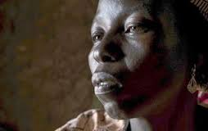
RAHILA AMOS

Slide 4
Rahila Amos, a Nigerian grandmother, was abducted by Boko Haram and forced to take classes on how to carry out a suicide bombing. Source: Tyler Hicks/The New York Times “Hold the bomb under your armpit to keep it steady “ “If you cut from the back of the neck, they die faster,” “I don’t want to take a bomb,” she cried

Slide 5
Boko Harams’s abuse of women
Stormed into a school in Nigeria and fled with about 300 girls (2014)
Women and girls abducted, imprisoned, threatened and starved
Forceful enrolment in Boko Haram’s classes on its version of Islam, a first step on her way toward being taught the art of suicide bombing. ( brainwash)
A major number of female rape cases
Females impregnated
Females used as human shield
The major goal is of creating a new generation of fighters
Depictions of the funeral rites performed before female bombers were sent on missions.

Slide 6
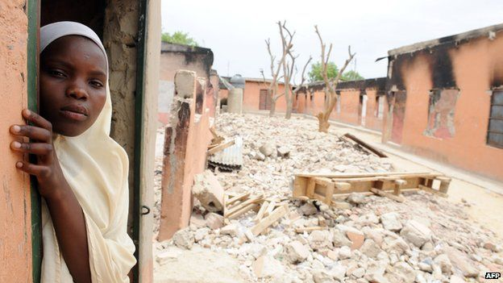
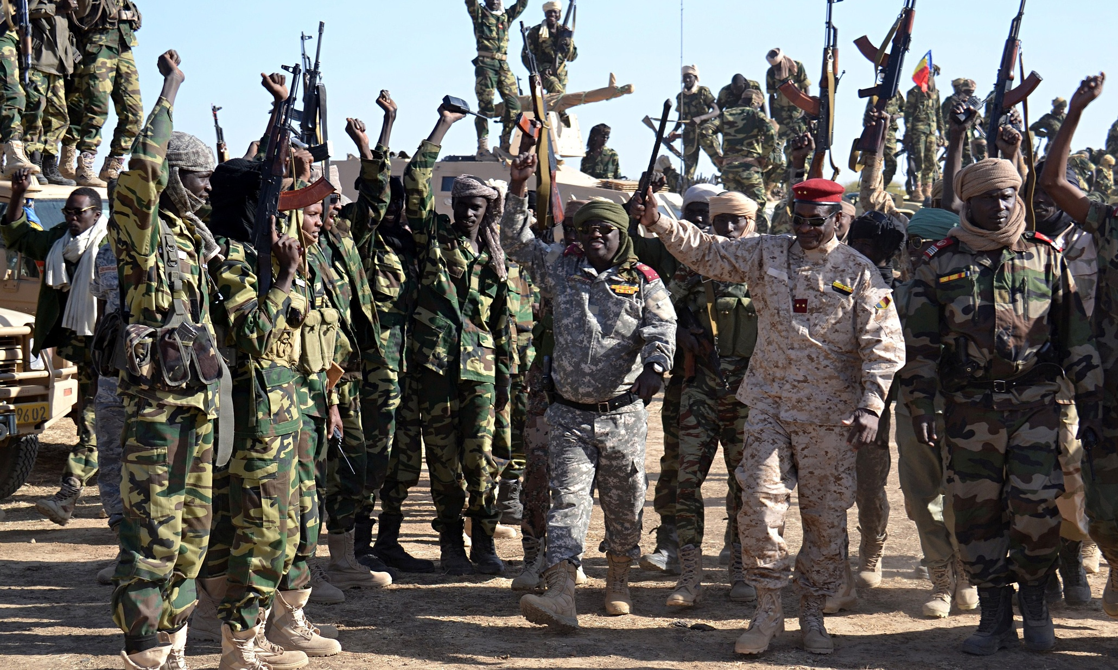
In November, elusive Boko Haram leader Abubakar Shekau released a video gloating that he’d married off the Chibok schoolgirls to fighters.

Slide 7
VIDEO

Slide 8
Incidents
Woman dressed as a man set off her explosives during morning prayers in a village in northeastern Nigeria. Another woman was waiting outside the mosque, and as people fled the first blast, she detonated her own explosives as well.
4 girls sent to a market place, where 2 of them exploded themselves into a public bathroom and the other 2 exploded themselves in the open market.
In northeastern Nigeria in February, three girls with bombs were sent into a camp for Nigerians fleeing Boko Haram. Two of the girls detonated their bombs, killing nearly 60 people there.

Slide 9
Why females ? - Perception that women are weaker, women are the gentler sex
Women generate less suspicion than men, and so can move closer to the target without as much opposition.
They can slip past security professionals without receiving the same level of scrutiny. - Substantial cultural barriers to physically searching or, in some cases, even looking at women. - A long hijab can conceal explosives and strict standards of morality make it difficult for law enforcement officers to search female suspects.
Organizations have used female suicide bombers to generate media attention, to promote their cause, and bolster recruiting.

Slide 10
The University of Chicago’s Project On Security and Terrorism recently opened its database chronicling attacks from 1982 to 2015 - 2015 -: 32 attacks - 2014 -: 16 attacks - 2013 -: 6 attacks In 2015, female attacks were responsible for 444 deaths
In 2014, 174 deaths in 2013, 51 deaths compared to 174 in 2014 and 51 in 2013.

Slide 11
Relation with Human Rights
- Crimes against humanity committed by Boko Haram, includes murder, torture, rapes, forced marriages and the recruitment of involuntary female soldiers.
Nigeria is a member of the UN.
Gender Based Violence is defined by the UN as ‘physical, sexual or mental harm or suffering to women, including threats of such acts, coercion or arbitrary deprivation of liberty, whether occurring in public or in private life’ (World Health Organization).

Slide 12
Recommendation - Preventive measures for counterterrorism should be implemented with gender in mind, and religious leaders and female advocates should be deployed in educational programs. A lot of women aren’t even literate in their own religion. Women have struggled with representation in the political sphere in Nigeria.

Slide 13
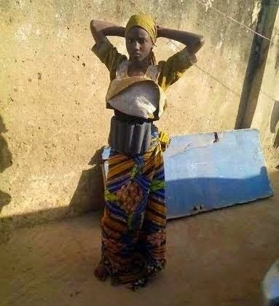

Slide 14
THANK YOU
Saumya Modi

Slide 15
References: 1. "Female Suicide Bomber". Wikipedia. N.p., 2016. Web. 20 July 2016.
2. "Strategic Studies Institute (SSI) | US Army War College". Strategicstudiesinstitute.army.mil. N.p., 2016. Web. 20 July 2016. 3. "Boko Haram". Wikipedia. N.p., 2016. Web. 20 July 2016. 4. “Boko-haram-suicide-bombers”. Nytimes. N.p., 2016. Web. 20 July 2016 5. Zenn, Jacob and Elizabeth Pearson. "Women, Gender And The Evolving Tactics Of Boko Haram". Journal of Terrorism Research 5.1 (2014): n. pag. Web. 20 July 2016. 6. "Abandon Weeping For Weapons By Lucy Frazier". Nyu.edu. N.p., 2016. Web. 20 July 2016. 7. "Women2000". Un.org. N.p., 2016. Web. 20 July 2016. 8. Rue, Jonathan. "Women In A War Zone: Combating The Military's Epidemic Of Sexual Violence | Jonathan Rue". the Guardian. N.p., 2013. Web. 20 July 2016.

