Slide 1
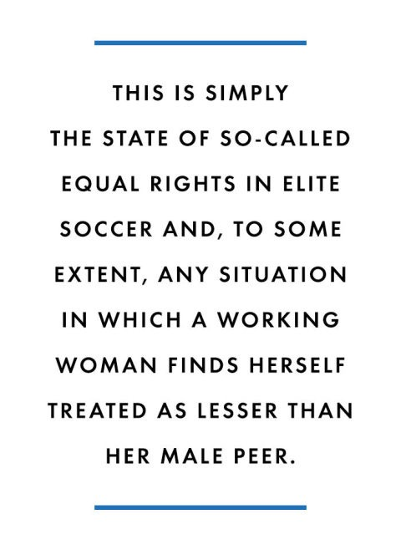
Human rights and football
Gender discrimination in the sport.
- Shivangini Kothari

Slide 2
FIFA and human rights
Article 3 of the FIFA Statutes ( April 2016 Edition) - FIFA is committed to respecting all internally recognised human rights and shall strive to promote the protection of these rights
Article 4 of the FIFA Statutes ( April 2016 Edition) - Discrimination of any kind against a country, private person or group of people on account of race, skin color, ethnic, national or social origin, gender, disability, language, religion, political opinion or any other opinion, wealth, birth or any other status, sexual orientation or any other reason is strictly prohibited and punishable by suspension or expulsion.

Slide 3
Discrimination on the basis of gender
The U.S. team’s 5-2 triumph in the Women’s World Cup soccer final Sunday – has reignited the long-running debate about inequality in women’s sports. That debate started on the field itself. As NBC News reported, the international soccer body, FIFA, not only declined to tweet about the women’s event from its usual World Cup account, “it then sent out 10 women in tight black dresses to escort a Mountie with the trophy after the match.”
The debate has been long running considering how the state of affairs is when it comes to women football.

Slide 4
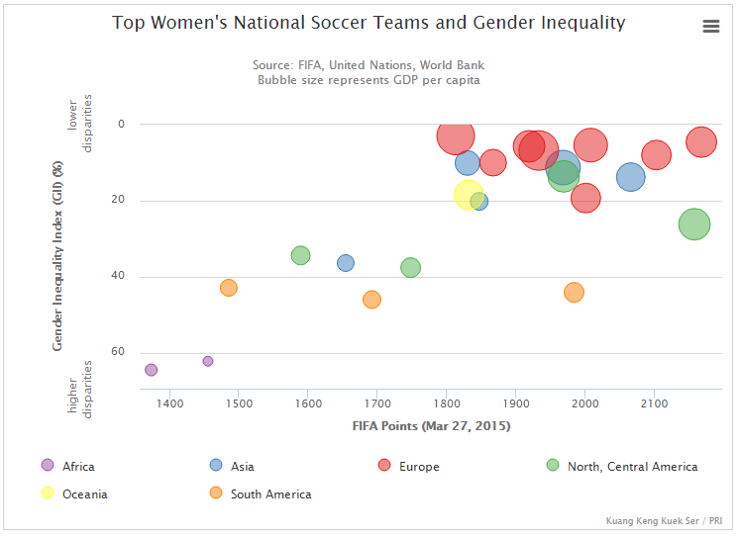

Slide 5
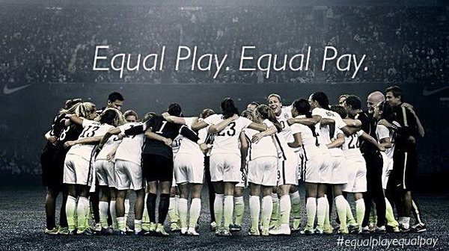
Pay gap
There is a considerable pay gap between the men’s and women’s games. The top female player at the moment, the Brazilian striker Marta Vieira da Silva, playing in Sweden, earns an estimated 3, 000 GBP/week. This contrasts with the weekly salary of Premiere League stars, where the record so far is 135, 000 GBP per week.
The $2 million the women won this year created a furor when compared to last year’s German men’s team purse of $35 million. Pay differences extend to coaching as well. U.S. national women’s coach Jill Ellis makes $185,000-$210,000 annually, a not-so-subtle difference of less than 10% of the $2.5 million men’s coach Joachim Loew makes.

Slide 6
Media attention to women football
The largest sporting audience ever for a women’s event was the 90,000 spectators who watched the 1999 Women’s World Cup final between the USA and China; in contrast, in contrast the 2006 FIFA Men’s World Cup final was watched by 15.1 million individuals (a ninth of the entire population of the planet).
In 2014, women’s sports received 2-3% of media time, whereas in 1989, women received 5% of airtime even though women’s sports have grown drastically over the last 25 years. There is some hope that the World Cup victory will rejuvenate that market, however the U.S. women have already been hugely successful in every World Cup and the professional leagues have failed. Bluntly put, women’s soccer needs more equality in media exposure to change the culture or it will quickly become irrelevant again.

Slide 7
turf wars
Last year, a gender discrimination suit was filed by 84 female soccer stars over the “turf wars” regarding the decision to have the Women’s World Cup played on artificial turf, despite the fact that the Men’s World Cup has always been played on grass. FIFA did not take the accusation seriously and ultimately the ladies had no time to wait for a lawsuit to go through without jeopardizing the entire cup. In order to not jeopardize the tournament being played at all, they were forced to drop the suit.
FIFA’s numerous outrageous claims began with the statement that artificial turf poses no serious health risk and is “the future” of soccer. The proposed lawsuit, in line with conventional wisdom in every other sport, argued that the “surface is widely recognized as inferior in international soccer” and comes with numerous health risks. Then, FIFA made a decision in the aftermath of the dropped suit to replace the BC Place turf with “newer better turf.” In other words, FIFA planned for the pre-eminent women’s soccer event to be played on substandard turf up until the controversial threatened lawsuit.
A third appalling, and lesser told, part of the shelved lawsuit was FIFA threatening players with retaliation of suspensions for bringing up the grievance.

Slide 8
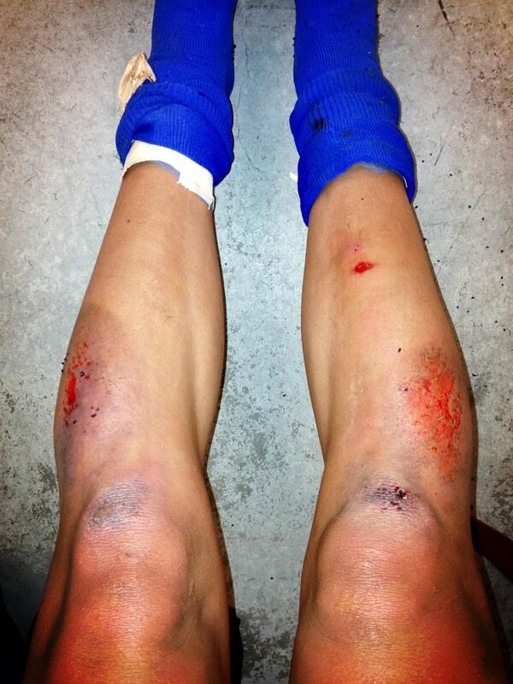
This was a photo tweeted by US
National Team Forward Sydney Leroux
Dwyer with the caption :
“ This is why soccer should be
played on grass.”

Slide 9
fun facts.
U.S. women on winning the World Cup: Won $2 million in prize money, per the BBC as compared to the $35 million won by the German men when they won the last World Cup.
Experts say that Title IX, the 1972 law requiring gender equality in education, including in sports, is one reason why U.S. women excel at soccer. But plenty of schools are flouting that law. A National Women’s Law Center report last month examined more than 16,000 high schools and found that 28% have massive gaps in opportunities for girls’ sports compared to boys.

Slide 10
The top earning male in the world, Ronaldo, makes $19 million per year (before endorsements and other activities that come with the benefit of being a well-marketed individual). Meanwhile, the top four highest paid women’s soccer players in the world make a combined $745,000 per year.
Some African nations use soccer to push the masculine dominance of society.
Sexual exploitation and soccer have gone hand-in-hand recently. The South African sex trade was reported to be exploited in the 2010 World Cup and legal prostitution rings in Germany targeted World Cup 2006 sites with “sex huts.”
http://www.bustle.com/articles/95041-5-insanely-sexist-womens-world-cup-memes-that-still-cant-spoil-the-sweet-sweet-taste-of

Slide 11
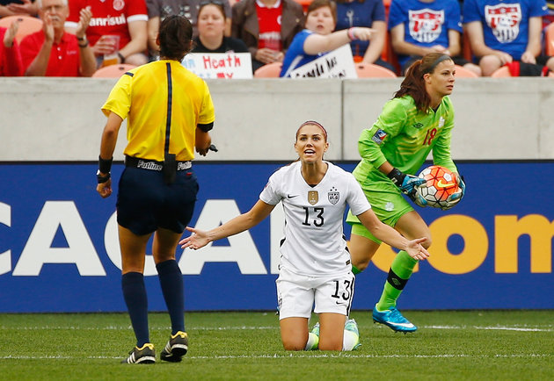
What fifa has done about reducing the discrimination
FIFA announced an updated task force of discrimination monitoring for review of all the qualifying teams for the 2018 World Cup. The article only refers to race, not gender, and no mention if FIFA uses their own system to check themselves. This August, due to heavy to criticism, FIFA created a task force dedicated to inclusion in terms of governance, competition, and business.

Slide 12
What steps can actually be taken to reduce the gender inequality
They’re should be promoted to better tv channels with more viewership than the usual ESPNW and should be televised on the lucrative television markets or news coverage. Integrating media and giving primetime slots on the major networks is also a way to give them importance and reduce the gender inequality.
Stop viewing them as a threat to the masculine aspect of football.
Stop viewing them as physically inferior and refrain from calling them as not good enough as compared to the men footballers. Marta, the Brazilian footballer, has been labelled as a legend in the football world and has also been labelled as “Pele with a skirt” for her extraordinary skills. She can easily surpass some of the “best” players in men’s football.
Better allocation of funds to the women football to reduce the wage gap.

Slide 13
Some famous quotes on women football.
Sepp Blatter, Former FIFA President : In 2004, FIFA president Sepp Blatter said that women of soccer should wear more feminine clothes, “tighter shorts . . . a more female aesthetic.” And then, in 2012, the self-proclaimed “godfather” of women’s soccer didn’t recognize Alex Morgan at an awards ceremony, even though she was the U.S. Soccer Player-of-the-Year and FIFA Player-of-the-Year finalist.

Slide 14
New Zealand Columnist, Chris Rattue :
“ Women are genetically inferior and should have different playing surfaces.”
“Top-level women’s football will never be as good to watch as top-level men’s football”
“ No one watches women’s sports.”
FIFA Secretary General Jerome Valcke when asked about the pay gap between men and women.
"That's not even a question I will answer because it is nonsense," he said. "We played the 30th World Cup in 2014 and we are playing the seventh Women's World Cup.... We are still another 23 World Cups before potentially women should receive the same amount as men.”

Slide 15
Zlatan Ibrahimovic, Swedish Footballer :
“ The men’s team deserves more recognition than the women’s team. Both the teams cannot be compared. It is highly demeaning to be compared to a woman player in your country when in the world you’re compared with the likes of Lionel Messi and Cristiano Ronaldo.”

Slide 16
#EqualMeansEqual
The above hashtag was started as a movement by the women footballers. It was started to make the world realise how they were discriminated against and how they need their equal rights. They wanted the world to know that they are being deprived of their basic right of equal and fair treatment by being exposed to FIFA’s discriminatory practices.
But what is sad is, it just remained as a hashtag as, once again, no one took women seriously.
It might seem as a dream but the day will come when a woman will walk away with the FIFA Ballon D’Or and the world will just hang their heads in shame on why they never took the women who played the same sport, with the same rules with the same passion but with so much more difficulty as the men, seriously.

Slide 17
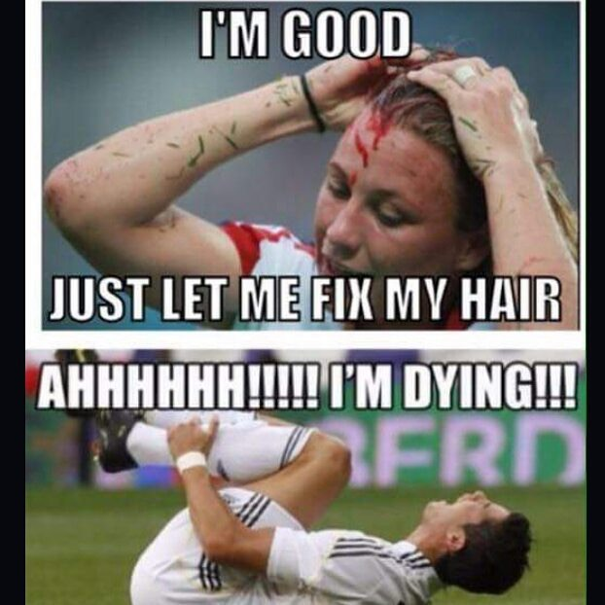
http://www.telegraph.co.uk/men/the-filter/11669841/11-reasons-why-womens-football-is-better-than-mens.html
Thank you!

Slide 18
References
FIFA Statutes ( April 2016 Edition)
http://www.nytimes.com/2016/04/01/sports/soccer/uswnt-us-women-carli-lloyd-alex-morgan-hope-solo-complain.html?_r=0
http://www.wikigender.org/wiki/gender-inequality-on-the-pitch-womens-football/
https://www.socialworkhelper.com/2015/09/01/outrageous-rampant-gender-discrimination-womens-soccer/
http://www.theatlantic.com/entertainment/archive/2015/06/womens-soccer-is-a-feminist-issue/394865/
http://www.theatlantic.com/entertainment/archive/2015/06/neymar-marta-world-cup-brazil/394856/
http://www.huffingtonpost.com/entry/hope-solo-soccer-field_us_56df7ab1e4b0860f99d71f56
http://www.theatlantic.com/entertainment/archive/2015/07/womens-soccer-world-cup-fifa-lawsuit/397592/
http://www.forbes.com/sites/alanaglass/2015/11/29/the-case-for-fifas-gender-reform/#542ad40a1968
http://www.latimes.com/sports/soccer/la-sp-soccer-world-cup-20150712-story.html
http://www.today.com/money/us-women-s-soccer-star-alex-morgan-time-take-stand-t85971

