Slide 1
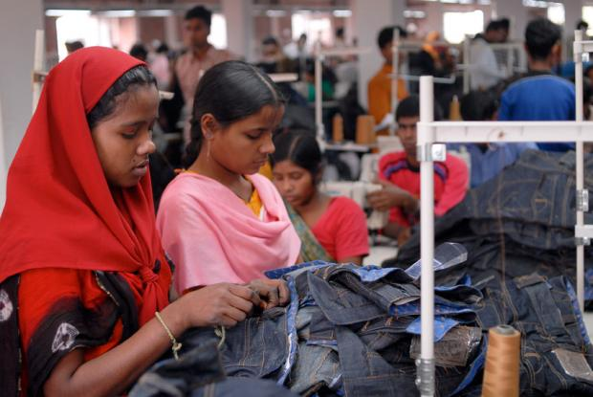
Critical review of child laborers and their employment in the fashion industry
Shree Kotwal

Slide 2
It has been noted that women’s clothing costs have fallen 35 percent in the last 10 years .
“HOW?”
Globalization

Slide 3
Overseas labor is one factor that lets the production cost so low that companies are able to make high turnover. And these industries are not hidden they include Wal-Mart, gap, h n m and other US companies as noted by Charles Keraghan(director national labor committee).

Slide 4
The International Labour Organization stated that 73 million face child labour worldwide amongst which 44.6 million are Asians( Nigeria Bangladesh Kenya Indonesia India China Brazil) 24% production for industries set in developed countries.

Slide 6
National Labor Committee 2006, estimated 200 children, some 11 years old or even younger, are sewing clothing for Hanes, Wal-Mart, J.C. Penney, and Puma at the Harvest Rich factory in Bangladesh.

Slide 7
Who is to be blamed?
For such a situation not only the succumbed to this situation but also provider of such situation is to be blamed. US being a party to ILO must respect labor rights of international laborers as well.

Slide 8
Possible Solutions :
Acceptance.
Special Rapporteur Miss. Urmila Bhoola on “contemporary forms of slavery, including its causes and consequences” (22 July 2014)Also expressed her grievance while addressing Recommendation No. 201 where she pointed out that education for child laborers must be paid heat to, She also addressed that child labor is being practiced where the labor rights of children are not being fulfilled. So firstly, one law is being infringed and on the other hand second law of their labor rights infringement also being patricide

Slide 9
This has been worked upon in Bangladesh under “the Labor Law of Bangladesh 2006”, the minimum legal age for employment has been reduced form 18 to 14. However, there is lack of accountability.
Lack of Awareness: increase in demand: increase in production :increase in exploitation.
Corporate veil should be pierced in such situations and the owner shall be made responsible for the manner in which ultimate outcome for sale is obtained

Slide 10
Implementation of “The Corporate Responsibility to Respect Human” under “Guiding principles on business and human rights” must be monitored.
Article 13 specifically elaborates on responsibility business enterprises to avoid any factor leading to contribution to human right infringement. These activities could either be a result of their direct or indirect act but must not be resulting to infringement on Human rights

Slide 11
An internationally recognized body must be assigned responsibility of mandating the fulfillment of these principle and that no human right violation is done on basis of national as well as international trade.
Private institutions are built up for this namely, International Labor Rights Forum is a human rights organization that advocates for workers globally.

