Slide 1
GENDER IN CONFLICT AND HUMAN RIGHTS VIOLATIONS
SREELAKSHMI S KURUP
JGU ID: 20120262

Slide 2
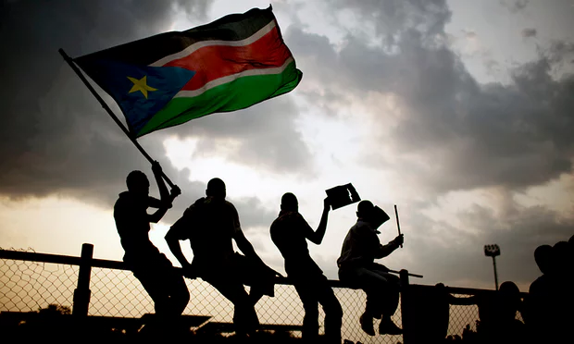
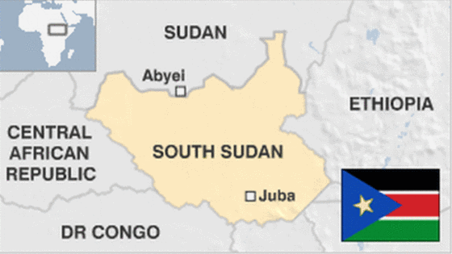
CASE STUDY: SOUTH SUDAN

Slide 3
KEY TERMS
GENDER MAINSTREAMING:
Gender mainstreaming was established as an intergovernmental mandate in the Beijing Declaration and Platform for Action in 1995, and again in the ECOSOC Agreed Conclusions in 1997
Gender Mainstreaming is a globally accepted strategy for promoting gender equality.
Mainstreaming involves ensuring that gender perspectives and attention to the goal of gender equality are central to all activities - policy development, research, advocacy/ dialogue, legislation, resource allocation, and planning, implementation and monitoring of programmes and projects.
http://www.un.org/womenwatch/osagi/gendermainstreaming.htm

Slide 4
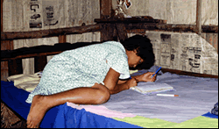
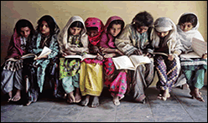
HUMAN RIGHTS
Human rights are rights inherent to all human beings, whatever our nationality, place of residence, sex, national or ethnic origin, color, religion, language, or any other status.
We are all equally entitled to our human rights without discrimination.
These rights are all interrelated, interdependent and indivisible.
Notes:
http://www.ohchr.org/EN/Issues/Pages/WhatareHumanRights.aspx

Slide 5
DEVELOPMENT
the act or process of growing or causing something to grow or become larger or more advanced;
: the act or process of creating something over a period of time;
: the state of being created or made more advanced.
Notes:
http://www.merriam-webster.com/dictionary/development

Slide 6
UNDERSTANDING THE HUMAN RIGHTS-GENDER-DEVELOPMENT NEXUS??
IS THEERE ANY LINK BETWEEN THESE??

Slide 7
WHAT HAPPENED IN SOUTH SUDAN??
South Sudan voted to break away from Sudan in 2011.
The Government's main concern has been to get oil flowing following disagreements with Khartoum (Capital of Sudan).
There have been a few small armed rebellions, border clashes and deadly cattle feuds .
Signs of friction within the governing SPLM party came in July when President Salva Kiir, an ethnic Dinka - the country's largest group, sacked his deputy Riek Machar, who is from the second largest community, the Nuer.
Notes:
http://www.bbc.com/news/world-africa-25427965

Slide 8
QUESTION??
Does gender mainstreaming act as an effective tool to enhance the understanding of gender in development?

Slide 9
IMPORTANT GENERAL ASSEMBLY RESOLUTIONS
S/RES/2057 (2012) | 5 Jul 2012 – Security Council extends mandate of UN Mission in South Sudan (UNSMIS) through 15 July 2012
S/RES/1999 (2011) | 13 Jul 2011 – Security Council recommends to the General Assembly that the Republic of South Sudan be admitted as a Member of the United Nations
S/RES/1996 (2011) | 8 Jul 2011 – Security Council establishes UN Mission in the Republic of South Sudan (UNMISS)

Slide 10
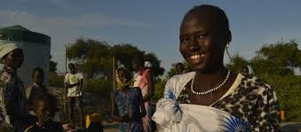
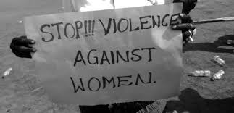
THEORETICAL FRAMEWORK
PRE-CONFLICT SITUATION
Flexible ethnicity for women than it is today.
OPEN-CONFLICT SITUATION
Gross instances of rape
For example, account by Susan- a rape survivor.

Slide 11
COMPARISON WITH ISIS CONFLICT
The report states that women have been banned from public life, education for girls has been curtailed and early marriage is on the rise.
Women have also been stoned to death after being accused of adultery, or for being seen in public without a male relative or with their heads uncovered.
(Report by the United Nations Human Rights Council, 2014)
An estimated 3,500 are being held as slaves by ISIS – the Islamic State – in Iraq, most of them women and children.
(UN Report, January 2016)

Slide 12
In January and February 2016, Human Rights Watch interviewed 21 Sunni Muslim Arab women from the Hawija area of Iraq and 15 women and girls from the Yezidi minority ethnic group, all of whom had fled ISIS-controlled areas, most in late 2015.
They described being forcibly converted to Islam, kept in sexual slavery, bought and sold in slave markets, and passed among as many as four ISIS members.
“Noor,”16, said an ISIS fighter raped her multiple times during two months in captivity. Deeply traumatized, she is one of the few Yezidi girls getting regular psychosocial treatment.
Notes:
https://www.hrw.org/news/2016/04/05/iraq-women-suffer-under-isis

Slide 13
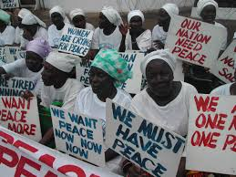
PROCESS OF PEACEBUILDING
Women considered to be active participants in establishing peace.
In Sanjasiri, Mary.A led up her community’s first peace-building campaign; raising awareness on women’s rights issues, such as marriage decisions, through the lens of conflict resolution.

Slide 14
POST-CONFLICT SITUATION
Peace Agreement – August 2015
Due to slow government, fighting continued.
International and African human rights groups have documented widespread human rights abuses and reported evidence that they are committed by both government and opposition forces.
Peacebuilding post-conflict-
The United Institute of Peace (USIP) works to build peace in South Sudan through partnerships with the State Department, nongovernmental organizations, and local stakeholders.

Slide 15
The Institute’s Unlearning Violence program convenes civil society leaders, men and women, for programs that help develop their skills in resolving community-level conflicts.
These include understanding the gender dimensions of those conflicts, including issues of masculinity.
The skills also include facilitating intergroup dialogues to help manage such conflicts.
The Unlearning Violence community works within the country to identify key stakeholders and areas for reconciliation work.

Slide 16
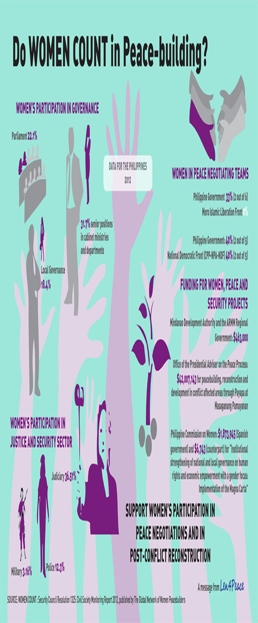

Slide 17
IMPORTANT FACTORS CAUSING VIOLENCE AGAINST WOMEN
Women’s status in society
Rape as a means to initiate marriage
Ongoing insecurity , displacement, etc.
Poverty, and the high cost of living
Anti-foreign fear
Alcohol abuse by men

Slide 18
RESULTS
Incidents | October | November | December | Total for the period | Total 2014
Domestic violence | 11 | 16 | 19 | 6 | 184
Rape | 1 | 0 | 0 | 1 | 29
Sexual harassment | 0 | 0 | 0 | 0 | 6
Attempted rape | 1 | 0 | 1 | 2 | 14
Forced marriage | 10 | 2 | 0 | 12 | 34
Early marriage | 1 | 0 | 0 | 1 | 17

Slide 19
IMPLICATIONS OF THE RESULTS
Gender Based Violence Management System (GBVIMS) operational is South Sudan and collects systematized GBV data using GBVIMS tools, including aid from international organizations, since 2013.
The above data is that of Madan (South Sudan) during the conflict – published in 2015.
1)Women have always been targeted victims regardless of the political condition of the State.
2) The predominant form of violence against a woman is rape. This implies that rape is perceived as a political tool. The patriarchs find, perhaps, some kind of sadistic pleasure in violating the body of the women ,and achieving their vested motives.
Here, rape is considered as a tool of oppression and dominance of male power.

Slide 20
3) There is a lack of awareness amongst a group of the women about their own rights.
For instance, women feel that it is absolutely fine for their husbands to beat/hit them.
The GBV studies provide only a framework of conflict.
It fails to incorporate the root causes and plausible solutions to address the gendered violence.
And this is because the external agencies, including international NGOs play a passive role.

Slide 21
PERSONAL RECOMMENDATIONS
The increasing pressures from Government authorities and non-State actors such as SPLM/A-IO “Relief Organization of South Sudan” with attendant ad hoc (mostly arbitrary) demands for corporation should be severely curtailed, as it prevents the independence of humanitarian and protection actors .
There should be sufficient dissemination of knowledge especially to the women, which enables them in identifying their rights and strongly fighting for them. In short, the governing bodies, in both the local as well as international levels, should inculcate what the United Nations calls “gender mainstreaming”, in the spheres of policy, development, advocacy, research, dialogue, etc . This should include not only woman, but also all other oppressed forms of gender.

Slide 22
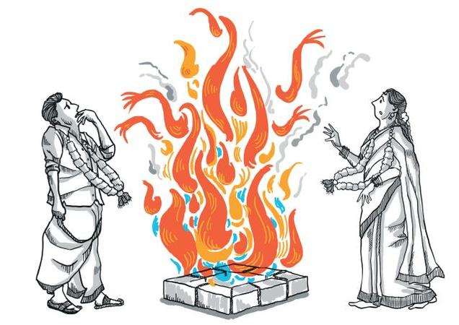
The humanitarian assistance should be reformed . The affected people should be the centre of concern, and not any other interests of the State.
The idea of symbolizing women to ‘honour’ should be reconstructed . Honour ought to be perceived a gender-neutral term and it should rest with individuals in general.

Slide 23
CONCLUSION
A conflict never cease to exist just by war coming to an end, but only when the inherent societal defects, such as male chauvinism and patriarchal abuses, are cured.
This makes “gender mainstreaming” the buzz word to understand today’s conflict, and South Sudan being a patriarchal State, has all the more relevance to imbibe the spirit to this very term.

Slide 24
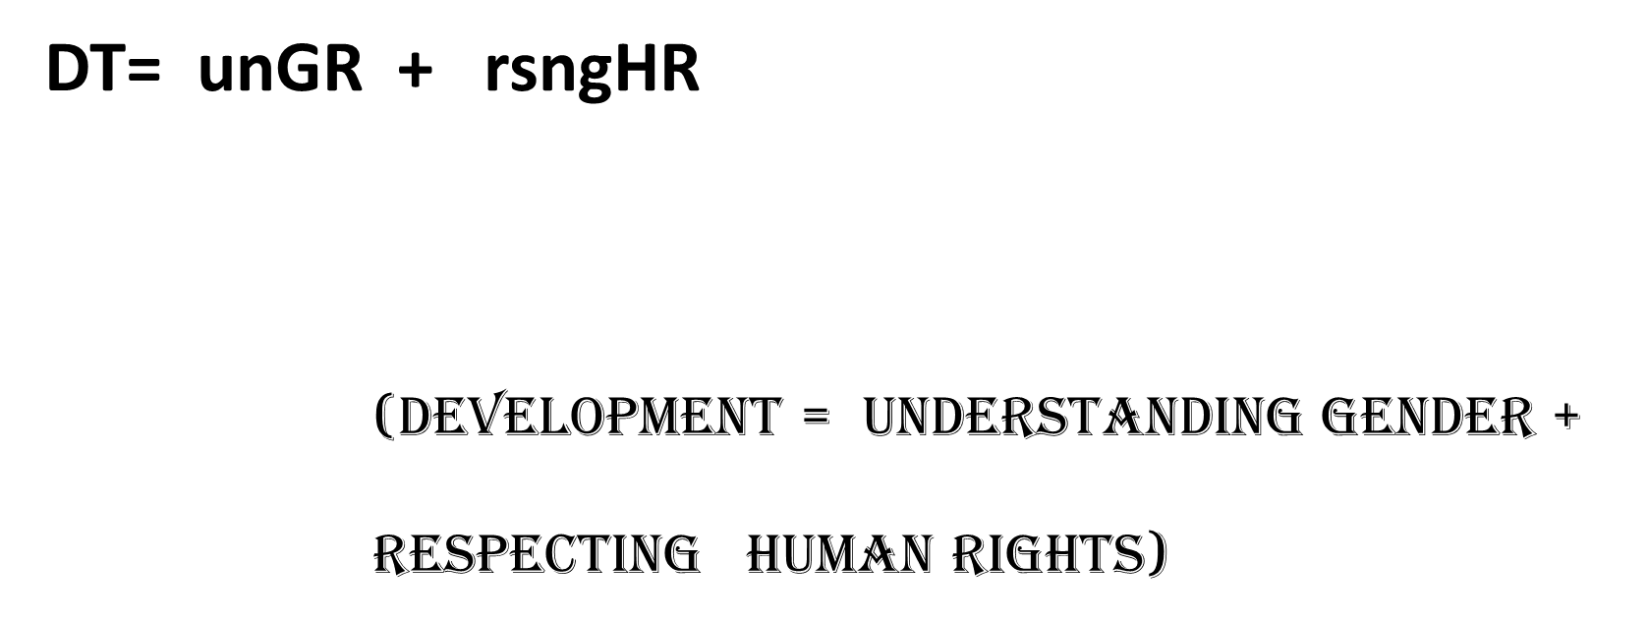
HENCE PROVED!!

