Slide 1
Enforcement of transgender people’s rights in India

Slide 2
Gender inequalities
Transgender: It is an umbrella term to refer to all people who do not identify with their assigned gender at birth
Transgender people are individuals of any age or sex whose appearance, personal characteristics, or behaviours differ from stereotypes about how men and women are ‘supposed’ to be. Transgender people have existed in every culture, race, and class since the story of human life has been recorded.
In India there are a host of socio – cultural groups of transgender people like hijras/ kinnars, and other transgender identities like – shiv-shaktis, jogtas, jogappas, Aradhis, Sakhi, etc
India's most recent census conducted the first official count of transgender people and the result was more than 4,90,000 people.

Slide 3
Supreme court of India in NALSA v Union of India
The third gender people will be considered as OBCs. They will be given educational and employment reservation as OBCs
The supreme court also said states and the Centre will provide social welfare schemes for third gender community and run a public awareness campaign to erase the negative public image.
The Supreme court also said that the states must provide special public toilets and provide assistance for special medical issues.

Slide 4
Rights for Transgender people
right to equality under Article 14 of the constitution of India
Article 15 speaks about the prohibition of discrimination on the ground of religion, race, caste, sex or place of birth.
Article 16- equal opportunity for everyone
Article 21 ensures right to privacy and personal dignity to all the citizens.
Article 23 prohibits trafficking in human beings as beggars and other similar forms of forced labor and any contravention of these provisions shall be an offence punishable in accordance with law.

Slide 5
The Constitution provides all the fundamental rights and also guarantees political rights, educational and health benefits to the third gender. But the third gender people continues to be ostracized. The main question is whether we can see equality in the real world?

Slide 6
Problems faced by transgender people
Discrimination- no access to public spaces, health care,family
unemployment
lack of educational facilities
homelessness- families do not accept them
lack of medical facilities: like HIV care and hygiene, depression, hormone pill abuse, tobacco and alcohol abuse
problems related to marriage and adoption.
A 2007 study showed the percentage of Hijras who reported: forced sex is 46%; physical abuse is 44%; verbal abuse is 56%; blackmail for money is 31%; and threat to life is 24%.

Slide 7
Supreme court judgement on transgender rights
Legal Recognition for Third Gender
Public Health and Sanitation
Socio-Economic Rights
Stigma and Public Awareness

Slide 8
Case – preethika yashni Tamil Nadu Uniformed Services Recruitment Board

Slide 9
Reforms to improve the situation
Legal measures
Police reforms
Social awareness

Slide 10
Awareness to the society – public image

Slide 11
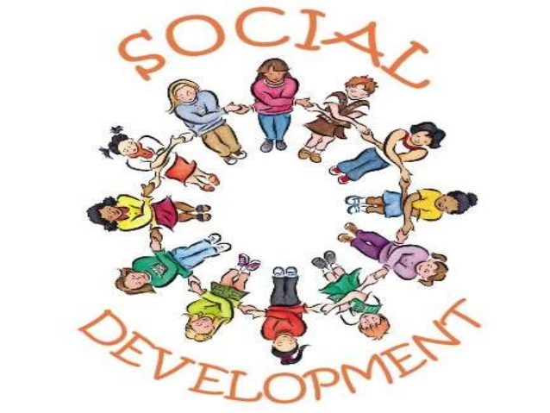

Slide 12
Social development theory
Social development can be summarily described as the process of organizing human energies and activities at higher levels to achieve greater results. Development increases the utilization of human potential.
Advances in development theory can enhance our social success rate by the same order of magnitude that advances in theoretical physics have multiplied technological achievements in this century

Slide 13
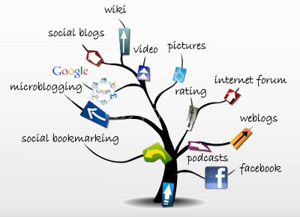

Slide 14
society+ human rights
development

Slide 15
Questions?

Slide 16
references
http://www.undp.org/content/dam/india/docs/hijras_transgender_in_india_hiv_human_rights_and_social_exclusion.pdf
http://www.icpd.org/development_theory/SocialDevTheory.htm
http://iasscore.in/national-details-74.html
http://www.undp.org/content/dam/india/docs/hijras_transgender_in_india_hiv_human_rights_and_social_exclusion.pdf
NALSA v Union of India
The constitution of India
http://timesofindia.indiatimes.com/india/Supreme-Court-recognizes-transgenders-as-third-gender/articleshow/33767900.cms
http://iasscore.in/national-details-74.html
http://www.glaad.org/blog/indias-census-counts-transgender-population-first-time

Slide 17
References
http://timesofindia.indiatimes.com/india/Supreme-Court-recognizes-transgenders-as-third-gender/articleshow/33767900.cms

Slide 18
Thank you

