Slide 1
Reconceptualization of economic abuse of women

Slide 2
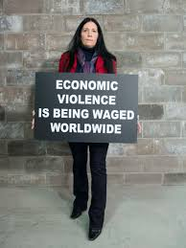
OVERVIEW
Definition
status of the problem
sources and impact
problem in India and its sources
recommendations

Slide 3
DEFINATION
This abuse is defined as consisting of “behaviors that control a woman’s ability to acquire, use, and maintain economic resources, thus threatening her economic security and potential for self-sufficiency”
“profoundly under-recognized phenomenon as it is deeply hidden within societal expectations that couples will equitably share their financial resources for the good of the whole family.”
National Coalition Against Domestic Violence -
“By controlling and limiting the victim’s access to financial resources, a batterer ensures that the victim will be financially limited when she chooses to leave the relationship. As a result, victims of domestic violence are often forced to choose between staying in an abusive relationship and facing economic hardship, which would possibly result in extreme poverty and homelessness.”

Slide 4
Little documented evidence of how it operates and its impact on women.
42% face lack of control over household resources.
Control over decision making is higher among educated women.
Women with higher education are twice less likely to face any kind of economic abuse.
Considerably more in rural areas than urban areas.

Slide 5
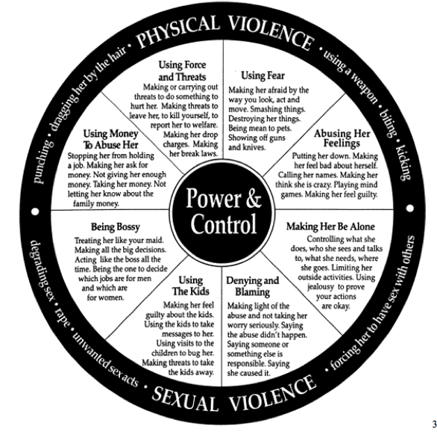

Slide 6
SOURCES
SOCIETAL STRUCTURES
Cultural norms
Systematic blocks
Gender inequality
COMMUNITY
The hidden nature of money and family violence
Lack of awareness
INDIVIDUAL
Economic dependence
Women’s perception of gender roles

Slide 7
PROBLEM IN INDIA AND ITS SOURCES
RELIGION
EDUCATION
POVERTY

Slide 8
RECOMENDATIONS
LEGAL
COMMUNITY DELEVOPMENT AND FINANCIAL EDUCATION
GOVERNMENT POLICY

Slide 9
BIBLIOGRAPHY
“Why doesn’t she leave” by caitlin weston
“ReConceptualizing Domestic Violence in India: Economic Abuse and The Need for Broad Statutory Interpretation to promote Women's Fundamental Rights”; Pami Vyas
DHS working papers; Relationship between Women’s Socioeconomic Status and Empowerment in Burkina Faso:A Focus on Participation in Decision-Making and Experience of Domestic Violence” by Madeleine Wayack Pambè Bilampoa Gnoumou Idrissa Kaboré.
-http://stoprelationshipabuse.org/educated/types-of-abuse/economic-abuse/
-http://www.bellbajao.org/considering-economic-abuse-as-domestic-violence/

Slide 10
Thank you !
-Apoorva singh

