Slide 1
The MDGs and the SDGs An analysis from the perspective of the human right(s) to water and sanitation
Sharmila L. Murthy Associate Professor
Suffolk University Law School

Slide 2
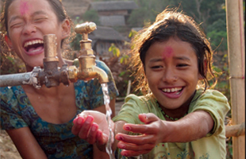
Human right(s) to safe drinking water and sanitation
MDG targets for wat-san: human rights critique
SDG targets for wat-san-hygiene: human rights critique

Slide 3
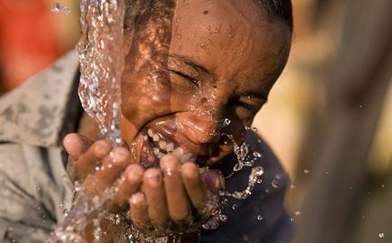
Mar Del Plata conference in Argentina (1977)
Action Plan on “Community Water Supply” declared “[a]ll peoples . . . have the right to have access to drinking water in quantities and of a quality equal to their basic needs.”

Slide 4
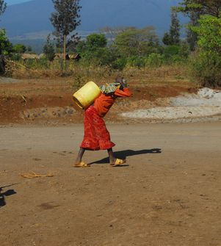
Convention on the Elimination of Discrimination against Women (1991)
To enjoy adequate living conditions, particularly in relation to housing, sanitation, electricity and water supply, transport and communications (Article 14(2))
http://eatdrinkbetter.com/2012/03/22/wateraid-and-choice-organic-teas/

Slide 5
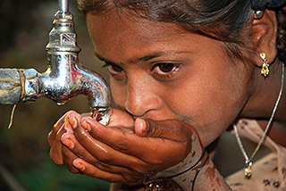
Convention on the Rights of the Child (1990)
To combat disease and malnutrition . . . through . . . the provision of adequate nutritious foods and clean drinking-water . . . (Article 24(c))
http://www.sev.asn.au/model-citizen/global-citizen/19-image--07-a-child-drinking-water.html
To ensure that all segments of society, in particular parents and children, are informed . . . and are supported in the use of basic knowledge of . . . hygiene and environmental sanitation . . . (Article 24(e))

Slide 6
Foundations of Int’l Human Rights Law
Universal Declaration of Human Rights
International Covenant on Civil and Political Rights
(1966, 1976)
International Covenant on Economic, Social and
Cultural Rights (1966, 1976)

Slide 7
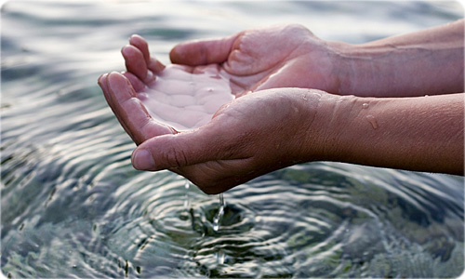
http://omiusajpic.org/topics/human-right-to-water-and-sanitation/
General Comment 15 (2002)
Article 11
adequate standard of living
Article 12
highest attainable standards of mental and physical health

Slide 8
Notes:
Text of resolution available at: http://www.internationalwaterlaw.org/documents/intldocs/UNGA_Resolution_HR_to_Water.pdf
When introducing resolution, Bolivia rep amended the text so that “declares” became “recognizes”

Slide 9
Abstentions
Support work of Human Rights Council in Geneva, including Ind’t Expert
Right not reflected in int’l law
Legal implications & scope
Not drafted in transparent manner
Notes:
US
Expressed “deep commitment to finding solutions to global water challenges,” “supported the work of the Human Rights Council’s Independent Expert” and “looked forward to . . . a more inclusive, deliberative approach . . .in Geneva”
Hoped to “negotiate and ultimately join the consensus on a text that would uphold the process under way at the Human Rights Council. Instead, the text . . . described the right to water and sanitation in a way not reflected in existing international law . . .”
“[A]ttempted to take a short cut around the serious work of formulating, articulating and upholding universal rights. It had not been drafted in a transparent, inclusive manner, and neither the Assembly, nor the Geneva process had yet considered fully the legal implications of a declared right to water. . . .”
Canada
“had joined the consensus on the resolution that had created the mandate of the independent expert. The work of that mechanism was expected to further promote study of the issue of access to water and sanitation as a human right and, as such, the text was premature. The non-binding resolution appeared to determine that there was indeed a right without setting out its scope. . . .”

Slide 10
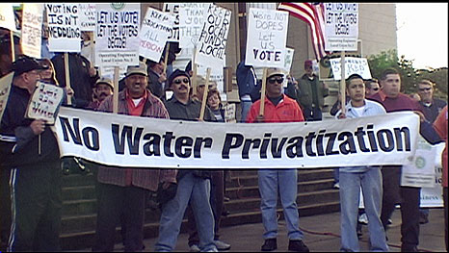
http://griid.files.wordpress.com/2011/02/no-water-privatization.jpg

Slide 11
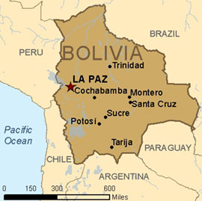
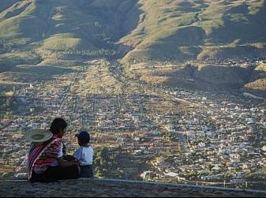
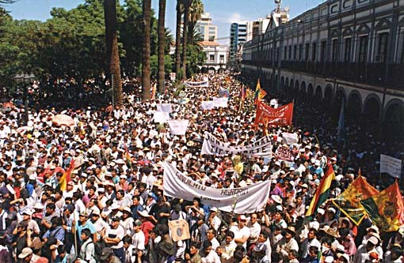
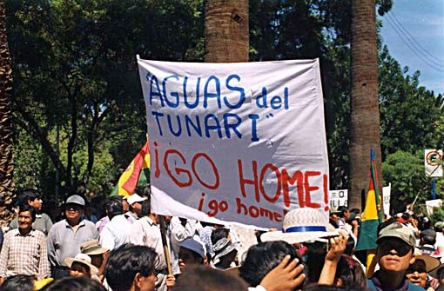
Cochabamba
http://wwwnc.cdc.gov/travel/destinations/bolivia.htm
http://worldsavvy.org/monitor/index.php?option=com_content&view=article&id=731&Itemid=1177
“La Guerra del Agua”
http://www.tlaxcala-int.org/article.asp?reference=121
http://www.tlaxcala-int.org/article.asp?reference=121

Slide 12
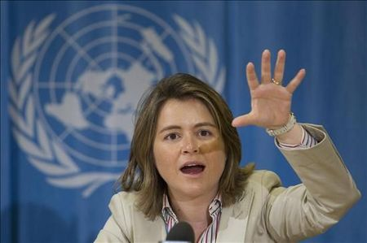
“Human rights are neutral as to economic models in general, and models of service provision more specifically.”
2009 report to HRC on non-State actors
by the UN Special Rapporteur
www.galdu.org
Notes:
2007 Report from OHCHR: The approach of United Nations treaty bodies and special procedures has been to stress that the human rights framework does not dictate a particular form of service delivery and leaves it to States to determine the best ways to implement their human rights obligations. While remaining neutral as to the way in which water and sanitation services are provided, and therefore not prohibiting the private provision of water and sanitation services, human rights obligations nonetheless require States to regulate and monitor private water and sanitation providers.
Philip Alston and Gerard Quinn state, “such arguments have been consistently and decisively rejected by the governments of all the Western European and market economy (i.e., mixed capitalist) Third World states that have ratified the Covenant.” Alston and Quinn, supra note 100 at 182.
Travaux prepartoire – bluntly contradict that ICESCR dictates one form of political economy
According to Alston & Quinn, a U.S. State Department official wrote in 1949 that “‘it is a grievous mistake.., to assume that... these rights must be secured exclusively or even primarily by direct State action.”

Slide 13
(6) Delegation to a third party does not exempt State from primary responsibility
(7) States may use non-state actors; regardless, must ensure transparency, non-discrimination and accountability
(9) spells out some key ways that States should monitor non-state actors

Slide 14
An evolving question: right or rights?
“Human right to water” (General Comment 15)
“Human right to safe drinking water and sanitation” (UN GA and HRC resolutions)
“Human rights to (safe drinking) water and sanitation” (Special Rapporteur & others; UN GA resolution from Dec. 2015)

Slide 15
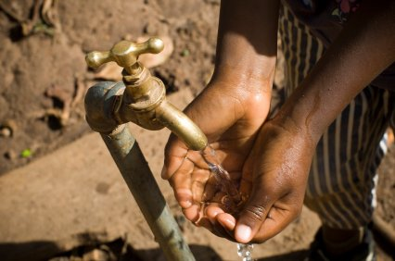
Normative Content
“The human right to water entitles everyone to sufficient, safe, acceptable, physically accessible and affordable water for personal and domestic uses.”
General Comment 15, ¶2 (2002)

Slide 16
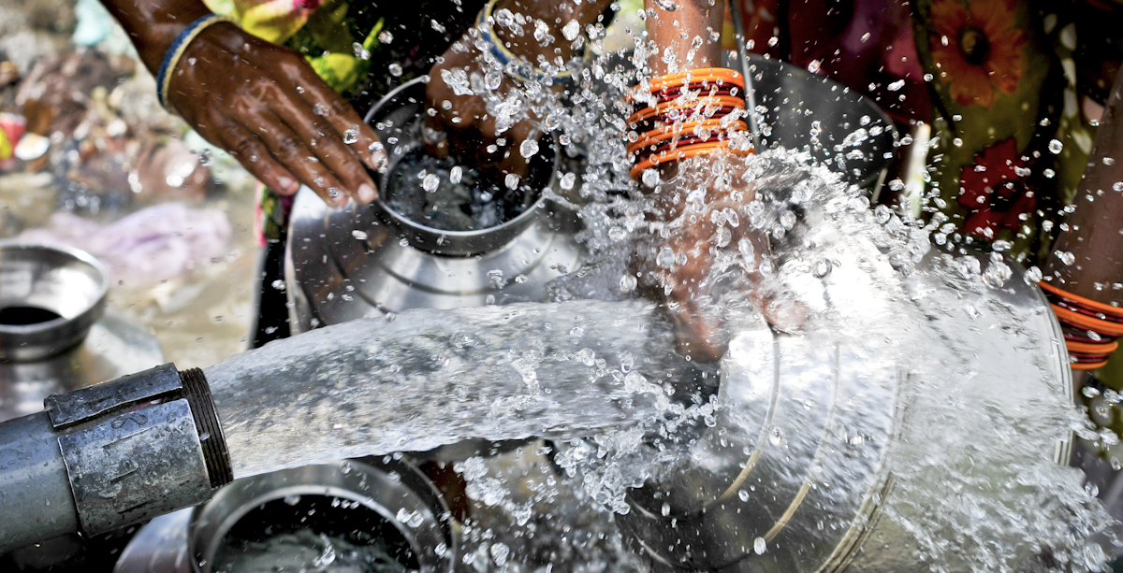
(1) Availability/Quantity: Water
http://www.bhopal.org/2012/01/support-for-petition-to-drop-dow-continues-to-grow/bhopal-water/
Continuously available and in a sufficient quantity for drinking, personal hygiene, and domestic uses (cooking, washing, etc.)

Slide 17
World Health Organization Guidelines Source: “The Right to Water” (2003)

Slide 18
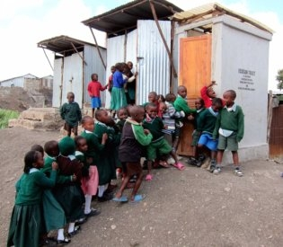
(1) Availability: Sanitation
Sufficient number of facilities
Waiting times not unreasonably long
http://bostonherald.com/business/technology/general/view/2011_0504mit_start-up_focuses_onsanitation_needs_of_poor

Slide 19
(2) Physical Accessibility: Water
Within, or in the immediate vicinity of
Household
Educational institution
Public institution
Health institution
Workplace
Disabilities
Gender burden
http://40brown.wordpress.com/

Slide 20
(2) Physical Accessibility: Sanitation
Within, or in the immediate vicinity of
Household
Educational institution
Public institution
Health institution
Workplace
Disabilities
Significant Gender Burden
http://www.cbm.org/Disability-inclusive-WASH-benefits-all--320705.php

Slide 21
(3) Safety/Quality: Water
Not pose a threat to human health
WHO Guidelines
Significant burden on infants and children
http://thegrowblog.blogspot.com/2011_03_01_archive.html

Slide 22
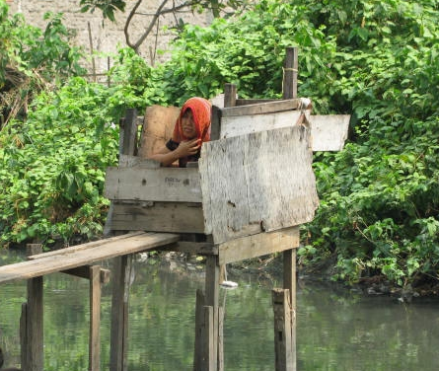
(3) Safety/Quality: Sanitation
Hygienically safe to use: human excreta must not come into contact with humans or animals
http://washtech.wordpress.com/category/topics/hygiene/
Hand washing is available
http://www.mercycorps.org/dewisaparini/blog/22706

Slide 23
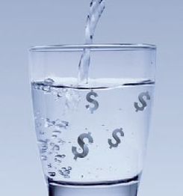
(4) Affordability: Water
Affordable does not mean free
BUT, no one disconnected for failure to pay
Policy mechanisms: lifeline policies, subsidies, block tariffs, etc.
http://ibnlive.in.com/news/water-policy-draft-is-convoluted/234742-55.html

Slide 24
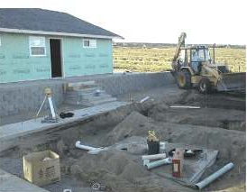
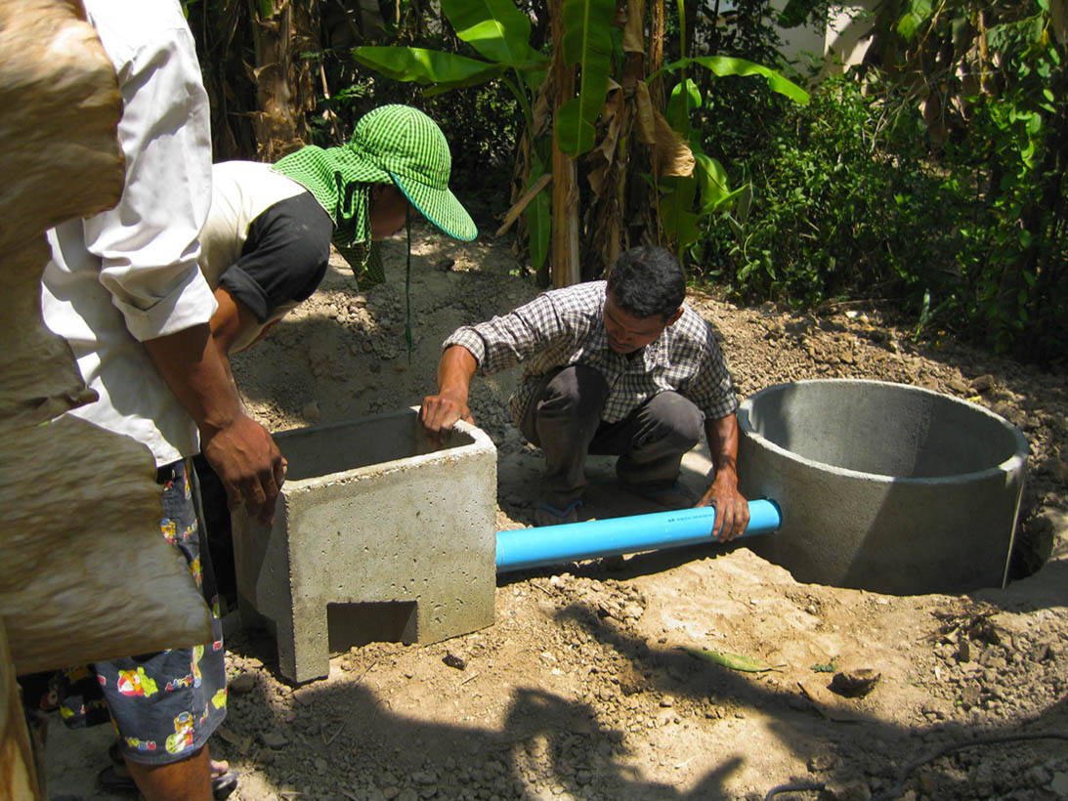
(4) Affordability: Sanitation
Costs of individual access
http://www.eco-nomic.com/septic.htm
Costs of waste disposal
Containment
Treatment
http://www.changemakers.com/morehealth/entries/revolootionary-developing-rural-markets-sanitation

Slide 25
(5) Cultural Acceptability: Water
Water must be of an acceptable color, odor and taste and provided in a way that is consistent with cultural practices
Important point for donor/NGO household water treatment programs
http://www.povertyactionlab.org/evaluation/source-dispensers-and-home-delivery-chlorine-kenya

Slide 26
(5) Culturally acceptable: Sanitation
http://www.defeatdd.org/blog/sanitation-not-just-more-better
Ensure privacy
Acceptable to women and men

Slide 27
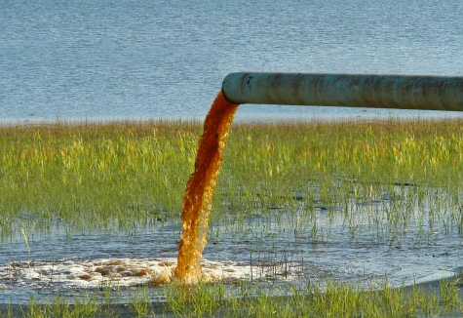
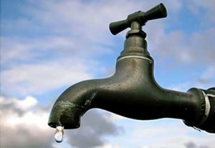
Protect
Respect
Fulfill
http://www.thewaterq.com/wnews1/images/stories/maxqcontent/World/water-pollution4.jpg
http://www.newslincolncounty.com/?p=19922
http://www.changemakers.com/morehealth/entries/revolootionary-developing-rural-markets-sanitation

Slide 28
Progressive Realization
Each State Party to the present Covenant undertakes to take steps, individually and through international assistance and co-operation, especially economic and technical, to the maximum of its available resources, with a view to achieving progressively the full realization of the rights recognized in the present Covenant by all appropriate means, including particularly the adoption of legislative measures.
Article 2(1) of ICESCR

Slide 29
Human right(s) to safe drinking water and sanitation
MDG targets for wat-san: human rights critique
SDG targets for wat-san-hygiene: human rights critique

Slide 30
Human rights & development like “ships passing in the night” (Alston)
So how and why have human rights influenced the monitoring of the MDG/SDG targets on water-sanitation-hygiene?

Slide 31
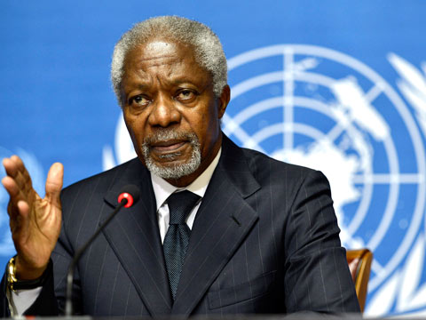
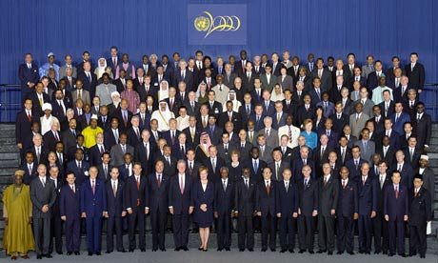
2000: Millennium Summit
UN Secretary General Kofi Annan
150 world leaders signed Millennium Declaration on Sept. 6, 2001

Slide 32
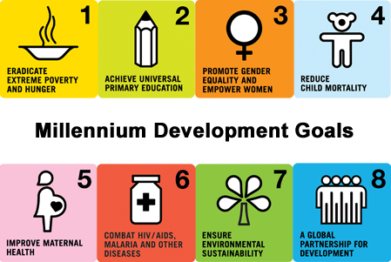

Slide 33
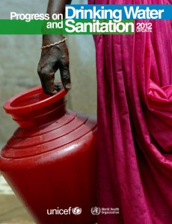
MDG: Target 7c
“To halve, by 2015, the proportion of people without sustainable access to safe drinking-water and basic sanitation.”
Sanitation added only in 2002
Notes:
33

Slide 34
In 2015, 663 million people still lacked access to improved drinking water sources
BUT, in 2017, 2.1 billion lacked access to safe, readily available water at home

Slide 36
In 2015, 2.4 billion people still lacked access to improved sanitation
BUT, in 2017, 4.5 billion people did not have safely managed sanitation and
2.3 billion still lacked basic sanitation

Slide 37
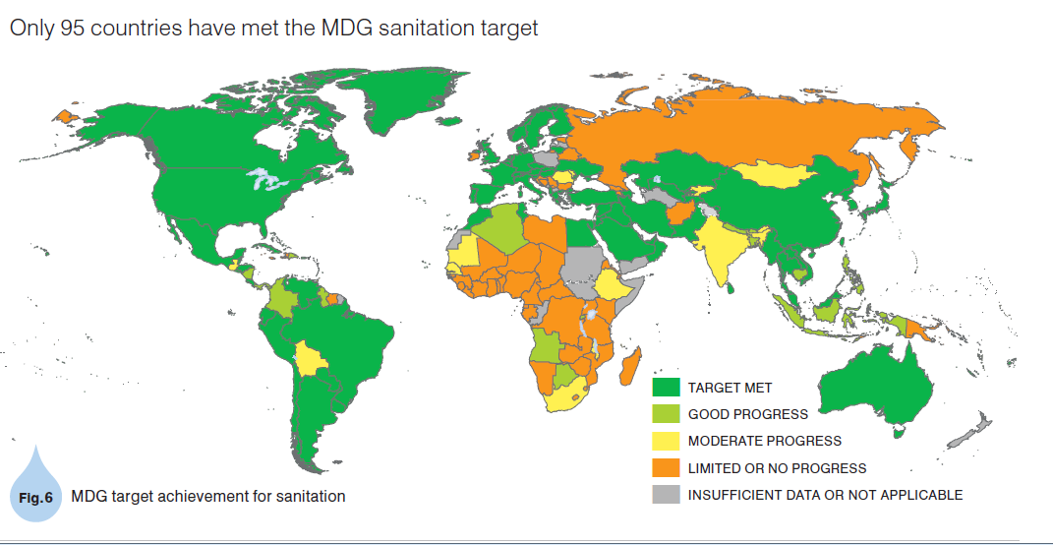

Slide 38
MDG Target 7c
“To halve, by 2015, the proportion of people without sustainable access to safe drinking-water and basic sanitation.”
Indicators
Proportion of people with access to improved water
Proportion of people with access to improved sanitation
Notes:
38

Slide 39
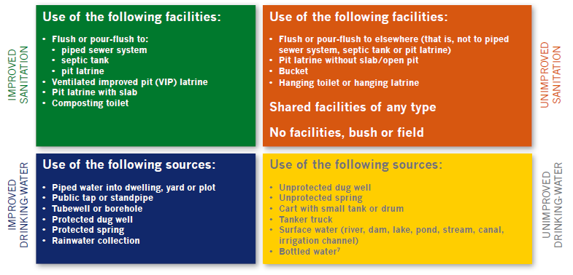
Defining “Improved”
Source: JMP 2010 Report

Slide 41
MDGs do not currently capture human rights criteria
Drinking-water quality
Quantity
Hours service available
Distance
Time spent
Social obstacles for certain populations
Infrastructure maintenance
Safe disposal of excreta
Affordability
Source: First Consultation on Post-2015 Monitoring of Wat-San, Berlin (May 2011)

Slide 42
Human right(s) to safe drinking water and sanitation
MDG targets for wat-san: human rights critique
SDG targets for wat-san-hygiene: human rights critique

Slide 43
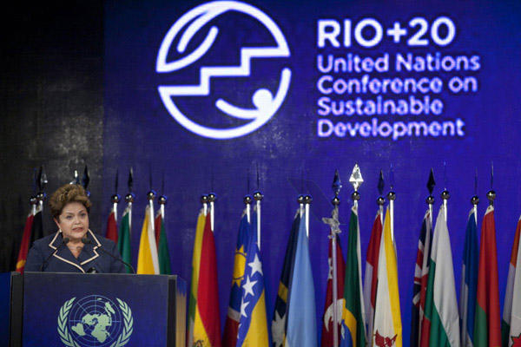

Slide 46
“Our vision” in the “Declaration” of 2030 Agenda for Sustainable Development (adopted at UN GA in 2015)
We envisage a world free of poverty, hunger, disease and want, where all life can thrive. . . . A world with equitable and universal access to quality education at all levels, to health care and social protection. . . . A world where we reaffirm our commitments regarding the human right to safe drinking water and sanitation and where there is improved hygiene; and where food is sufficient, safe, affordable and nutritious. A world where human habitats are safe, resilient and sustainable and where there is universal access to affordable, reliable and sustainable energy.

Slide 47
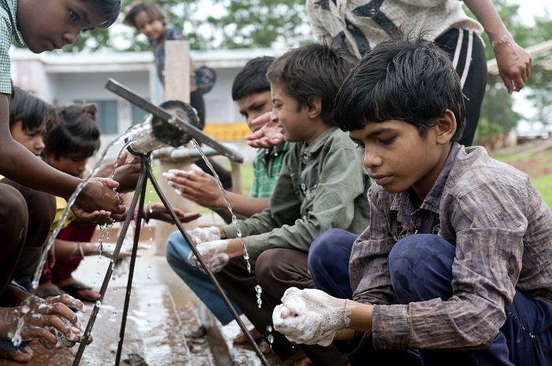
Goal 6 Ensure availability and sustainable management of water and sanitation for all
Photo: UNICEF India

Slide 48
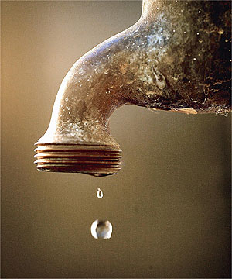
TRANSLATING LEGAL NORMS INTO QUANTITATIVE
INDICATORS: LESSONS FROM THE GLOBAL WATER,
SANITATION, AND HYGIENE SECTOR
Through a case study of global water goals, I argued that:
Information disclosure can induce compliance with non-binding “soft law” (“governance effect”)
But indicators must reflect normative goals to avoid policy distortion (“knowledge effect”)
I developed a conceptual framework to analyze current global water indicators
Current efforts much better but still potential for some distortion
Human rights to water and sanitation influencing technical process – and vice versa

Slide 49
How is dialogue between statisticians & human rights community possible?
Rise of human rights indicators
“Unbundling” of the right to water
“Normative”: accessibility, availability, acceptability, affordability & quality
“Cross-cutting”: non-discrimination, participation, accountability
Equivalence
Calculability
Data inertia
Expertise inertia

Slide 50
Joint Monitoring Program: “Service level indicators correspond with human rights criteria of quality, availability, accessibility, acceptability and affordability and build directly on existing MDG indicators.”

Slide 51
Target 6.1 (“outcome” target)
Target: By 2030, achieve universal and equitable access to safe and affordable drinking water for all
Primary indicator: Population using a basic drinking water source (‘improved’ sources of drinking water used for MDG monitoring . . .) which is located on premises and available when needed and free of faecal (and priority chemical) contamination

Slide 52
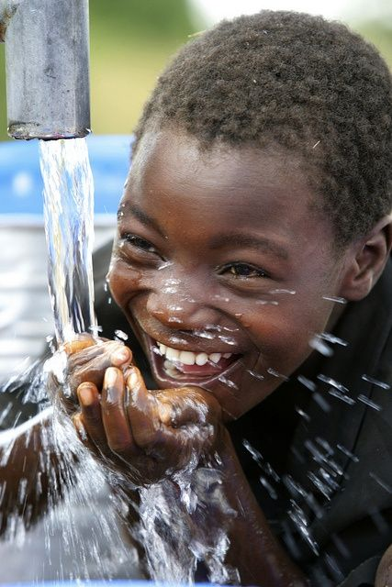
SDG water indicator will now measure whether
Water source is reliably available close to home
Wait times
Free from pathogens
Now calculable
Prior MDG indicator of “improved” water limited by data and expertise inertia

Slide 53
Source: WHO/UNICEF JMP, Progress on household drinking water, sanitation and hygiene I 2000-2017. Special Focus: Inequalities (2019).

Slide 54
Target 6.2 (“outcome” target)
Target: By 2030, achieve access to adequate and equitable sanitation and hygiene for all and end open defecation, paying special attention to the needs of women and girls and those in vulnerable situations
Primary indicator: Population using a basic sanitation facility at the household level (‘improved’ sanitation facilities used for MDG monitoring . . . ) which is not shared with other households and where excreta is safely disposed in situ or treated off-site. This is therefore a multipurpose indicator also serving the household element of the wastewater treatment indicator (6.3.1).

Slide 55
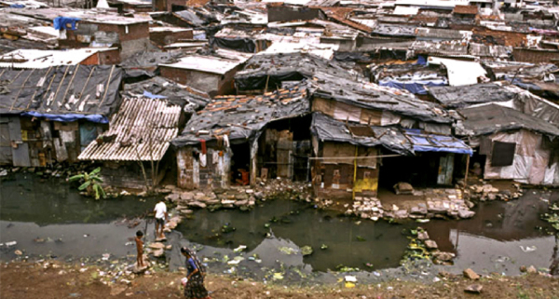
JMP focusing on intra-state inequalities
Disaggregate data
Rural-urban
Intra-urban
Wealth quintiles
Marginalized groups
Data inertia could be a problem

Slide 56
Target 6.b (“process” target)
Target: Support and strengthen the participation of local communities in improving water and sanitation management
Indicator: Percentage of local administrative units with established and operational policies and procedures for participation of local communities in water and sanitation management

Slide 57
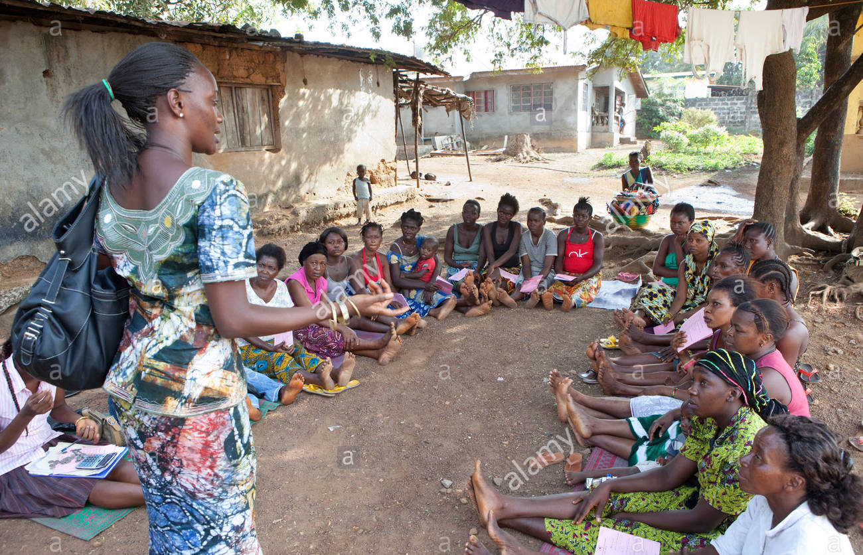
How to effectively measure participation?
Limited by equivalence, calculability, data inertia and expertise inertia

Slide 58
Human right(s) to safe drinking water and sanitation
MDG targets for wat-san: human rights critique
SDG targets for wat-san-hygiene: human rights critique

