Slide 1
Always targeting the unreached: lessons from the immunisation world
GMNCH Equity Plenary
Anuradha Gupta
21 October 2015, Mexico

Slide 2
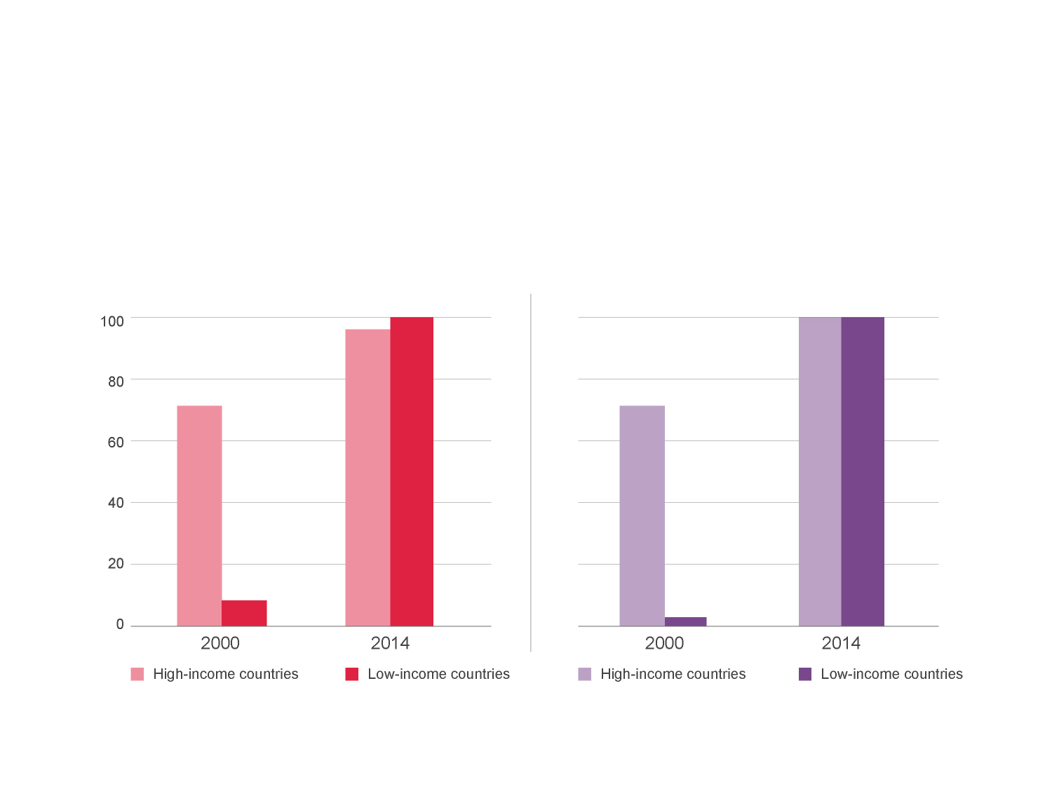
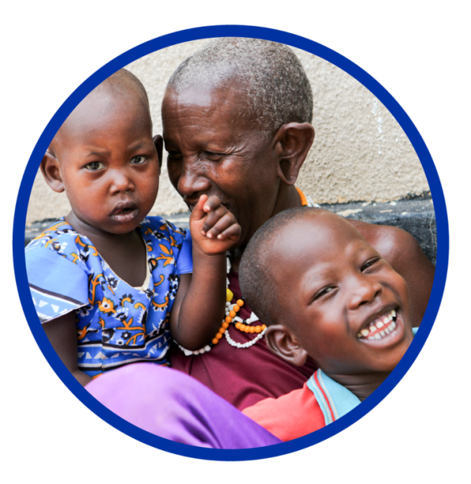
Equity – Driving equity in vaccine access
Between high- and low-income countries, 2000–2014
% of countries that have introduced the vaccines nationally
Hepatitis B
Haemophilus influenzae type b (Hib)
Source: The International Vaccine Access Center (IVAC) VIMS database. Data as of 31 December 2014.
Note: Only countries with universal national introduction are included.

Slide 3
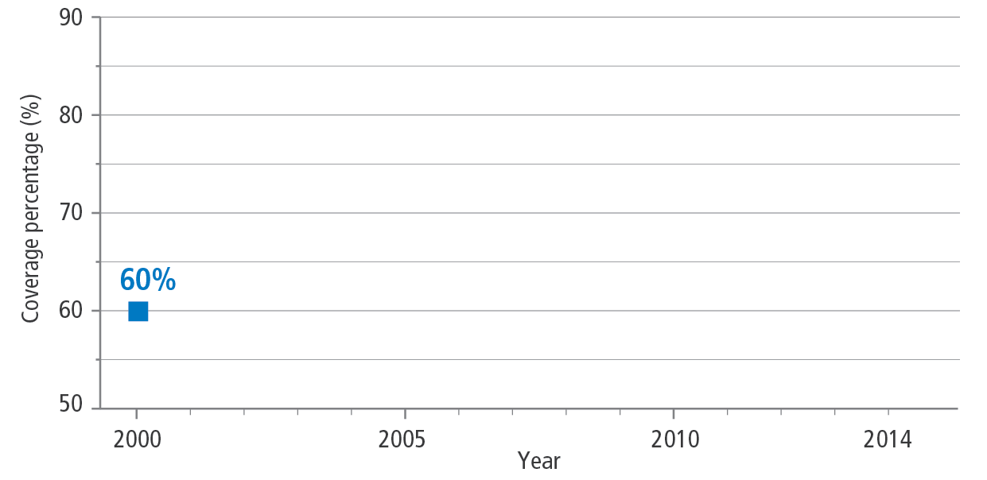
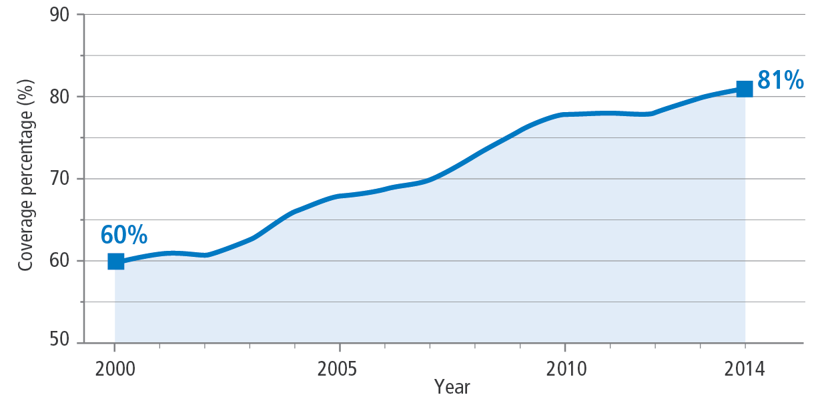
Immunisation coverage in 73 Gavi-supported countries

Slide 4
A closer look...

Slide 5
A closer look...

Slide 6
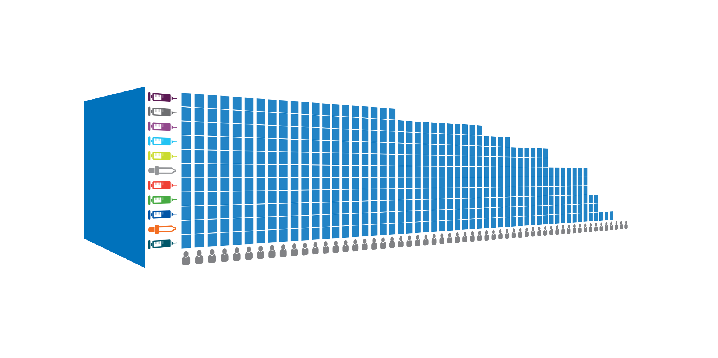
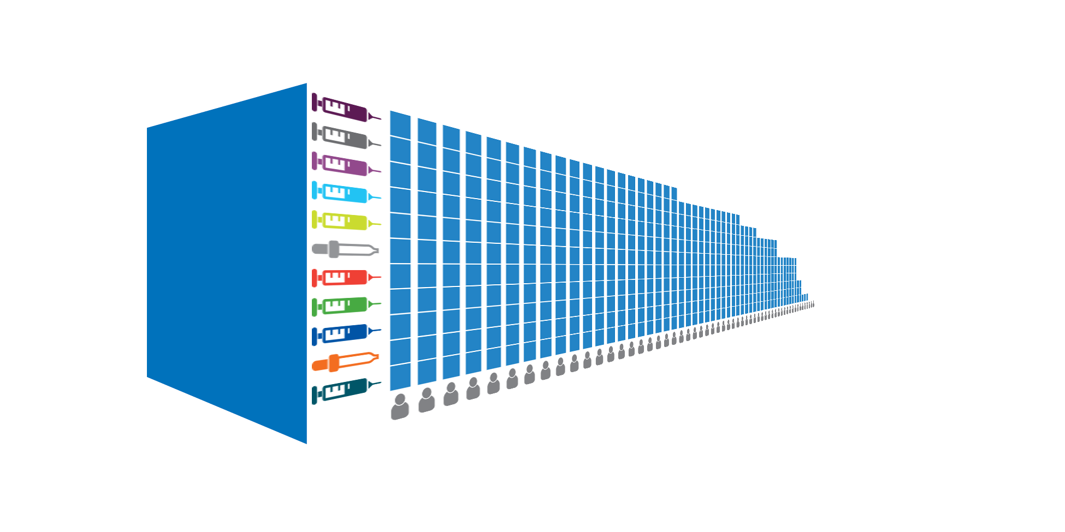
A closer look...
New vaccines
Universal Health Coverage
Routine coverage

Slide 7
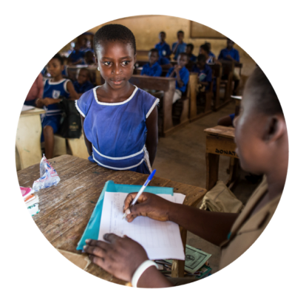
The full potential of reaching children everywhere
More politically & economically stable countries
Child vaccinated
New vaccines
Child lives longer
Improved community stability and productivity
Fewer illnesses
Birth rates drop – mother’s health improves
Strengthened economic condition within family
Routine coverage
Lower ongoing healthcare costs
More skilled and reliable workforce
Greater educational opportunities

Slide 8
Sub-national data critical to reach the unreached
Zambia immunisation coverage (DTP, BCG, measles and polio)
2013 national DTP3 coverage 79%. Many districts have >90% coverage while under-served areas changed significantly since 2000
Zambia using data to improve RI planning
In-country capacity building to conduct surveys going forward
Plan to replicate approach in at least 10 countries

Slide 9
Madagascar equity data
Immunisation inequities by population characteristics, Madagascar, 2011
Source:

Slide 10
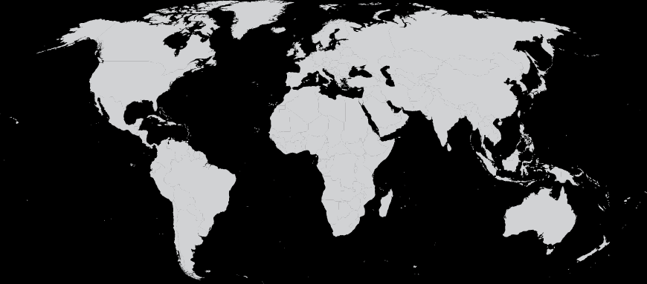
Impact of inequity
Child A:
Child B:
- Gender: mother well educated - Geography: urban area* - Wealth: highest quintile
- Gender: mother less educated - Geography: rural area - Wealth: lowest quintile
*excluding slums

Slide 11
We need a sustainable effort
Not just today or tomorrow,
Not just today or tomorrow,
but anytime in the future.
but anytime in the future.
intergenerational
EQUITY
Leaving no one behind.
Leaving no one behind.

Slide 12
THANK YOU

