Slide 1
Public Charge: A Threat to Immigrant Health and Public Health
Nancy Krieger, PhD, Moderator
Lara Jirmanus, MD, MPH
Andrew Cohen, JD
Leah Zallman, MD, MPH
Notes:
I have been asked because of my work and research with Syrian refugees in Lebanon to address Healthcare Access Challenges and Initiatives for Immigrants and Refugees from the Middle East. I believe the similarities are greater than the differences and so I will be addressing this topic and the case of immigrants and refugees more broadly.

Slide 2
Political context
More people displaced than every before (68.5 million), with largest number from Syria (6.3 million)
US set refugee limit at 45,000, a historical low
Muslim ban 3.0 upheld by US Supreme Court
Indefinite ban on immigrants from five Muslim-majority countries (Iran, Libya, Somalia, Syria and Yemen), as well as North Korea and Venezuelan government officials
Notes:
And this brings me to our current political context where more people are displaced in the world than ever before… and the largest number of displaced people in the world are from Syria. And with that backdrop, the refugee limit was set at a historic low, only 45000 per year and Muslim Ban 3.0 was upheld by the Supreme Court. According to the ban, people from 5 Muslim majority countries are banned indefinitely. So we are basically banning entry of any refugees from some of the countries most affected by the global displacement crisis. As you may recall the ban includes also North Korea and Venezuelan government officials

Slide 3
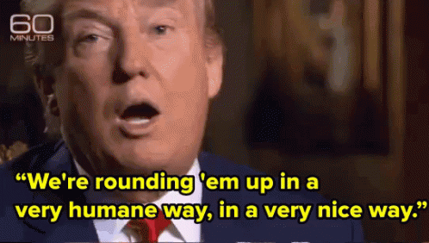
The Deportation Machine
1/25/17 Executive Order “Enhancing Public Safety in the Interior of the United States”
Broadened deportation priorities
Encouraged 287(g) agreements with states, which deputize local police to enforce immigration law

Slide 4
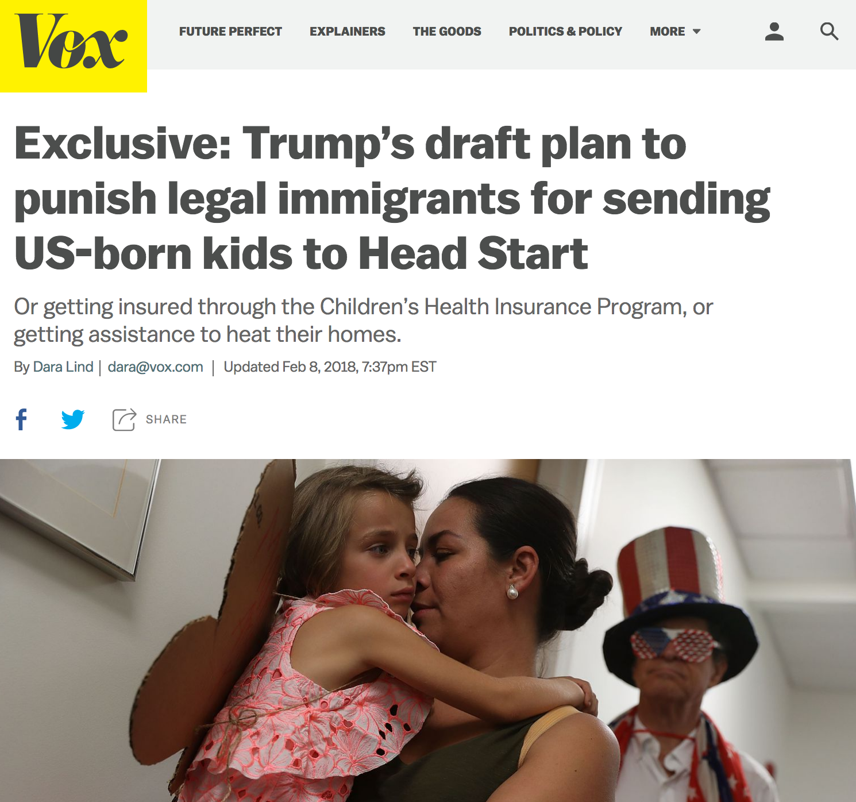
Notes:
Public Charge memo was first leaked in late January 2017, setting off fear in the immigrant community

Slide 5
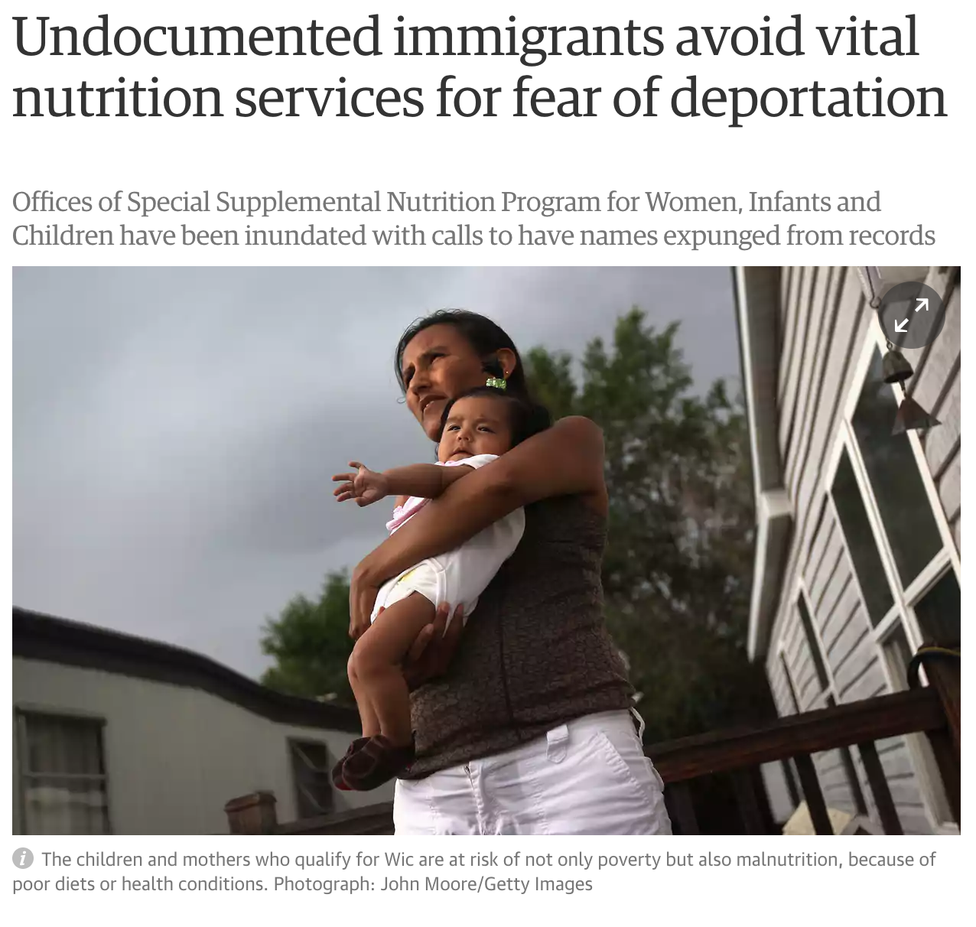
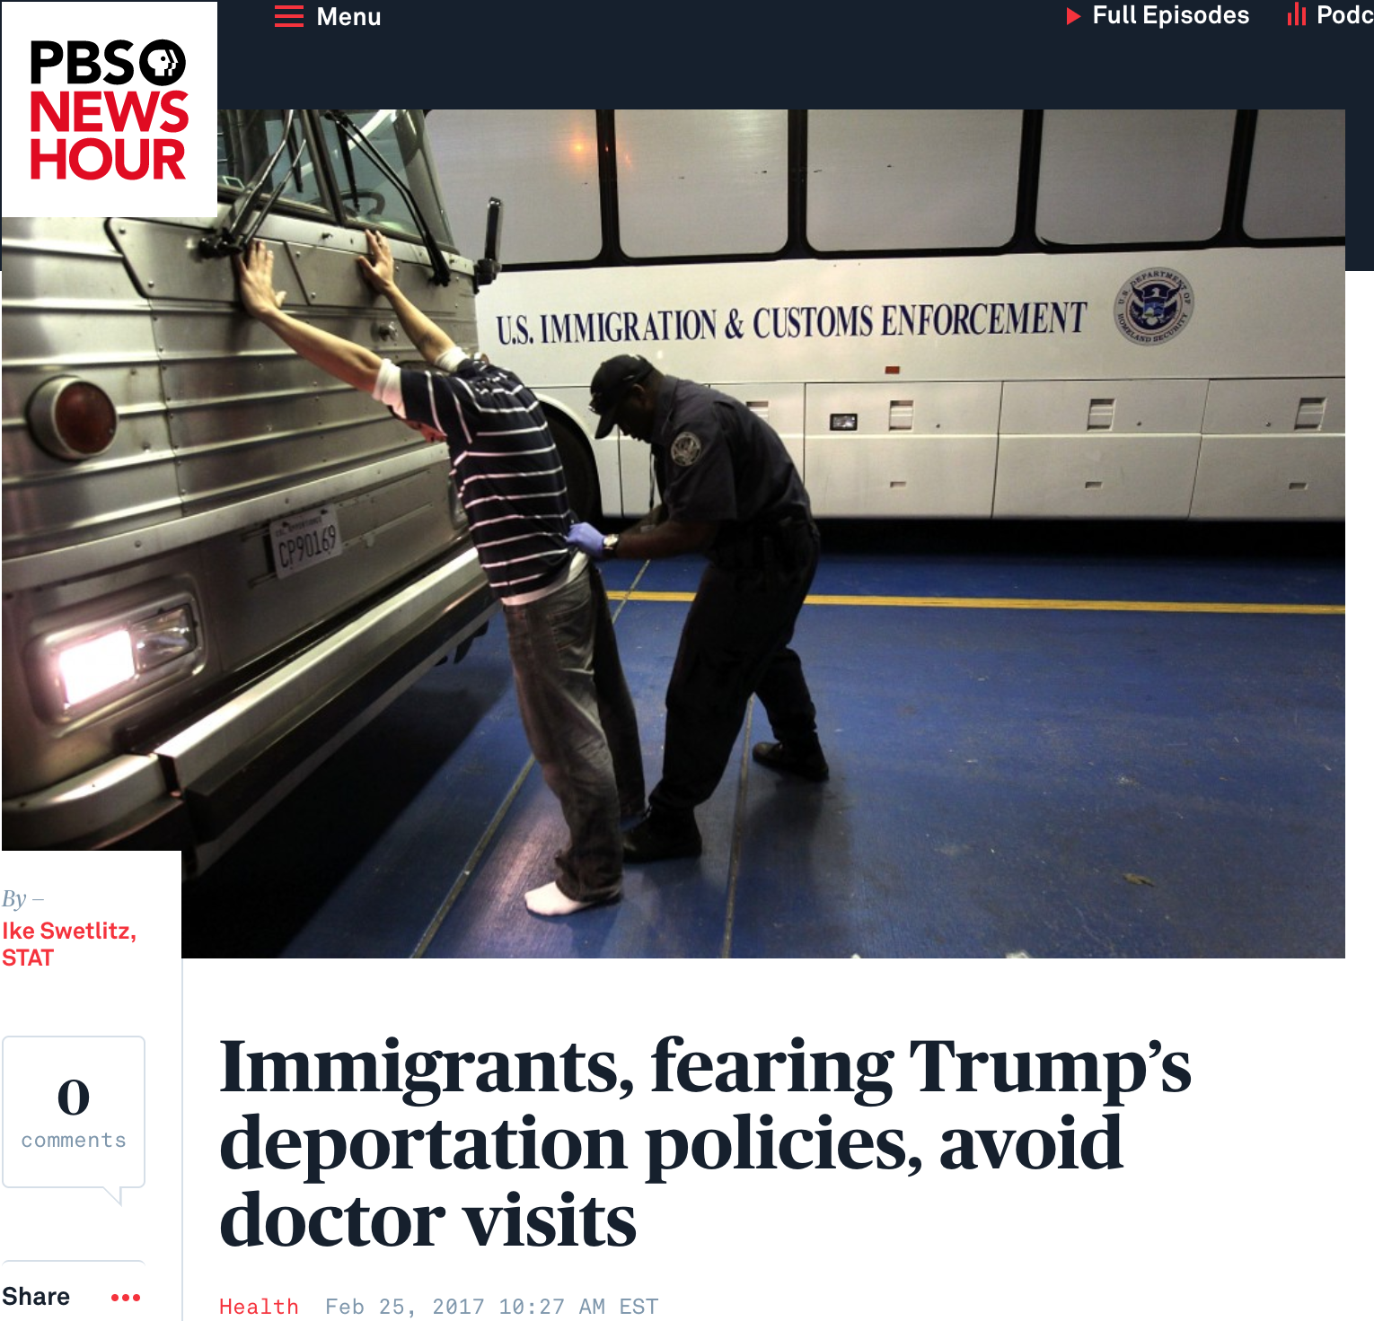
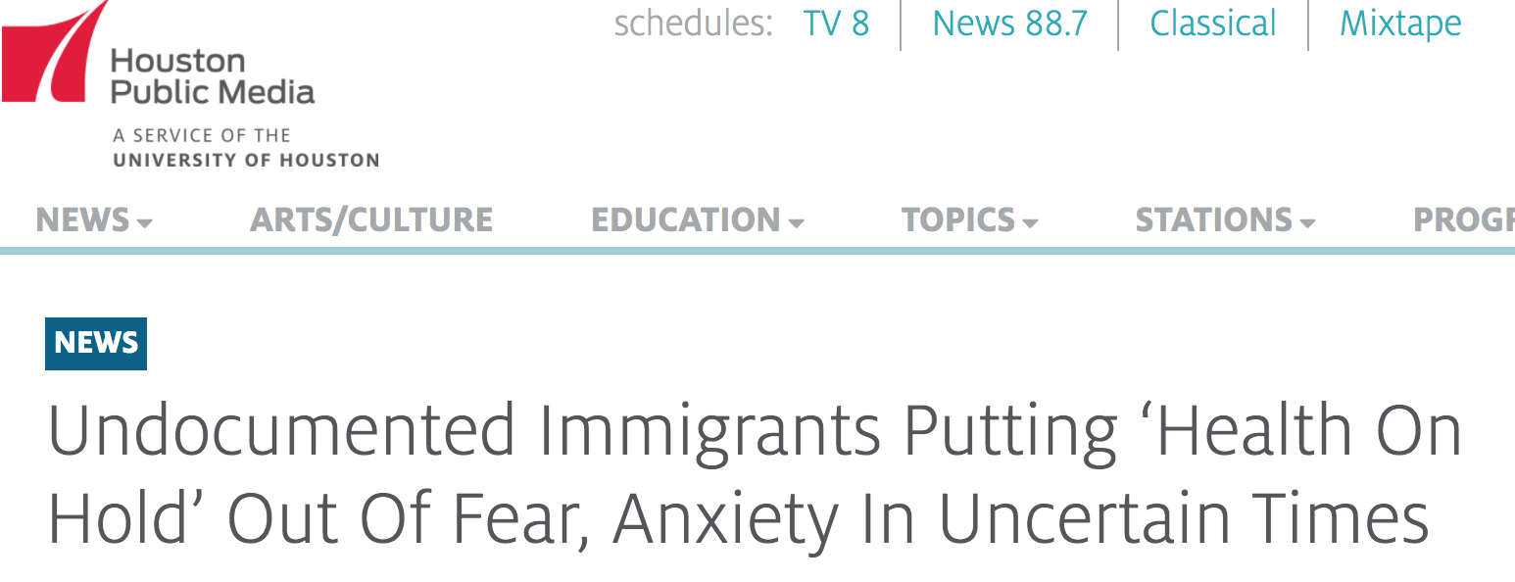
News Roundup
Notes:
Anecdotally seeing patients not renew MassHealth out of fear at CHA

Slide 6
Immigration enforcement has major health consequences
May 2008, in Postville, Iowa:
900 ICE Officers raided a meat processing plant and detained 389 workers
Notes:
The ICE raid on a meat-processing plant in Postville, Iowa, on 12 May 2008 was implemented without advance warning to local or state officials. ICE deployed 900 agents using military tactics, including armed officers and a UH-60 Black Hawk helicopter, to arrest 389 employees, 98% of whom were Latino.34 Agents used presumed race/ethnicity to identify suspected undocumented immigrants, allegedly handcuffing all employees assumed to be Latino until their immigration status was verified.35
Male arrestees were detained at the National Cattle Congress in Waterloo, Iowa (80 miles from Postville), whereas women were detained in county jails. Mothers of small children were allowed to return to Postville with ankle monitors but, barred from working, survived on charitable aid.34,36 Detainees were chained together and arraigned in groups of 10 for felony charges of aggravated identity theft (knowingly working under a false Social Security Number). A plea bargain led nearly all to plead guilty, although few were technically guilty of the crime, and 297 arrestees were deported after serving a 5-month prison sentence.34
The raid separated hundreds of families, most often from their primary breadwinner. Fear of follow-up home raids kept many Postville families from staying in their own homes, choosing instead to sleep in church pews or leave town altogether.36 News of the raid immediately spread throughout the state. La Prensa, a Spanish-language newspaper in western Iowa, published eyewitness testimony of arrestees detained at a cattle fairground, cuffed and chained together from the waist to the ankles.37

Slide 7
Immigration enforcement has major health consequences
Novak et al. 2017
24% increase in LBW among babies born to Latina Mothers in Iowa, which lasted for 9 months after the raid
Notes:
Sarah
THIS AFFECTS WHOLE COMMUNITIES
-24% increase in risk of low birth weight among infants born to Latina mothers after a major immigration raid, when compared to birth weights before the raid
Independent of actual immigration status
Lasted for 9 months after the raid
There are primary effects on people who hold a certain immigration status and then spillover effects on their communities
Turn it over to Dr. Jirmanus for best practices

Slide 8
Access to immigration status has important health impacts
Hainmueller, J., et al. 2017
Compared children born to mothers of similar age with and without DACA, using Medicaid claims data
Notes:
Sarah
THIS AFFECTS WHOLE COMMUNITIES
-24% increase in risk of low birth weight among infants born to Latina mothers after a major immigration raid, when compared to birth weights before the raid
Independent of actual immigration status
Lasted for 9 months after the raid
There are primary effects on people who hold a certain immigration status and then spillover effects on their communities
Turn it over to Dr. Jirmanus for best practices

Slide 9
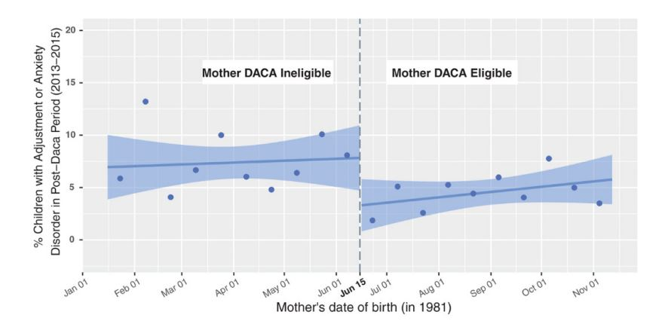
Role of immigration status on health: Mental Health
Science. 2017 Sep 8;357(6355):1041-1044. doi: 10.1126/science.aan5893. Epub 2017 Aug 31.
Notes:
Data on Emergency Medicaid beneficiaries
5653 mothers
8610 children
Tracked mental health
Ad d/o: reaction to stressor leading to inability to function normally. Sx anxiety, depressed mood, conduct disturbances- impairment social activities, school performance, sleep
Mental health benefits extended across generations among children of DACA eligible mothers
Rates of adjustment and anxiety disorders fell by more than half after DACA implemented
Parental immigration status has important effects on immigrant children – intergeneral effects, and transmission of disadvantage.

Slide 10
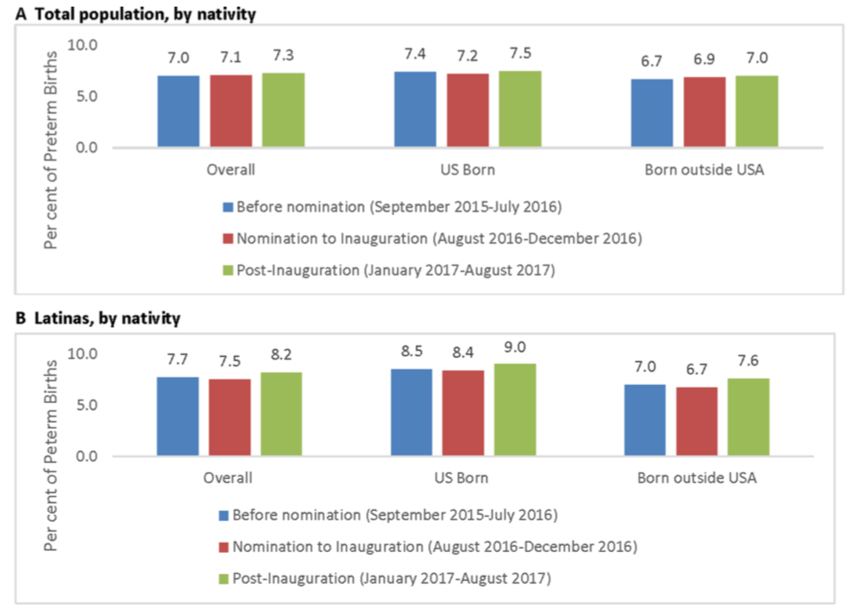
Total PTB rate increased from 7.0% to 7.3% RR=1.04; 95% CI 1.00 to 1.07).
Highest increase among foreign-born Hispanic women with Mexican or Central American ancestry (RR: 1.15; 95% CI 1.01 to 1.31).

Slide 11
Health and Law Immigrant Solidarity Network (HLISN)
Nearly 400 medical and legal professionals and community members working to support and make health systems more welcoming to immigrant patients
Started in February 2017
Notes:
The Health and Law Immigrant Solidarity Network is a group of over 200 medical and legal professionals and community members working to support and make health systems more welcoming to immigrant patients.

Slide 12
HLISN Initiatives to support immigrant and refugee patients
Networking with immigration/health attorneys to follow policy changes & advocate
Political Advocacy
Online resource database for immigrants
Peer education
Medical Care for patients in sanctuary
Medical/psych affidavits for asylum seekers
Connecting recently arrived/reunited families with care
Research

Slide 13
Stop the “public charge” rule Submit comments before Dec 10
www.protectingimmigrantfamilies.org
Notes:
If there is one thing you remember to day about how to support immigrant families, I would urge you to go home and visit protecting immigrant families.org and to please, issue a pubic comment before december 10.

Slide 14
Health Care for Immigrants in MA: Coverage, Public Charge
Harvard School of Public Health December 5, 2018
Andrew P. Cohen
Supervising Attorney
Health Law Advocates

Slide 15
Health Law Advocates
Non-profit, public interest law firm
Pro bono legal services for low-income Mass. residents (< 300% FPL)
Core issues:
Legal barriers to care and coverage
Appeals of coverage or service denials
Medical debt/collections assistance
Immigrant Healthcare Access Initiative

Slide 16
HLA’s Immigrant Health Care Access Initiative
Free legal services for low-income immigrant clients, regardless of status
Trainings about immigrants’ access to coverage under Mass. public programs
Policy advocacy through the Immigrant Healthcare Access Coalition (“IHAC”)
Consulting with medical providers (Community Health Centers, Hospitals)

Slide 17
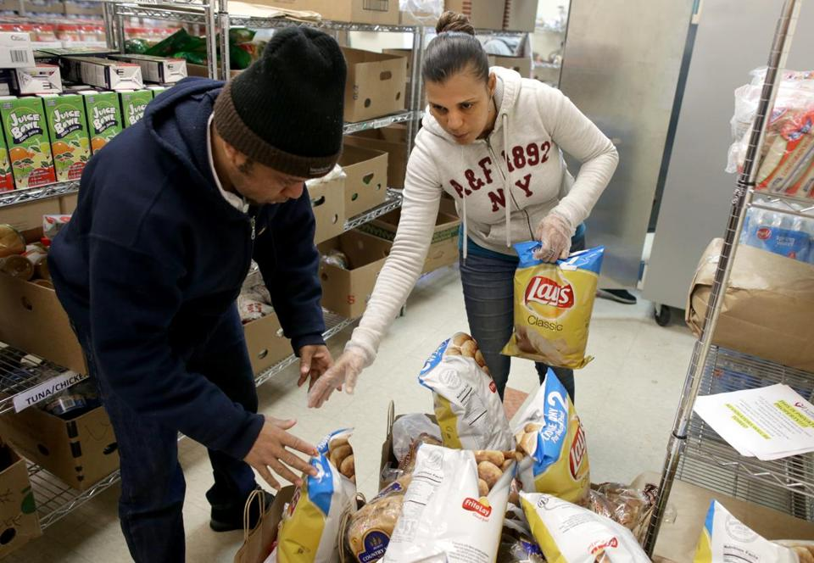
“Culture of Fear”
https://www.bostonglobe.com/metro/2017/04/26/immigrants-refugees-too-afraid-seek-critical-help-from-food-pantries-domestic-violence-resources/JrOJqOrYtHYeedLid9I69N/story.html
Notes:
“Chilling effect”

Slide 18
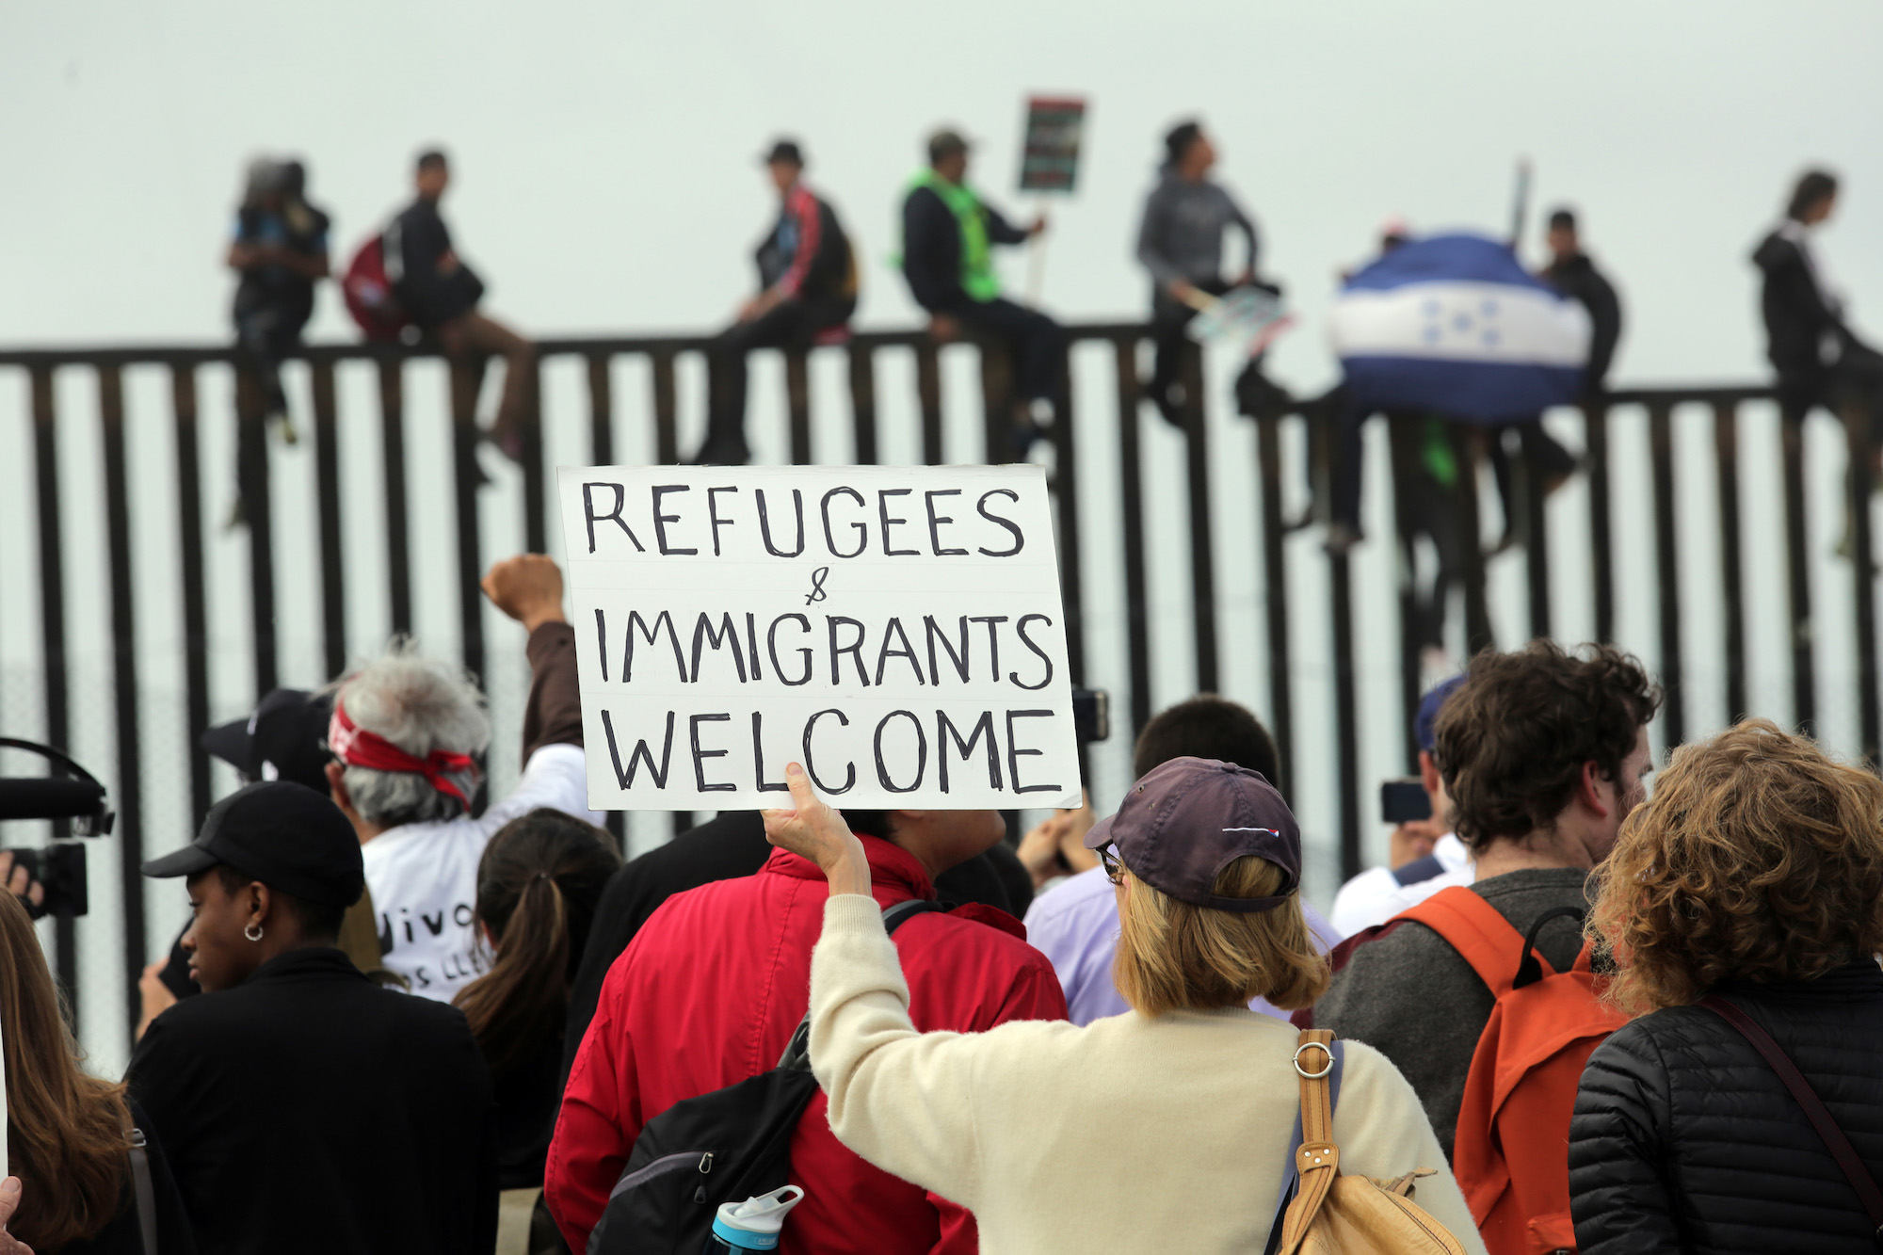
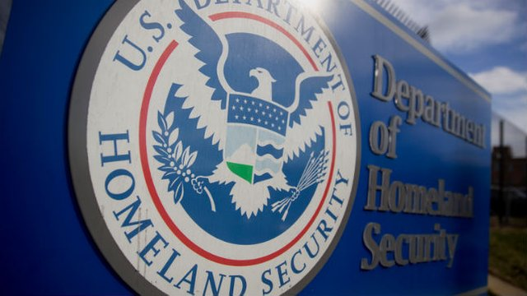
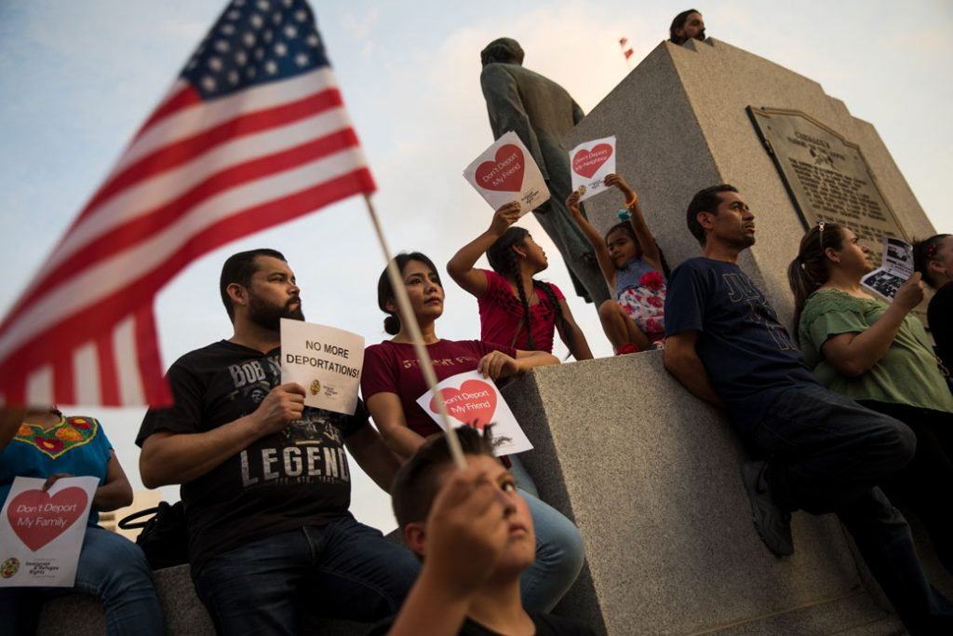
“Public charge” Proposal

Slide 19
Protecting Immigrant Families Campaign (PIF)
National campaign
www.protectingimmigrantfamilies.org
Massachusetts campaign (PIF-MA) led by:
Mass. Immigrant and Refugee Advocacy Coalition (MIRA), Mass Law Reform Institute (MLRI), Health Care For All (HCFA), Health Law Advocates (HLA)
Join the campaign!: http://bit.ly/PIFCampaign
Mass. comment aid: http://bit.ly/PIF-MA

Slide 20
Top Three Messages
Nothing has changed!
Existing rules are still in place.
The proposed rule will not take effect for many months (at the earliest)
Keep your public benefits!
There is no advantage to disenrolling now.
We’re fighting back!
And you can join us.

Slide 21
Current Policy: Overview
Definition: Likely to become primarily dependent on government due to receipt of public benefits.
Benefits: 1) Cash assistance, 2) Long-term care institutionalization at government expense
Sponsorship affidavit showing income of 125% FPL usually sufficient to pass public charge test

Slide 22
Proposed Rule: Overview
DHS proposes more restrictive test to get/renew:
Green card (LPR), visas (immigrant/non-immigrant)
“Totality of the circumstances” test continues
Highly discretionary
Prospective determination continues
Is applicant “likely at any time in the future” to receive a public benefit? Past benefits = evidence
New draconian income requirements
Does not apply to many immigrants:
People who already have green cards/LPR status
Many “humanitarian statuses” are exempt

Slide 23
Proposed Rule: Who is not Subject?
Examples:
Refugees/Asylees
VAWA self-petitioners
U or T visa beneficiaries
Individuals applying for or renewing TPS
Special Immigrant Juveniles
*However…if people with any of these statuses seek LPR or visa status on a different basis, then they could be subject to public charge.

Slide 24
Proposed Rule: Included benefits
Cash assistance programs (TANF, SSI)
Long term institutional care
Supplemental Nutritional Assistance Program (SNAP) (i.e. “food stamps”)
Section 8 Housing, housing subsidies
Medicaid (Non-Emergency)
Subsidies under Medicare Part D

Slide 25
Proposed Rule: Health-related factors
Presumptions about ability to work and care for oneself
Age: Under 18 or above 61
Health status: Sick or disabled and not privately insured (“medical diagnosis”)
“Heavily weighed negative factor”

Slide 26
Proposed Rule: Health coverage
Health coverage ≠ public charge*
Emergency Medicaid (“MassHealth Limited”)
Tax credits under the Affordable Care Act (“Connector Care”)
CHIP (TBD, but not right now)
State and local health coverage programs
Health Safety Net (HSN), Children’s Medical Security Plan (CMSP), etc.
*We believe this to be true as of now, but our analysis, or the rule, could change.

Slide 27
Top Five Takeaways
How the rule operates in practice is what will matter
Enormous discretion for decisionmakers
Prospective in focus
Complicated (!!!)
Emphasis on income and assets
Possibly more problematic than inclusion of additional public benefits

Slide 28
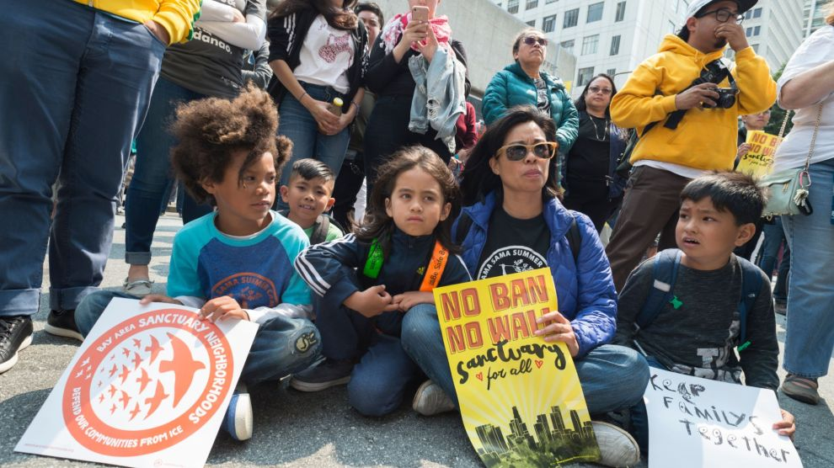
Resistance!
Rally and Protest
Submit a public comment
Deadline: December 10, 2018
Mass. comment aid: http://bit.ly/PIF-MA
Host a comment writing party
Advocate with your organization to write a comment
Educate yourself and others

Slide 29
Questions?
Andrew P. Cohen
Supervising Attorney
617-275-2891
acohen@hla-inc.org

Slide 30
Public Charge Research
Leah Zallman, MD, MPH
Institute for Community Health
Cambridge Health Alliance
Harvard School of Public Health
12/5/2018

Slide 31
Broad Reaching Rule
7 of 10 LPRs have at least one negative factor, while just 4 of 10 had one of the heavily weighed positive factors Capps, Migration Policy Institute, 2018
41 million noncitizens and their family members could be impacted (Mannat, 2018)
2.1 to 4.9 million Medicaid/CHIP enrollees could disenroll. (Artiga, Kaiser Family Foundation, 2018)
19 million or one in four children live in a family with an immigrant parent, and nearly nine in ten (86%) of these children are citizens. Artiga, Kaiser Family Foundation, 2018

Slide 32
Children in Need of Medical Care
At risk due to chilling effect (and few directly subject to rule)
Benefits support families (SNAP, housing)
Medicaid/CHIP
CHIP not in current version of rule
Blended Medicaid/CHIP funding

Slide 33
Children in Need of Medical Care
Examined 2011 MEPS/NHIS data
Nationally representative non institutionalized population
Children living with at least one non citizen adult
Current (or recent) medical diagnosis, disability, or need for specific care if they had the condition or received the care in the prior 12 months.

Slide 34
Disenrollment scenarios
Drawing on previous research on the chilling effect welfare reform had on enrollment among immigrant families
Began with 25% disenrollment
Given the uncertainty about the actual impact, we examined the impact if the disenrollment rate was lower (15%) or higher (35%).
Neeraj Kaushal and Robert Kaestner, “Welfare Reform and Health Insurance of Immigrants,” Health Services Research 40, no. 3 (June 2005): 697– 722

Slide 36
Impact on Health of US born Individuals
Medicaid revenue for community health centers will decline by $346 million to $624 million.
number of patients served will fall by 295,000 to 538,000, many of whom are US born citizens Ku, Geiger Gibson/RHCN, 2018
Immigrants support the care of
elderly & disabled through subsidizing Medicare Zallman, Health Affairs, 2013
private health insurance enrollees by subsidizing private health insurance Zallman, Health Affairs, 2018
policies that discourage immigration will have implications for the care of US born citizens.

Slide 37
Impact on Economy
Immigrants’ economic status improves over time, especially low-income immigrants Ku, George Washington University, 2018
Stifle immigrants’ future opportunities
Undercut their ability to contribute to the nation
Estimated $17.5 billion in loss of health care & food supports
$33.8 billion in potential economic ripple effects of this lost spending,
230,000 potentially lost jobs Fiscal Policy Institute, 2018

Slide 38
Tips for submitting public comments
Unique comments in your own words (not form letters) have the greatest impact and are counted.
Start and end with: “I am writing in opposition to the proposed rule “Inadmissibility on Public Charge Grounds” and respectfully request that it be withdrawn.”
Request the proposed rule to be withdrawn. Don’t suggest corrective action.
Express your subject matter expertise/perspectives as a student of public health, safety net provider, researcher, etc.

Slide 39
Tips for submitting public comments
Citing research and personal stories are effective. If citing research, attach a copy so it must be examined as part of the public comments. www.protectingimmigrantfamilies.org/resources has links to research on public charge
Use non-partisan comments on specific aspects of the proposed rule and not the Federal Administration.
Don’t discuss programs that are not included in the proposed rule.
All comments must be submitted in English (or translated into English).
If community members wish to submit a comment but remain anonymous, a representative can submit the comment on their behalf.

