Slide 1
Understanding Gene Regulation Through Integrated Analysis of Genomic Data
Guo-Cheng Yuan
Department of Biostatistics and Computational Biology
Dana-Farber Cancer Institute
Harvard School of Public Health
Faculty Workshop, July 23rd, 2014

Slide 2
Biology used to be about memorizing terms and facts
Category | Human | Zebrafish
Domain | Eukarya | Eukarya
Kingdom | Animalia | Animalia
Phylum | Chordata | Chordata
Class | Mammalia | Actinopterygii
Order | Primates | Cypriniformes
Family | Hominidae | Cyprinidae
Genus | Homo | Danio
Species | H. Sapiens | D. Rerio

Slide 3
Genome sequencing has digitized biology
aggcctttgttgttggcagattgctagggtctgaatgtttatgcccctg
tgaaatttctttgttgaaatcttcacccctaaggtaatgctattagaagg
tgggaaccttagaataattaggtgatggggacagagccctcatgaagggg
atcagtgcccttataaaagaaatctgagagagaccctttgccacttctgc
catgtgggttagagtgagaagaaggttatttacgagaaagtagcccttac
tagacgctgaatcttctggtgccttgatcttagactcaccagctttcaga
actgtaagaaataaatttctagtgtttacaagccacccagcctatggtat
tttgttatagcatctggaatggactaagacacagaacaagataatgggtg
gatatgctaaactttgtatatacacatgtccatttatatttccatatgtc
tccatctgttatctatatcaagctaaacatgagttcatattgatgtttcc
aattccaattgttacaaaatggatcatcaccttgtttttctgtaatcctc
tattcagtgaaaaaccttgctcccatactatgacatccatttatttaatt
gttcaatttcattatatatgtacagcaatatccaaattaataacatgtac
ccctgtggacatgattatgtgaactagagtatagggcttatAAATTAAAA
AAATTTAtttttattttggaaaatgcatataacaaaatgtggcattttaa
tgatttttaagggtaaaatttagtgacattaattatattactaacgttgt
acagctatcattactatctactttgaaaatacttttaagaacccaaacag
aaaatccatacccactaagcaataaccctattgccccctcctttcagccc
ttggcaatgaccattgtacttttagtctgtatgagtttgccttttctgga
tatttcattttagtgaaatcatagaatatttgctcttttgtgtgtggatt
atttcacttatttttaaagtttattcatttgtaacatgtattaaaacttt
attcctttttttggttgaataatattctattatgtgtatataacacattt
tgtttattcattcatttgttggtgaatacttgggttatttccaccttcta
gaaattgtgagtcatgctgcagtggacataggcatacaattatctgagtt
tctactttctattgttttggatatataatcagaattttaattgctggtgc
atatggtaattttatgtatactaatttgaggagaatccatactgtttttc
tcaatggctacaccattttacattcccaccagcaatgcattatggggcaa
tttatccacaccaacagcaacacttattattttctaggtttttttatctt
tttattttattaatgtttatcctaacagatatgaaataatatttcattgt
gattttgatttacatgctaatgattagtgatgttgaacagtatttcatgt
gcttatgggctatcttgtatcttttttagataaatgtctatttaaatcct
ttgtttatttttgagctgaaatgtttagtttttgtggagttgtgggaatt

Slide 4
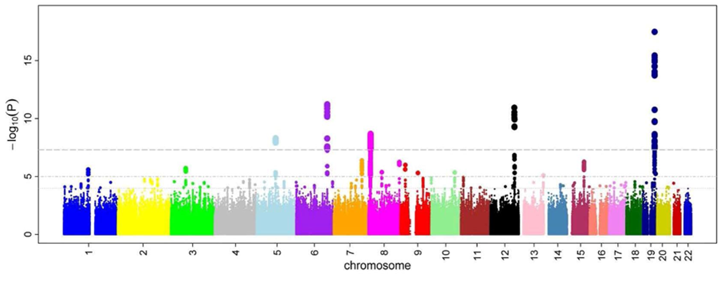
Variation of genetic information may predict disease risk
wikipedia
What is the mechanism?

Slide 5
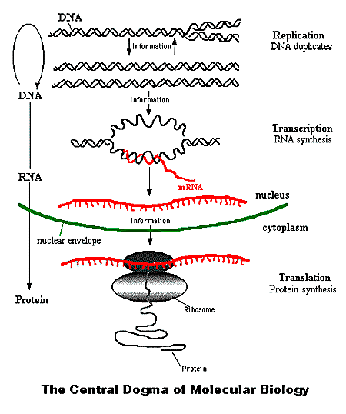
Most DNA is not transcribed
Most transcripts are noncoding
Most proteins has unknown functions
Courtesy of National Health Museum

Slide 6
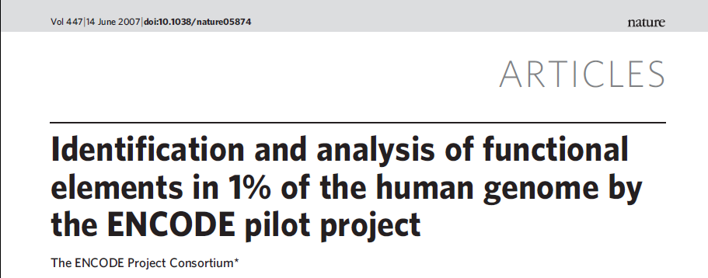
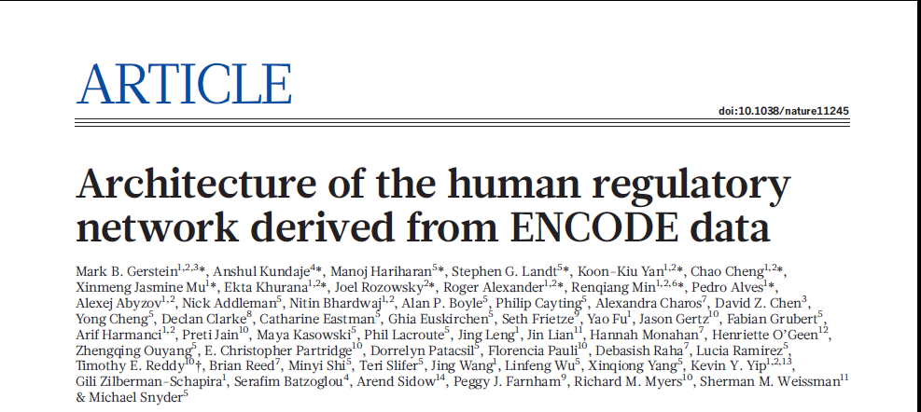
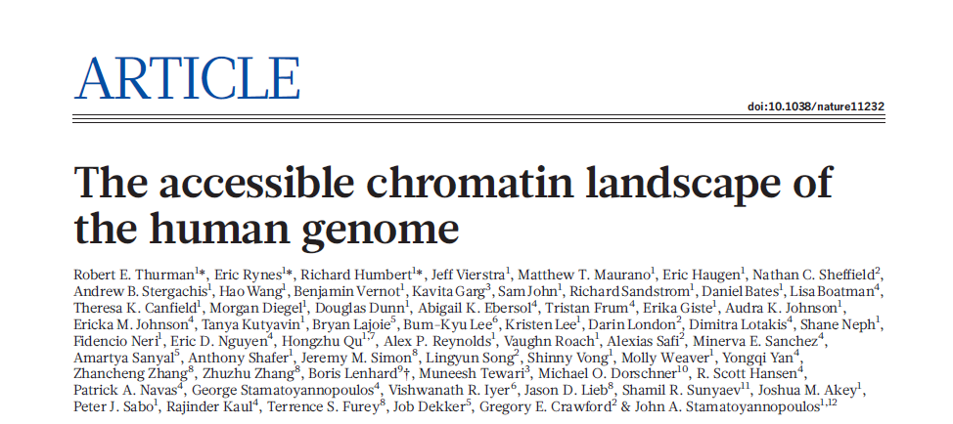
2007
The human genome encodes the blueprint of life, but the function of the vast majority of its nearly three billion bases is unknown. The Encyclopedia of DNA Elements (ENCODE) project has … These data enabled us to assign biochemical functions for 80% of the genome, in particular outside of the well-studied protein-coding regions. Many discovered candidate regulatory elements are physically associated with one another and with expressed genes … The newly identified elements also show a statistical correspondence to sequence variants linked to human disease, and can thereby guide interpretation of this variation…
2012
2012
2012

Slide 7
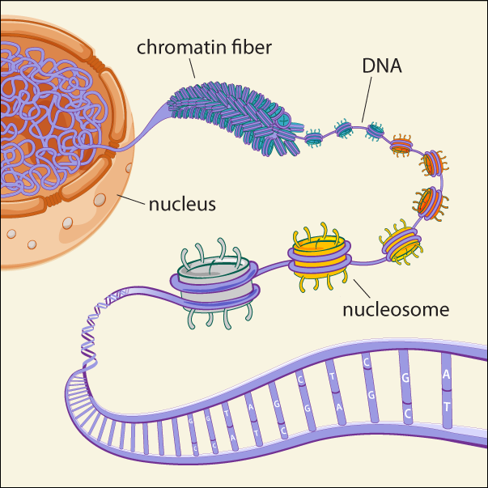
Courtesy of Broad Institute

Slide 8
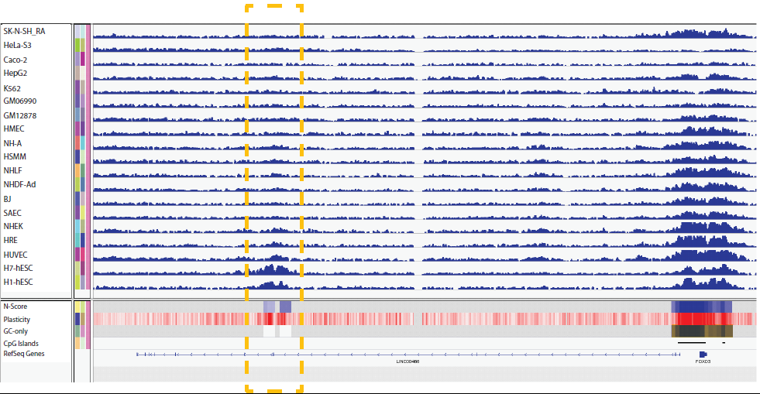
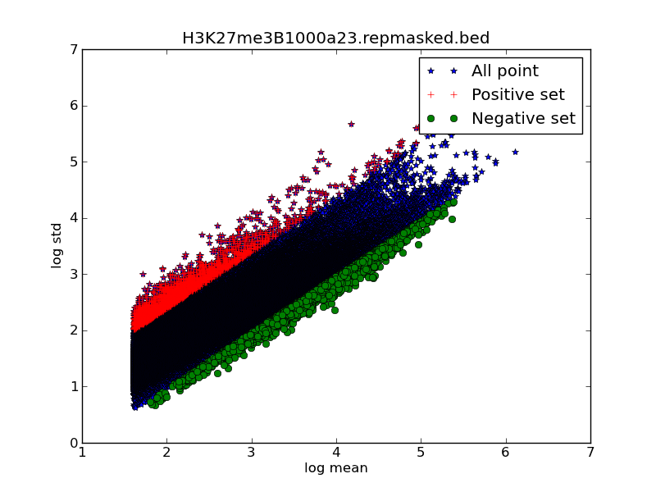
Quantifying cross cell-type plasticity
H3K27me3
variance
mean
Highly Plastic Regions (HPR): the top 1% with highest plastic score.
Lowly Plastic Regions (LPR): the bottom 1% with lowest plastic score.

Slide 9
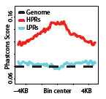
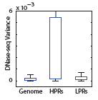
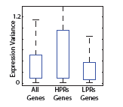
HPRs are associated with regulatory regions

Slide 10
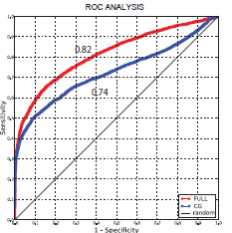
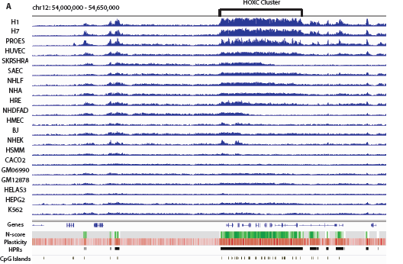
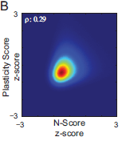
Chromatin plasticity is related to DNA sequence

Slide 11
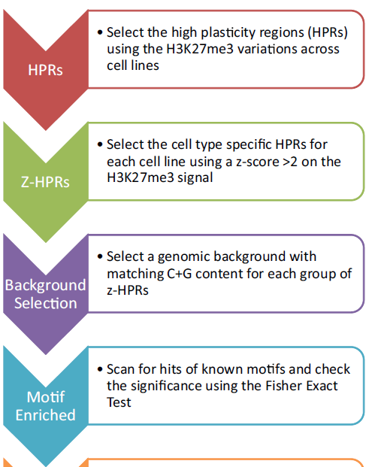
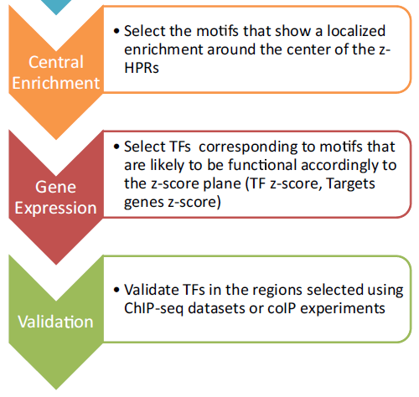
A pipeline to identify regulatory TFs
Pinello, PNAS. 2014 Jan 21;111(3):E344-53

Slide 12
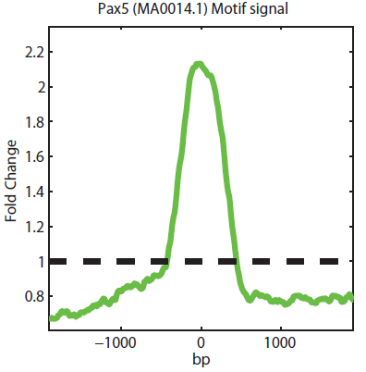
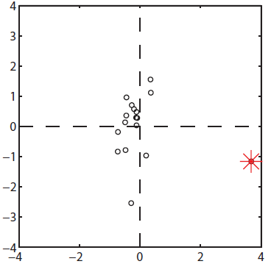
Example: PAX5 in GM12878
1. Motif Enrichment
3. Centralization
PAX5 is one of the most enriched motifs in GM12878 specific MPRs
2. Coordinated Expression (z-score)
Enrichment Score
PAX5 Targeted HPR Genes
-2KB MPR_Center 2KB
GM12878
PAX5
Notes:
Explain the pipeline: enrichment value; gene expression; central enrichment
Ann Feeney’s lab show that Pax5-/- pro B cell the H3K27me3 level is significantly reduced in Vh region. Feeney PNAS 2008

Slide 13
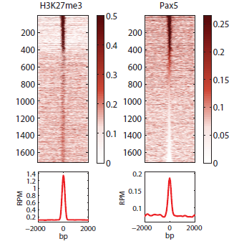
ChIPseq confirms colocalization between Pax5 and H3K27me3 in GM12878
-2KB
HPR Center
-2KB
-2KB
HPR Center
-2KB

Slide 14
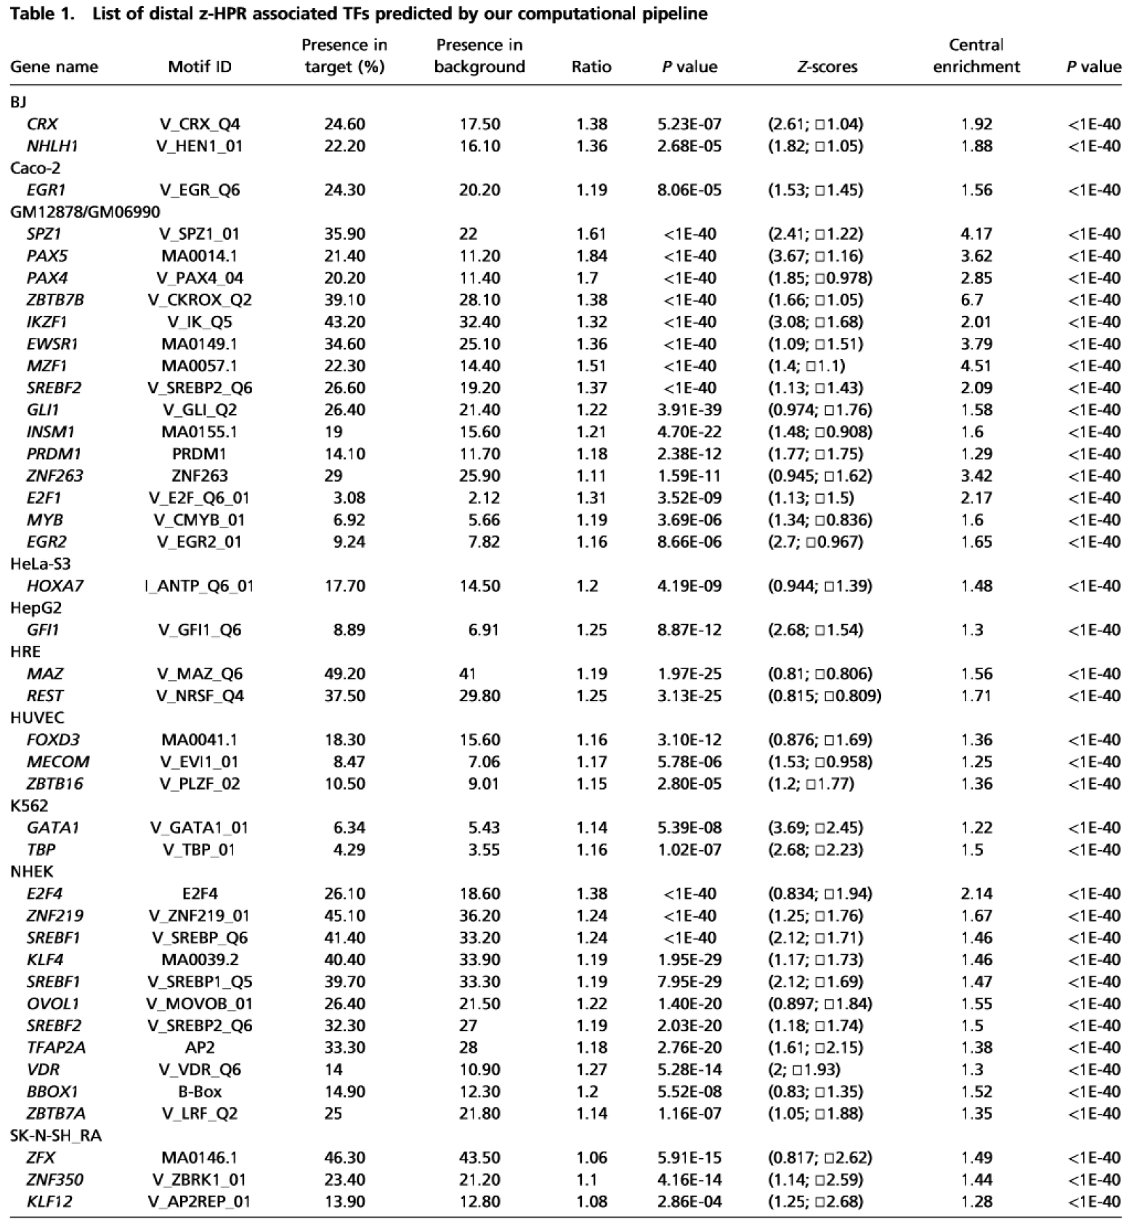

Slide 15
Haystack is (almost) available!
INPUT: Aligned reads from ChIP-seq (.bam files)
ONE COMMAND ONLY:
haystack_pipeline my_bam_folder hg19
OUTPUTS:
Highly plastic regions
Tracks normalized for IGV or Genome Browser
List of candidate regulatory TFs.

Slide 16
Take home message
We shouldn't just focus on a snapshot of the histone patterns and try to interpret what they all mean. Dynamic change is the key to understand biological function.

Slide 17
Conclusions
Biology has entered a data-rich era.
“All models are wrong; but some are useful.” ---- George E. P. Box

Slide 18
Acknowledgement
Our group
Luca Pinello
Kimberly Glass
Eugenio Marco
Jialiang Huang
Stuart Orkin
Jian Xu
Zhen Shao
Dan Bauer
NIH, Barr Award, Milton Foundation, HSPH CIF

