Slide 1
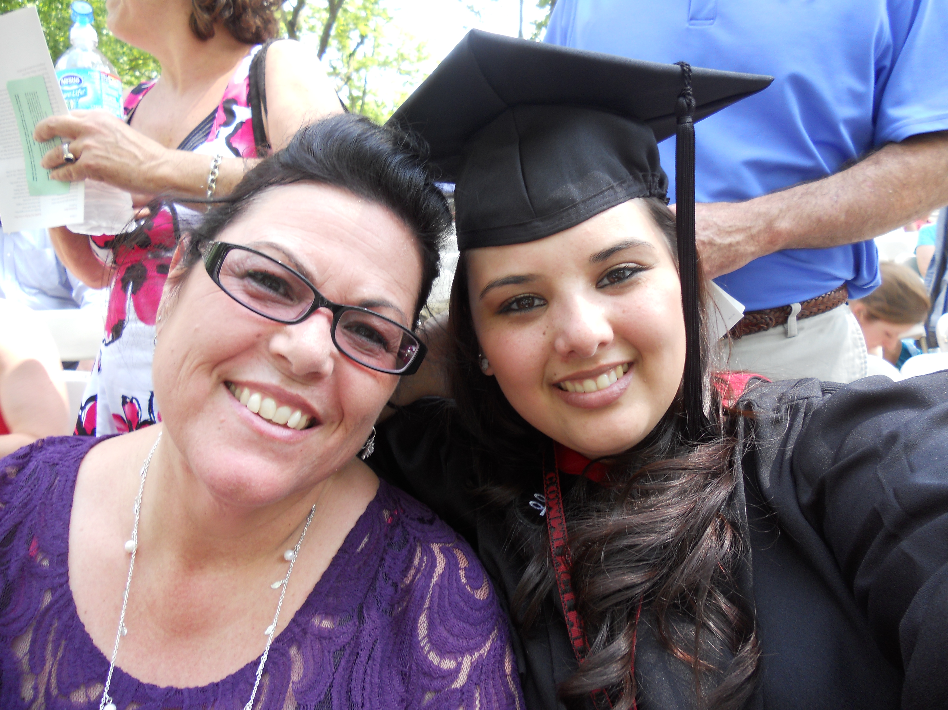
My Pathway to Biostatistics
Heather Mattie
July 25, 2014
Harvard School of Public Health

Slide 2
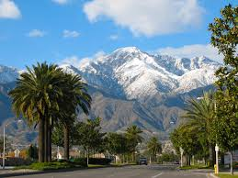
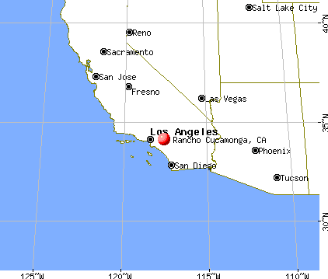
Hometown
Rancho Cucamonga, CA
Born and raised
Honors classes throughout school

Slide 3
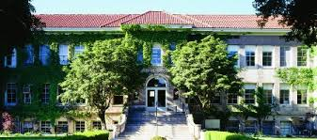
Undergraduate
University of La Verne, ’08
Mathematics major
Computer Science minor
Small, private liberal arts college
Smallest class size: 3
Largest class size: 26

Slide 4
Undergraduate
Small math department
4 main professors, 4-5 assistant professors
4-6 Math majors per year
No Statistics or Biostatistics departments
Summer programs, independent study and conference opportunities were known, but not thought of as an option
Studying at such a small school instilled a sense of doubt in my capabilities
There were low expectations of the students

Slide 5
Undergraduate
First thought about graduate school toward the end of my 3rd year
My geography professor noticed I put a lot of effort into my assignments – said I had a lot of talent, intelligence and drive and would go far in life
Went home and googled graduate schools in Southern California
Applied to Claremont Graduate University (CGU) and UC Irvine
Had to navigate the application process myself
Almost missed the GRE deadline
Had no idea graduate degrees could come with funding
Had no idea how different graduate school would be

Slide 6
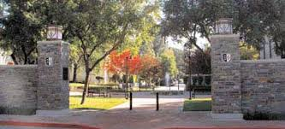
Graduate - Masters
Was accepted to Claremont Graduate University as a PhD student in Applied Mathematics
Claremont, CA
Another small, private school located two towns over from my undergraduate campus
Received my MS in Mathematics after 3 semesters

Slide 7
Graduate - Masters
Received a fellowship that involved collaborating with fellow students, Boeing employees and an advisor
Was thrown into the ‘research world’ without much guidance
Failed the qualifying exam twice – along with my entire cohort
Was asked to leave the program after my 4th semester
Very little support for the students

Slide 8
Graduate - Masters
Took a Computational Methods for Molecular Biology class my last semester
Involved analyzing microarray data with R and presenting my results using LaTeX
Loved the way I could use math to study biology
The professor noticed my interest and recommended I look into Biostatistics
Went home and googled Biostatistics and the different subfields associated with Biostats
Took a year off of school to work and apply to PhD programs in Biostatistics

Slide 9
Applications
Had a better idea of what was required for an application
Had better writing samples from projects completed at CGU
Had more of an idea about what I wanted to study (specifically, statistical genetics)
Applied to 11 schools total
8 in CA, University of Washington, Penn State and Harvard
Most applications were for a PhD in Biostatistics, one was for a PhD in Biomathematics and one was for a PhD in computational genomics
Was only accepted to Penn State and Harvard

Slide 10
Choices
Penn State
Computationally heavy program
Not much funding available
Some resources available, but not many
Harvard
Balanced program – theory and application
Very supportive of their students
Offer qualifying exam prep courses
Much of the first year course work focuses on qual prep
Encourage students to explore and find which subfield they are interested in
Friendly faculty and staff who give you individual attention
An abundance of resources
The school is surrounded by several hospitals and laboratories
Experienced faculty and staff
Tight-knit student cohorts
Students study and work together, especially the first two years while taking courses

Slide 11
Graduate – PhD
Started the PhD program at Harvard in August 2011
Summer prep courses were offered as a refresher of math theory useful for the first year courses
Received a Masters in Biostatistics after 4 semesters
Was put on the statistical genetics training grant first
Wrote that I was interested in chronic disease and genetics in my personal statement
Decided to switch to network science after passing the qualifying exam (on my first try!)
Talked to a few potential advisors and decided on an advisor whose areas of interest included network science
Incorporates Biostats and graph theory I learned at CGU

Slide 12
What I Wish I Knew
My capabilities
If I could go back to undergrad, I would apply to summer programs and internships and attend more conferences
The application process
I should’ve sought out help from faculty
GRE prep classes would’ve been helpful
The different majors available
I thought since I was a math major in undergrad, I had to major in math in grad school as well

